Slide 1
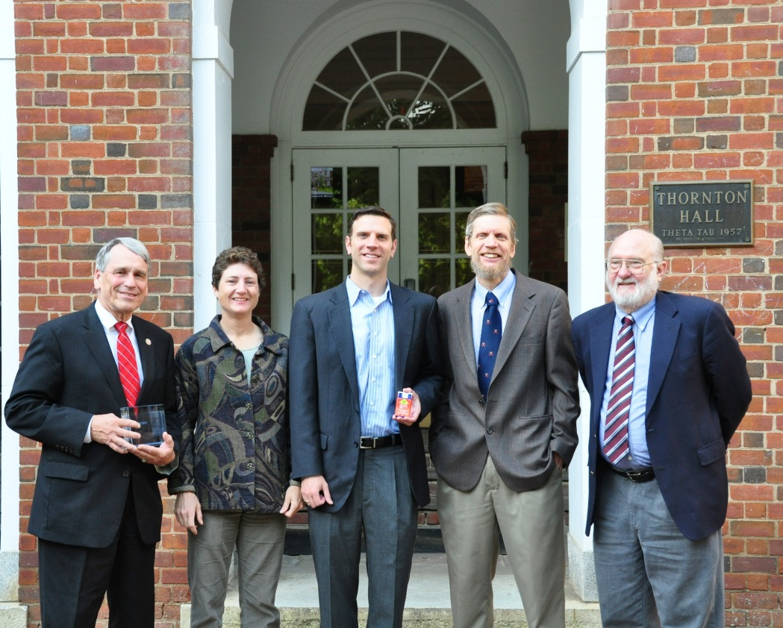
From NCIIA E-Team To Lifesaving Device
Esther Klinger
Michael E. Gorman
Larry G. Richards
University of Virginia

Slide 2
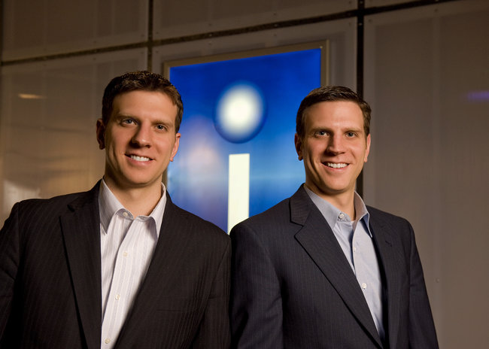
A Case Study of Intelliject, Inc.
Presented as a story to students
Broken into decision points—examples below
Helps students to understand the entrepreneurial process
Evan Edwards says, “The bumps are the road”
http://www.nytimes.com/2013/02/02/business/auvi-q-challenges-epipen-with-a-new-shape-and-size.html?_r=0
Notes:
Facilitates classroom discussion
Each decision point is a bump in the road to success, students must consider what to do in difficult situations.

Slide 3
The Case
Tells the story of Evan and Eric Edwards
From idea genesis to creation of the Auvi-Q™
Foundation and growth of Intelliject, Inc.
http://www.nytimes.com/2013/02/02/business/auvi-q-challenges-epipen-with-a-new-shape-and-size.html?_r=0
Notes:
Erase this slide?

Slide 4
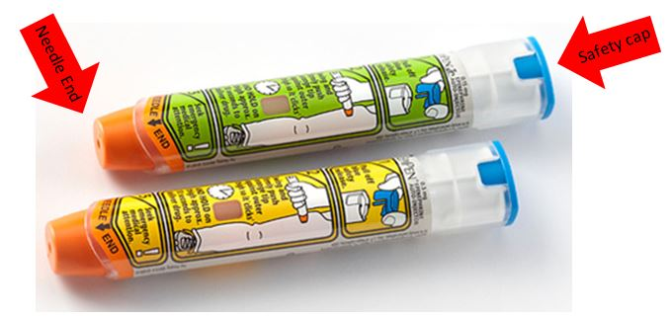
Genesis
Evan and Eric Edwards grew up with many severe allergies
Were unsatisfied with the EpiPen®
Decided to create a better product in 1998
http://www.epipen.com/About-EpiPen/Overview
Notes:
Unsatisfied
Often had trouble remembering to carry it with them
Decided to create an improved epinephrine auto-injector before entering into first year of undergraduate college
Better Product
Wanted a product that was smaller and easier to carry around
Goal was to make an epinephrine auto injector the size of a credit card or smartphone
Evan and Eric understood the problem from a patient’s perspective, wanted to create a device acceptable to patients like themselves.

Slide 5
A Student and an Entrepreneur
Evan met Professors Gorman and Richards during his second year at the University of Virginia in an NSF/NCIIA supported Invention and Design class
The professors encouraged Evan to apply for and E-team grant

Slide 6
Decision Point Example
Would you pursue a revolutionary invention while still in school? How do you manage this on top of other commitments? What entrepreneurial support is available at your university?
Notes:
Here is an example of a decision point that would be presented to students at this point in the case. The goal is to facilitate discussion among students and have them really
Think about what it takes to be a successful entrepreneur.

Slide 7
Creation of an E-team
Applied for and earned an NCIIA E-team grant while undergraduates, 2000
Began developing their product, applying for patents, and forming a company
E-team presents at NCIIA March Madness for the Mind 2002
http://nciia.org/

Slide 8
The Growth of Intelliject, Inc.
Intelliject Inc. started as a family business in 2001
Moved to Virginia Biotechnology Research Park in Richmond, VA where they participated in an incubator program
Began searching for venture funding, 2004
http://s3.amazonaws.com/crunchbase_prod_assets/assets/images/resized/0006/8241/68241v3-max-250x250.jpg

Slide 9
FDA approval
Went to the FDA in 2005
Product was considered a drug, not a device, by the FDA
The approval process was more costly and time-consuming than anticipated
Device approval takes about 90 days and costs about $100,000
Drug approval takes years and costs millions
Notes:
In 2005, Intelliject, Inc. took its idea for an auto-injector to the Food and Drug Administration (FDA). The team thought that it would be regulated as a device.
Obtaining clearance for a new device with the FDA takes about 90 days and costs a few hundred thousand dollars.
Obtaining the required FDA approval for a new drug costs millions of dollars and takes years to accomplish, as multiple phases of testing must be done, including clinical trials.

Slide 10
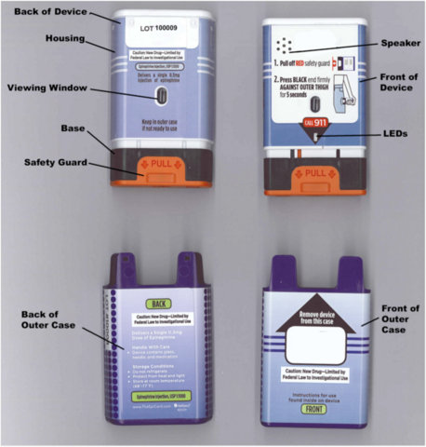
Perseverance
Intelliject, Inc. didn’t give up
Pursued FDA approval
Continued to improve the device
Notes:
Main improvement:
automated voice prompts similar to those used in the AED
Picture is the original device tested for FDA approval, as you’ll see many adjustments were made before taking the product to market.

Slide 11
A Pharmaceutical Partner
Intelliject, Inc. partnered with Sanofi in 2009.
Sanofi originally paid $25 million plus royalties for rights.
Sanofi would market the product in the U.S and Canada.
Notes:
Sanofi – Fourth largest pharmaceutical company in the world by prescription sales
What size of pharmaceutical partner should Intelliject Inc. choose? What territories will it cover and what medicines should be targeted as a part of the deal? How will this decision affect the company’s future? What are the pros and cons of your selected option?

Slide 12
You know you are succeeding if you get sued
Intelliject, Inc. was sued by King Pharmaceuticals in 2011
Lawsuit served to delay FDA approval
Slowed product to market
Suit was settled in 2012 just before going to court
Notes:
King Pharmaceuticals holds the patent for the EpiPen
Sued over possible patent infringement
Sanofi $ made Intelliject able to fight off suit
*Considering removal of this slide

Slide 13
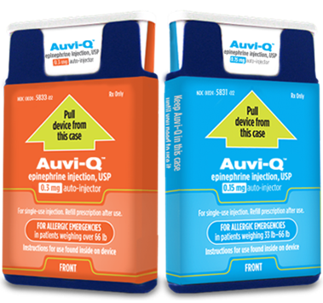
Product Release
Auto injector released in January 2013
Notes:
Released to positive responses from many allergy sufferers

Slide 14
Questions?

Slide 15
Presenters
Esther Klinger
Student of Mechanical Engineering
eek3cf@virginia.edu
Michael E. Gorman
Professor of Engineering & Society
meg3c@virginia.edu
Larry G. Richards
Professor of Mechanical & Aerospace Engineering
lgr@virginia.edu

