Slide 1
Design & Operation
of the Yale Center for Engineering Innovation & Design

Slide 2


Slide 3
traditional engineering sequence @Yale
capstone
design
engineering
fundamentals
applied design
courses
engineering
fundamentals
experiences
intro
to design

Slide 4
concurrent engineering sequence @Yale
interests
experiences
courses
community

Slide 5

experiencing engineering @Yale
capstone
design
engineering
fundamentals
applied design
engineering
fundamentals
intro
to design

Slide 6
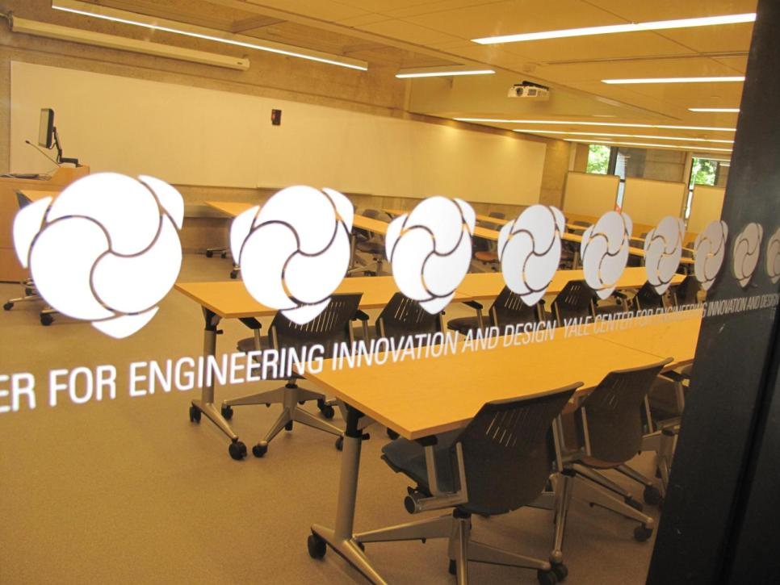

Slide 7
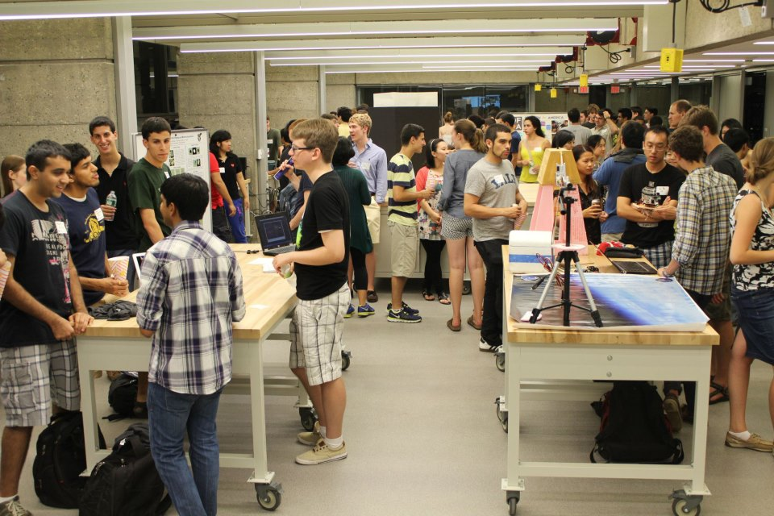

Slide 8
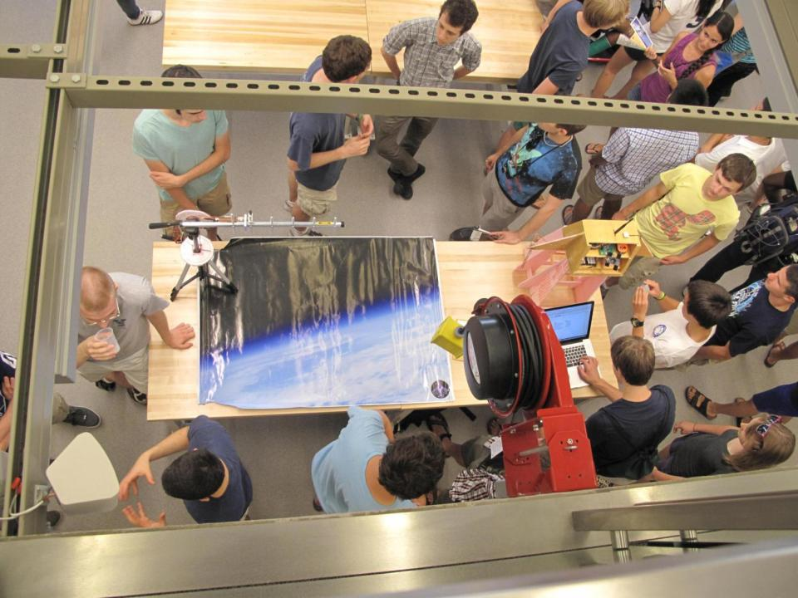

Slide 9
Yale Center for Engineering Innovation & Design Origin: 2010 Strategic Plan
Biomolecular Engineering and Biodesign
Biomolecular Engineering and Biodesign
Energy and Sustainability
Energy and Sustainability
Sensing, Imaging, and Networked Systems
Sensing, Imaging, and Networked Systems
Surface and Interfacial Engineering
Surface and Interfacial Engineering
Center for Engineering Innovation and Design
Department of Biomedical
Engineering
Department of Chemical & Environmental Engineering
Department of Electrical Engineering
Department of Mechanical Engineering
& Materials Science
Advanced Graduate Leadership Program

Slide 10
design@Yale
course-based
extra-curricular
entrepreneurship
Notes:
Shine a spot light on this

Slide 11
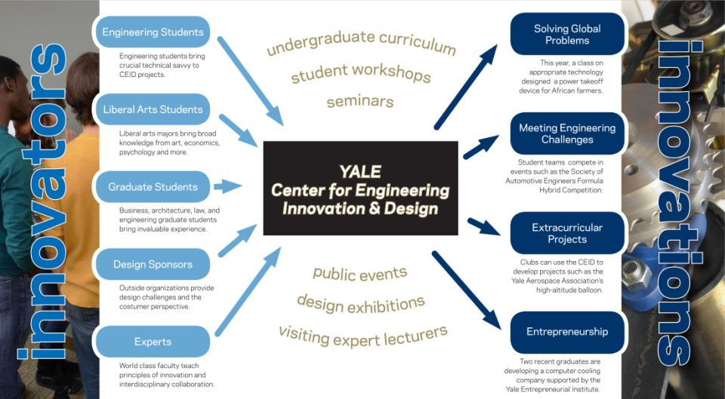

Slide 12

Engineering Design Process: Conceptual Design

Slide 13
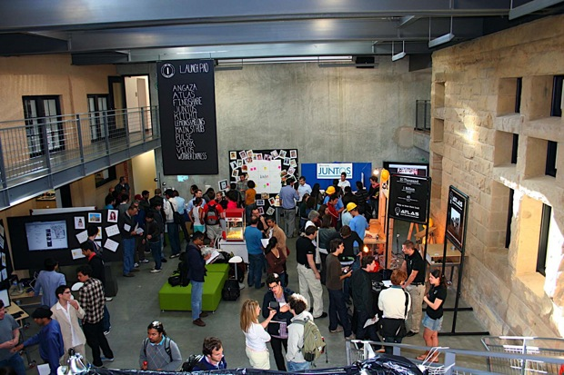

Slide 14
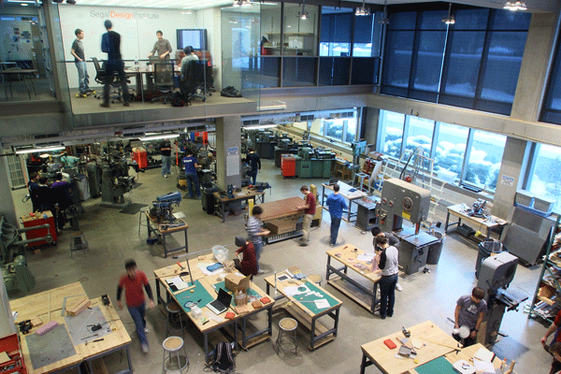
Engineering Design Process: Conceptual Design

Slide 15

Engineering Design Process: Conceptual Design
Notes:
15
Stayed the same

Slide 16
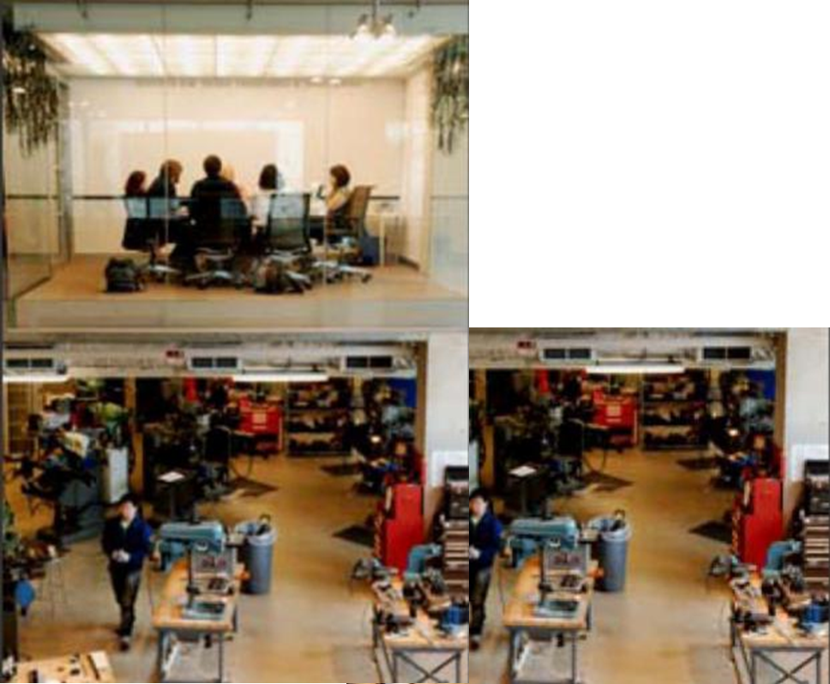
Engineering Design Process: Conceptual Design
Notes:
16
Stayed the same

Slide 17
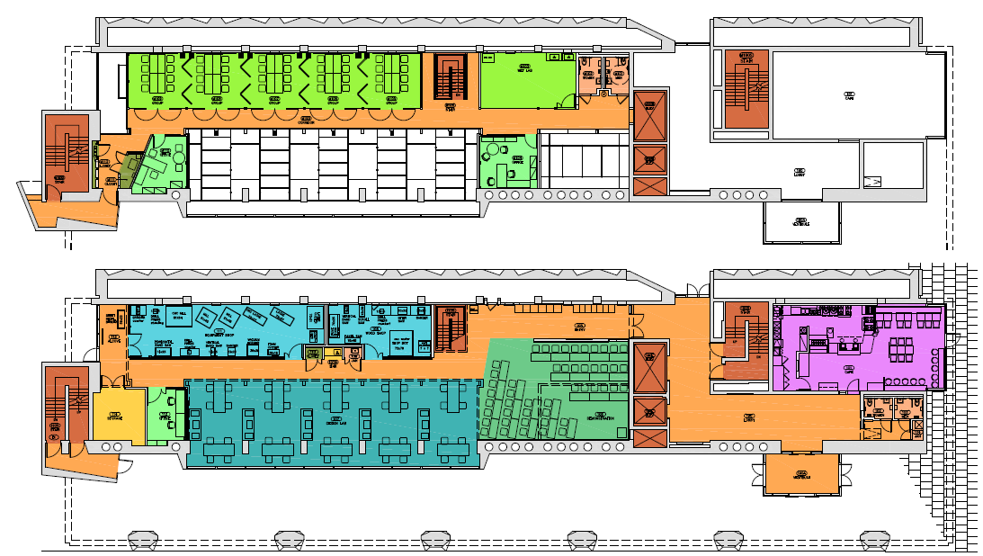
Engineering Design Process: Preliminary Design
Notes:
17
Stayed the same

Slide 18
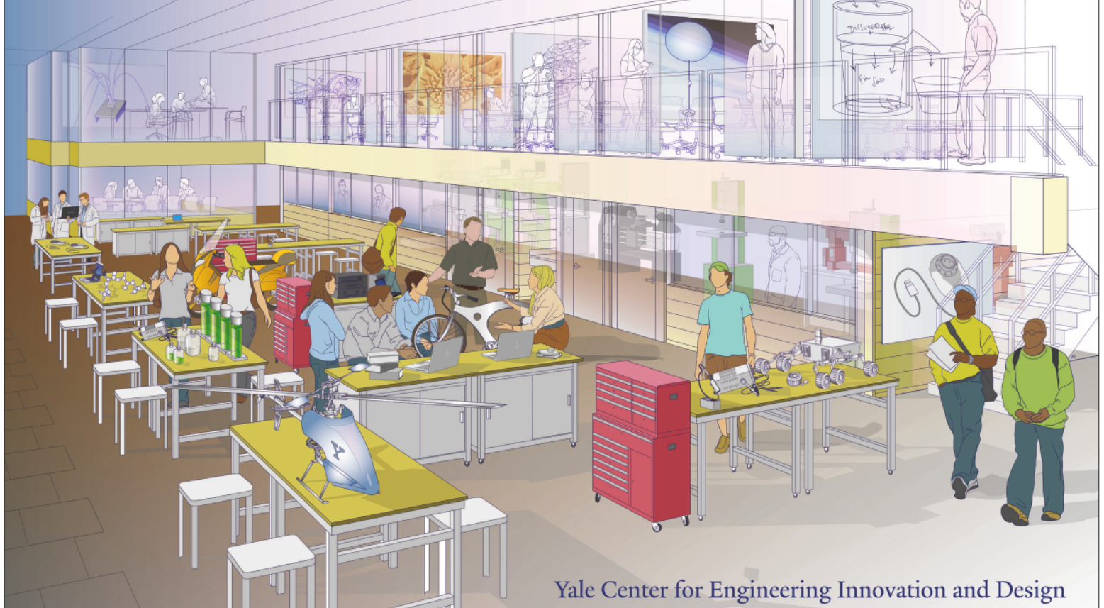

Slide 19
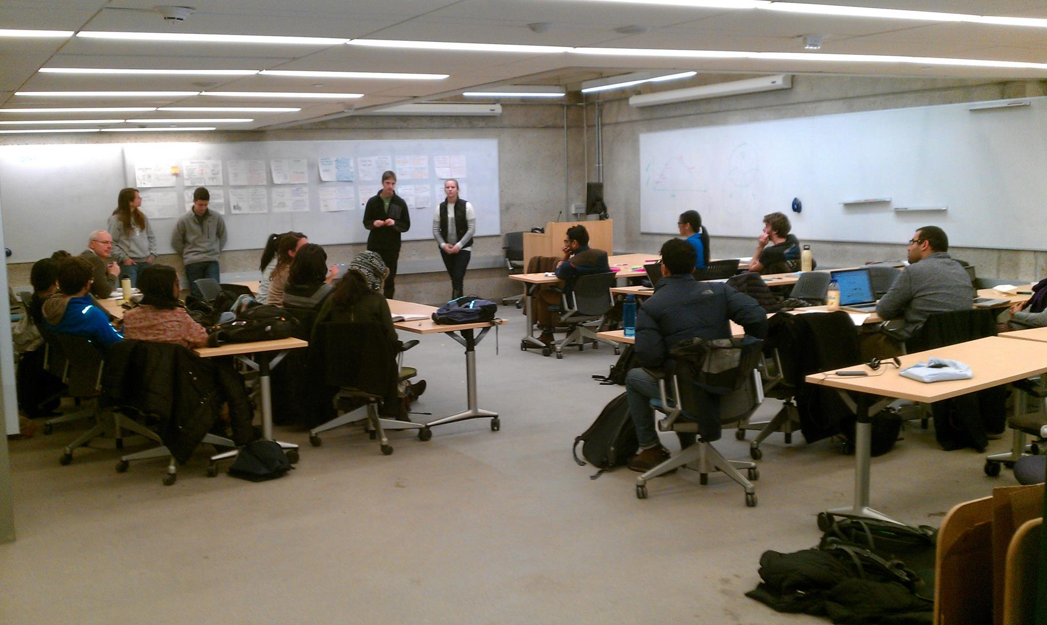

Slide 20
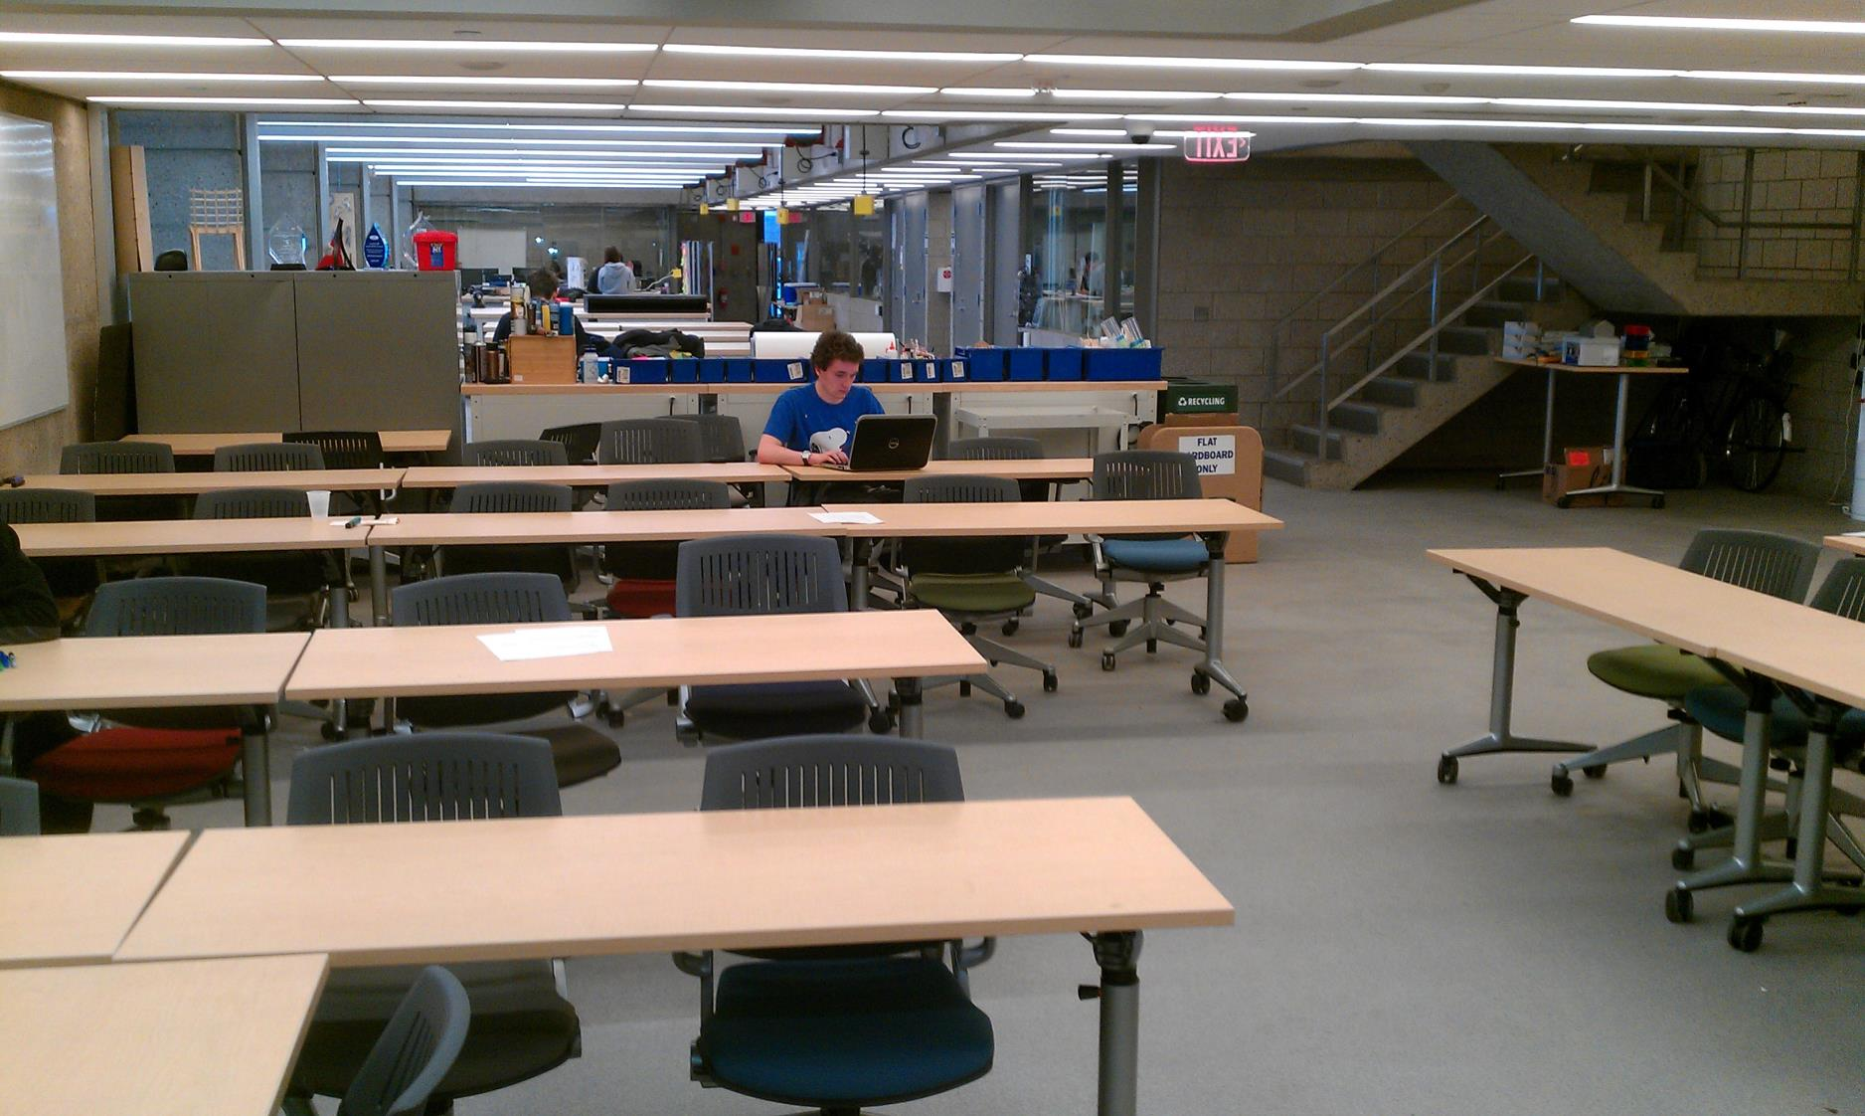

Slide 21
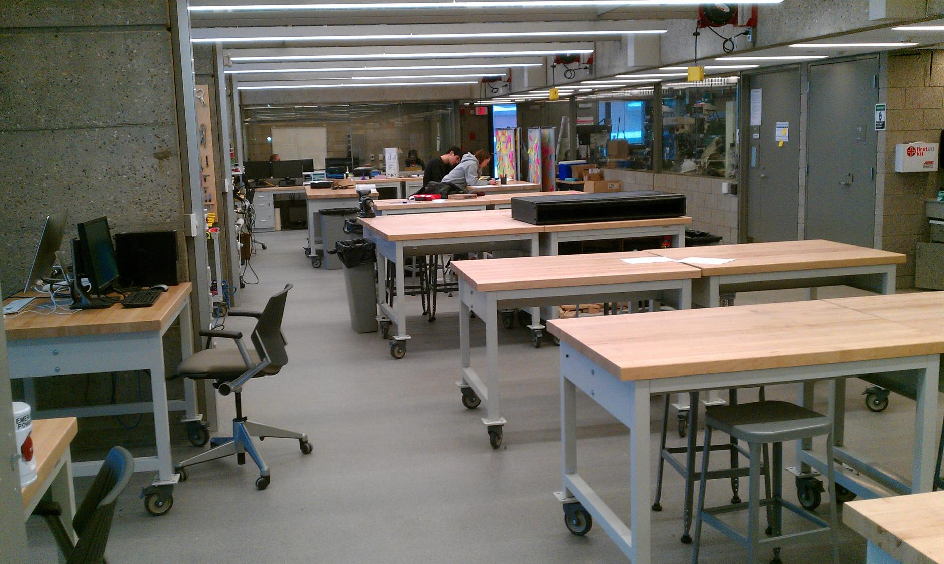

Slide 22
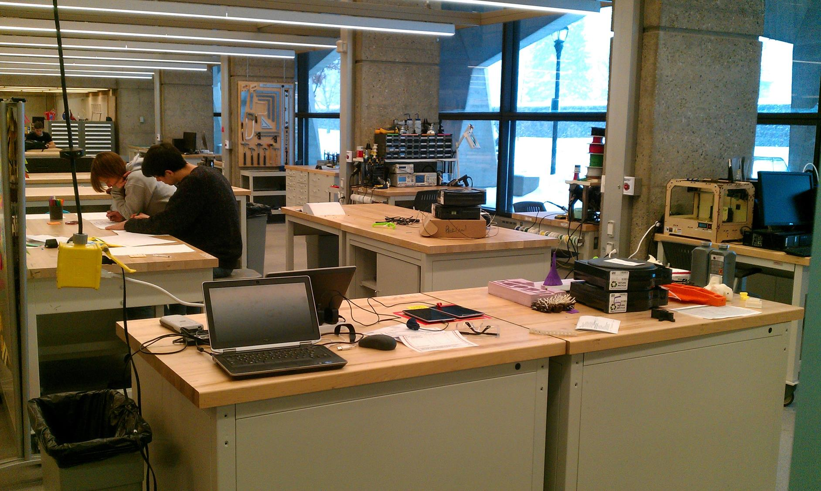

Slide 23
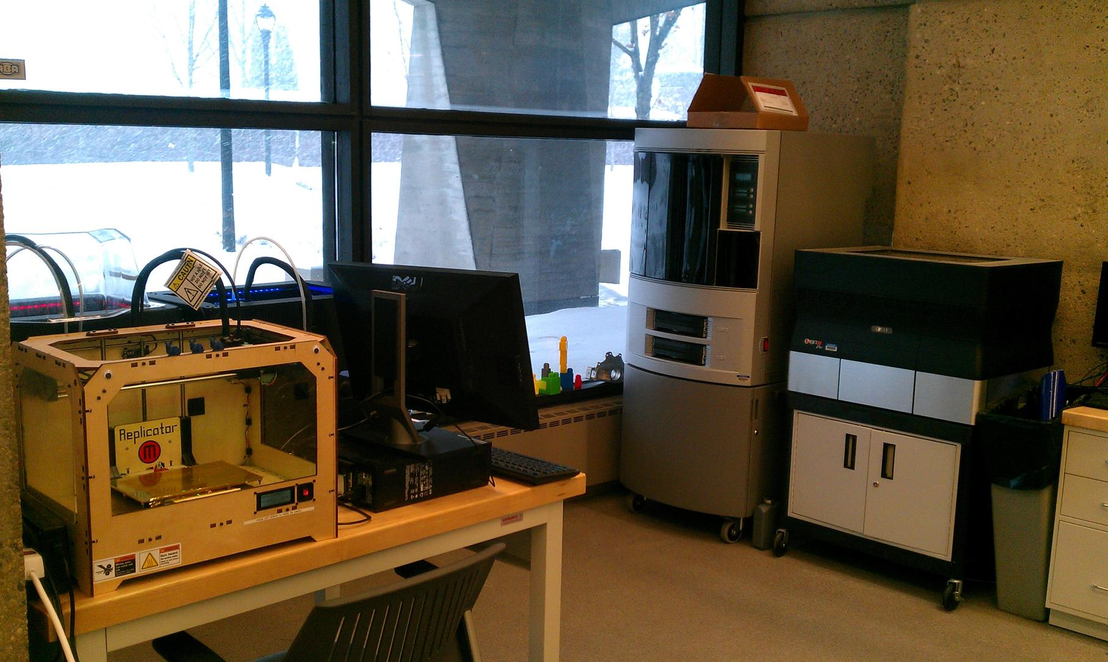

Slide 24
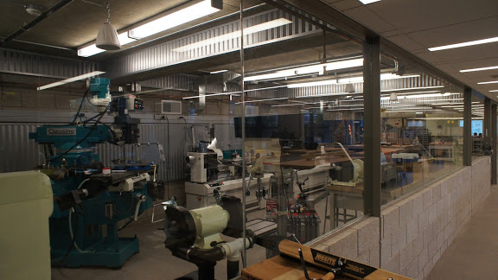

Slide 25
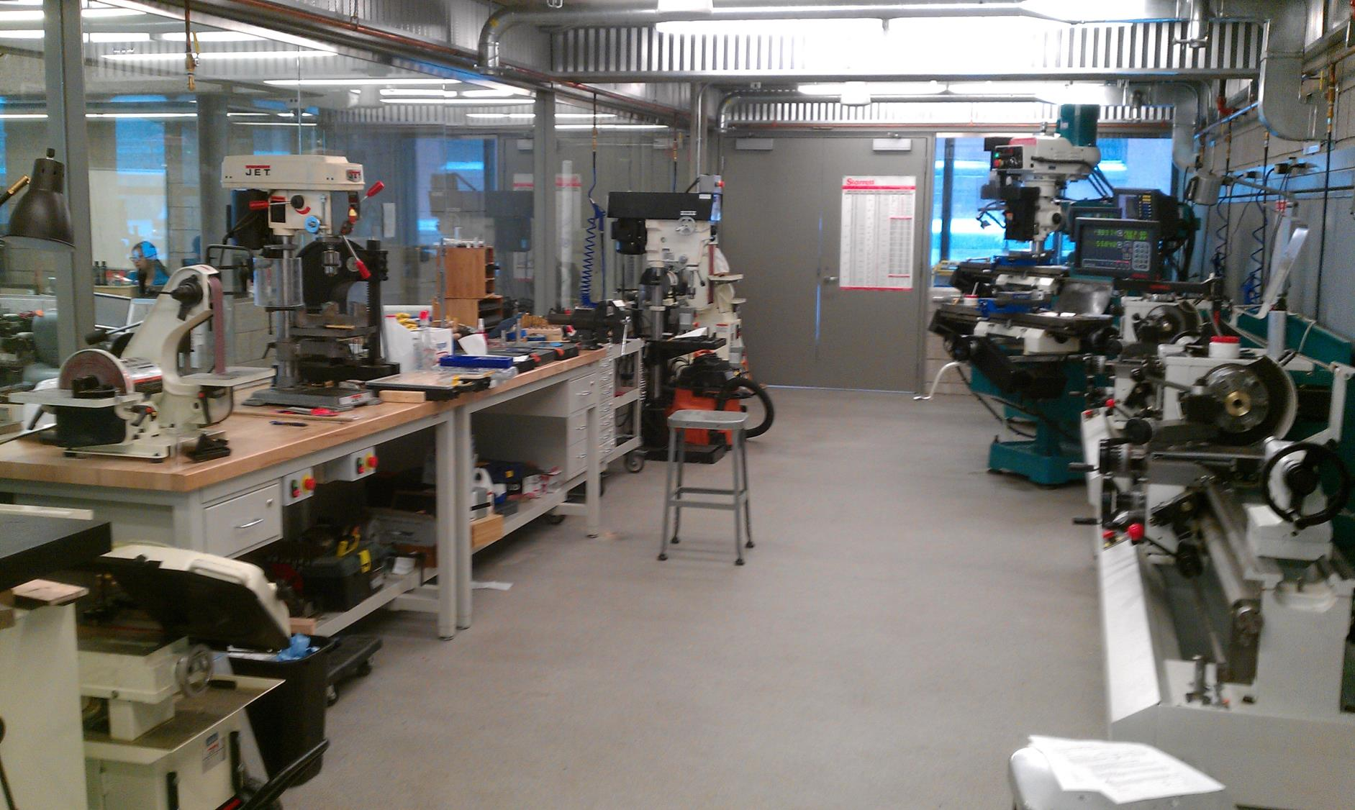

Slide 26
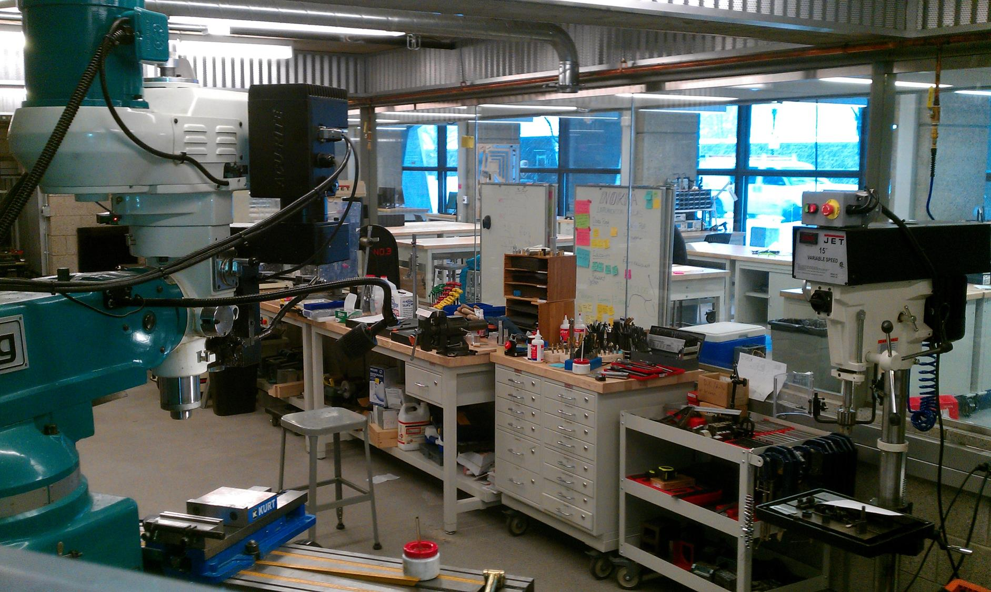

Slide 27
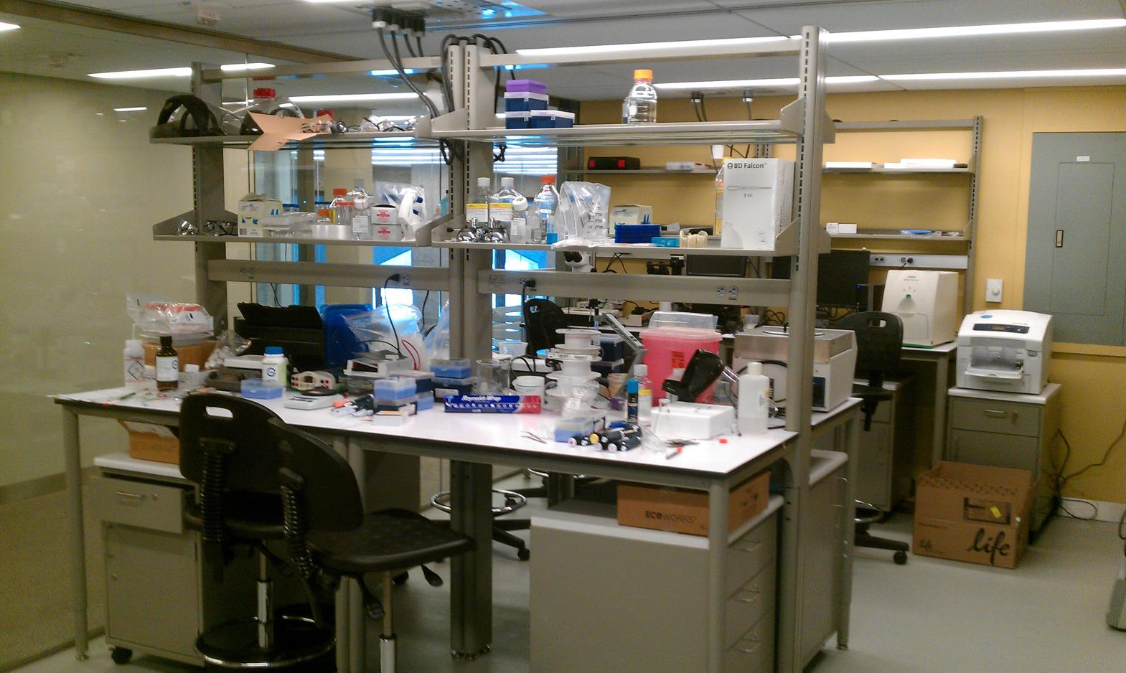

Slide 28
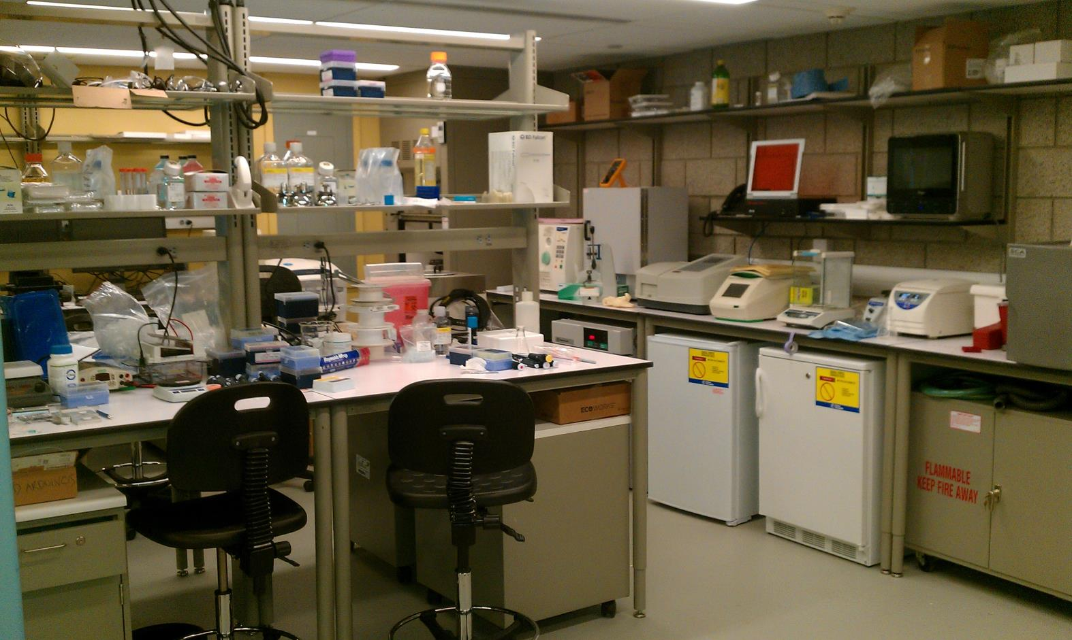

Slide 29
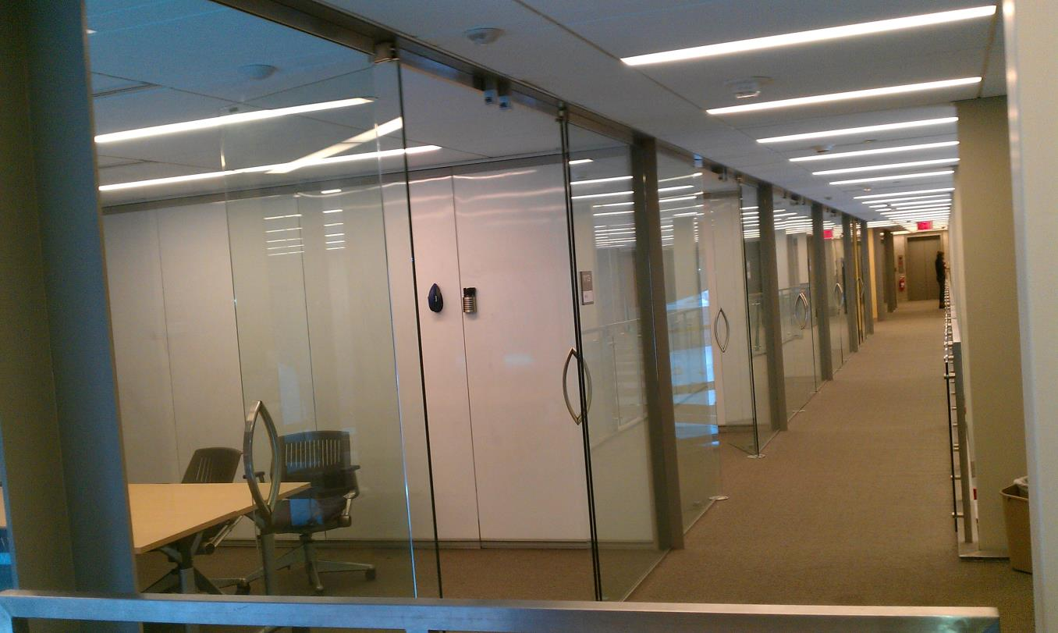

Slide 30
