Slide 1
3rd Annual Deshpande Symposium on Innovation & Entrepreneurship in Higher Education
Panel Presentation Tracks
Entrepreneurship in the Curriculum
University Commercialization & Startups
Developing Entrepreneurial University Cultures
National Speakers & Colleagues
Optional Boston-Cambridge Innovation Tour
Visit http://continuinged.uml.edu/deshpande
See Steve Tello or Phil Weilerstein

Slide 2
Engaging Community & Campus to Support an Entrepreneurial Ecosystem
Steven Tello Assoc. Vice Chancellor, UMass Lowell
Joseph Hartman Dean, Francis College of Engineering
Tom O’Donnell MV Sandbox Leadership Team
Notes:
Thank you all for coming today.
This is an exciting time for all of us on this campus.
We have spent the last 5 years repositioning the University so that our students, our faculty and staff, and our community see us as a true public enterprise committed to taking an entrepreneurial approach to innovation in all aspects of our University.
I am looking forward to hearing your questions and comments. But first, I wanted to give you a little update on where we are today, and how far we have come.

Slide 3
Presentation Points
Who are the players in our community?
How has the entrepreneurial ecosystem evolved over the past four years?
What is the role of the University in supporting entrepreneurship?
What is the role of the Merrimack Valley Sandbox?
What is the potential impact?

Slide 4
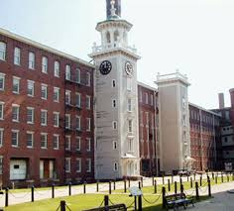
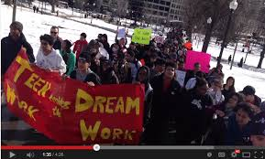
Welcome to Lowell & Lawrence: Immigrant Gateway Cities
Lowell: 100k population
8.6% unemployment rate (7.9% US)
18% poverty rate (MA rate: 11%)
42% of households do not speak English at home
A real melting pot
Lawrence: 75k population
15% unemployment rate
29% poverty rate
50% dropout rate from high school
75% do not speak English
Primarily Hispanic

Slide 5
Introducing the Players
University of Massachusetts Lowell 2014 Hockey East Championship Game 7:00 PM EST Puck Drop against #4 UNH

Slide 6
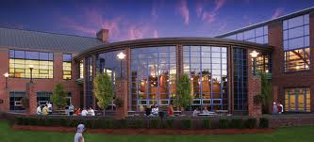
Introducing the Players
University of Massachusetts Lowell
Research University, $63M Research Exp. Roots in Lowell Tech Institute & Lowell State Teachers
Six Colleges/Schools, approx. 17,500 students
Francis College of Engineering
Manning School of Business
Deshpande Foundation
Merrimack Valley Sandbox – Oct. 2010
$5 M commitment through 2015
Community Partners
Mill City Grows, Lawrence CommunityWorks, etc.

Slide 7
Circa 2010-2011
UMass Lowell
Undergraduate & graduate entrepreneurship programs in Business School
Active service learning program in Engineering
M2D2 – medical device incubator, primary tech. commercialization effort
Deshpande Foundation introduces MV Sandbox
Student Entrepreneurship - Campus Catalyst, Student pitch events
Community Leadership program
Community organization grants

Slide 8
Year 1-2 Progress
Four campus partners
UMass Lowell, Merrimack College, Middlesex Community College, Northern Essex College
Campus Catalyst program engages students around concepts & solutions
Early seed funding for students
Sandbox Leadership Program
Two 20 person cohorts, 9 month community based leadership program
But what about community entrepreneurs?

Slide 9
Changes in Years 2 – 4
Sandbox Accelerator Program
Broaden focus from campus-based activities to “Entrepreneurship for All”
2-3 cycles of themed pitch events, then 12 week Accelerator Program
Attracts mix of sole proprietor service, non-profit service, boutique manufacturing
Sandbox Leadership Program spins off, Mill Cities Leadership Institute
University grows its own campus focused efforts

Slide 10
UMass Lowell Innovation Ecosystem
 | ACADEMIC PROGRAMS | STUDENT ACTIVITIES & LEADERSHIP | ECOSYSTEM
2010 - 2011 | Entrepreneurship BSBA, MS ITE SLICE - Engineering MS Comp. Science | MV Sandbox-Campus Catalyst MLSC Internship Challenge | M2D2 Incubator UML Licensing Faculty Seed Grants
 | ACADEMIC PROGRAMS | STUDENT ACTIVITIES & LEADERSHIP | ECOSYSTEM
2010 - 2011 | Entrepreneurship BSBA, MS ITE SLICE - Engineering MS Comp. Science | MV Sandbox-Campus Catalyst MLSC Internship Challenge | M2D2 Incubator UML Licensing Faculty Seed Grants
2012 - 2014 | DifferenceMakers™ Freshmen Seminars Faculty Fellows Enterprise Coops | DifferenceMakers™ Move-In Weekend Arel Moodie, Climate Change Freshmen Convocation Pitch $3000 student awarded Living Learning Community $25K DM IdeaChallenge | DM Central opens Sandbox Accelerator NERVE Center Deshpande Symposium
 | ACADEMIC PROGRAMS | STUDENT ACTIVITIES & LEADERSHIP | ECOSYSTEM
2010 - 2011 | Entrepreneurship BSBA, MS ITE SLICE - Engineering MS Comp. Science | MV Sandbox-Campus Catalyst MLSC Internship Challenge | M2D2 Incubator UML Licensing Faculty Seed Grants
2012 - 2014 | DifferenceMakers™ Freshmen Seminars Faculty Fellows Enterprise Coops | DifferenceMakers™ Move-In Weekend Arel Moodie, Climate Change Freshmen Convocation Pitch $3000 student awarded Living Learning Community $25K DM Idea Challenge | DM Central opens Sandbox Accelerator NERVE Center Deshpande Symposium
2014 - Future | Pathways to Innovation Entre. In Capstones Engin. & Bus. Faculty Biomed. Eng. UG Prog. EIR program | Epicenter Univ. Innov. Fellows DM Certificate introduced $35K DM Idea Challenge | CIE branding of Innov. & Entre. UML MakerSpace Innovation Hub in Lowell (22K sq ft )

Slide 11
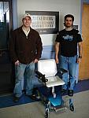
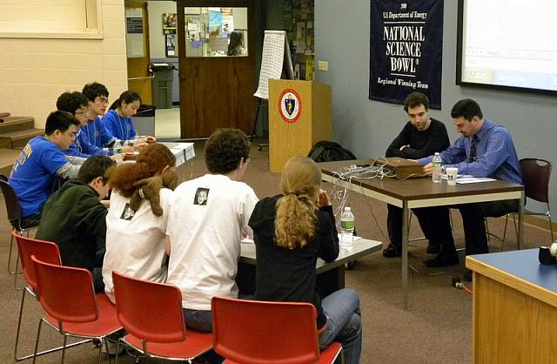
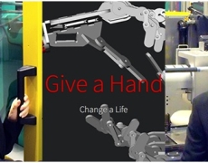
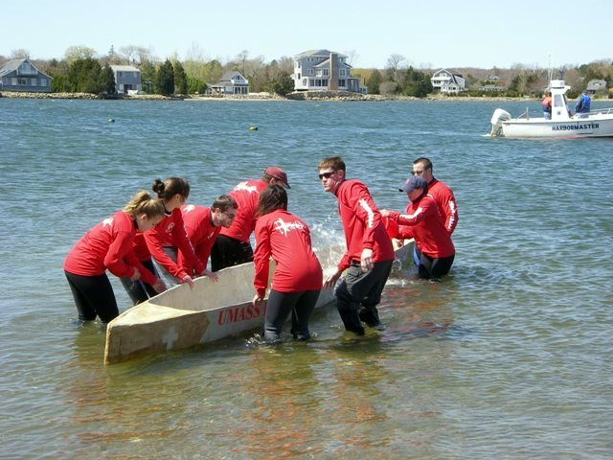
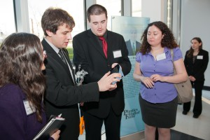
Opportunities for Engineering
Francis College of Engineering
Dean Joseph Hartman

Slide 12
Opportunities for Engineering: Small
Incorporate Innovation Concepts into Classes
Currently occurs in Service Learning
“Simple” Questions to Add to Homeworks:
Is your solution marketable?
Who would buy your answers/design?
Can you “make” your solution?
Add Innovation Component to Projects
Research competing solutions
Determine market validity

Slide 13
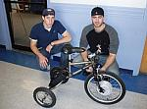
Opportunities for Engineering: Med
Multi-Disciplinary Capstone Design
Engineering and Business Students
Infuse Innovation into Process
Traditional Capstone: Design a Solution
Solution Meets Design Specifications
Faculty Member and Proposer (Industry) Evaluate
New Capstone: Will Design Sell?
Include Innovation Questions into Design Process
Two Stages: Proposal then Prototype
VC Panel (Sandbox) Judge Proposals
Opportunities for Innovation Expo

Slide 14
Opportunities for Engineering: Large
Creating an Innovation Academy
Want Faculty to be Innovators
Not Just a Student Endeavors
Faculty Innovators lead to more Student Innovators
Requirements:
Understanding Value of Innovation
Education on Innovation Process
Access to Assets (seed funding, labs, etc.)
Credit for Innovation (patents = papers, etc.)

Slide 15
Merrimack Valley Sandbox
“Entrepreneurship for All”
Tom O’Donnell – Sandbox Leadership Team

Slide 16
Lowell/Lawrence: Immigrant Gateway Cities
Lowell: 100k population
8.6% unemployment rate (7.9% US)
18% poverty rate (MA rate: 11%)
42% of households do not speak English at home
A real melting pot
Lawrence: 75k population
15% unemployment rate
29% poverty rate
50% dropout rate from high school
75% do not speak English
Primarily Hispanic

Slide 17
Merrimack Valley: State of Entrepreneurship
Entrepreneurial Spirit is alive and well:
600+ adults submitted ideas to Sandbox over past 18 months
44 graduates of 3 accelerator programs, 20% acceptance rate, 70% of ventures still going after 1 year
120+ mentors
30 partner institutions (non profits, cities, banks, universities/colleges)

Slide 18
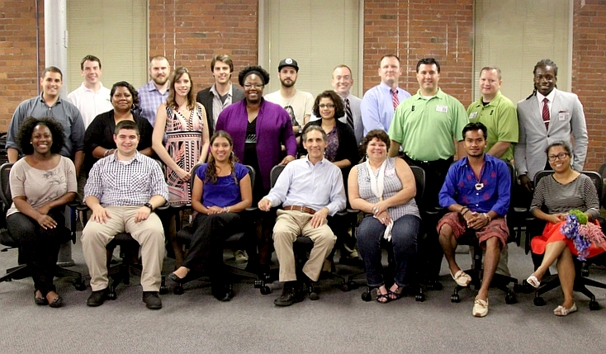
Who are these Entrepreneurs?
1st time immigrants, landscaper, florist, suburban residents, college students, a lawyer, a teacher, an engineer…
Notes:
Reside within 10 miles of city centers
Some with decent understanding of business concepts
Others have no networks, little exposure to startups
From all walks of life (including recent immigrants)
Many face challenges (poverty, single parent)
Lacking role models at home or school
Naïve (little concept of customer/business)

Slide 19
What are their Ideas?
Local Ideas:
Baker, Day care/training center; florist; printmaker; citizenship training; leather medallions; dyed yarn

Slide 20
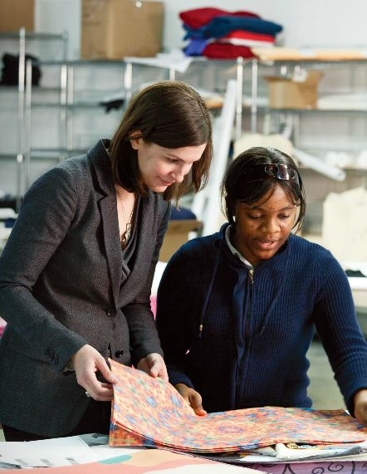
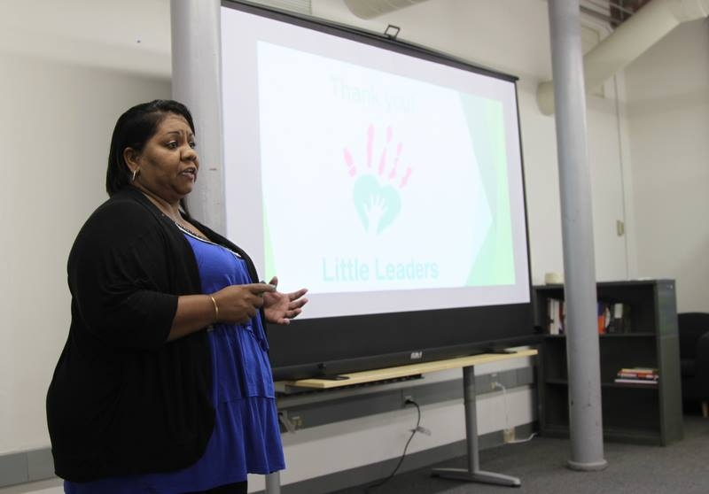
Sandbox Entrepreneur Case Studies
99 Degrees Custom
“Me-Commerce” Custom textile manufacturing
Break the cycle of poverty through employment, access to training and education, and benefits that empower.
Bridge between the local workforce and high-paying manufacturing careers
Little Leaders
Daycare provider in Lawrence
Training for parents to run their own daycare centers
Tremendous need for child care providers in Lawrence

Slide 21
Sandbox Programs –Students
High School and College level program
Students receive basic training and ~$300 to pursue idea
Growing involvement from partners:
UML “DifferenceMaker” program, faculty/admin involvement
MCC Entrepreneurship professor & EIR hired
High School clubs focused on entrepreneurial activity
After school programs devoting resources to teaching entrepreneurship

Slide 22
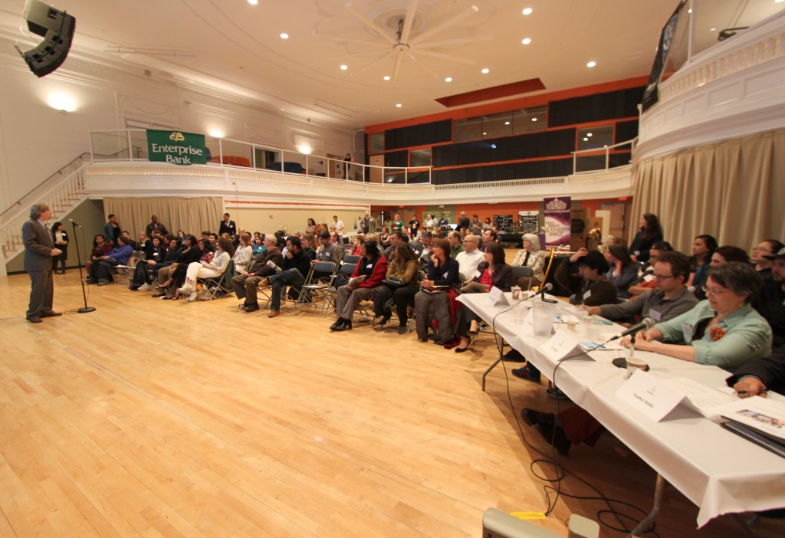
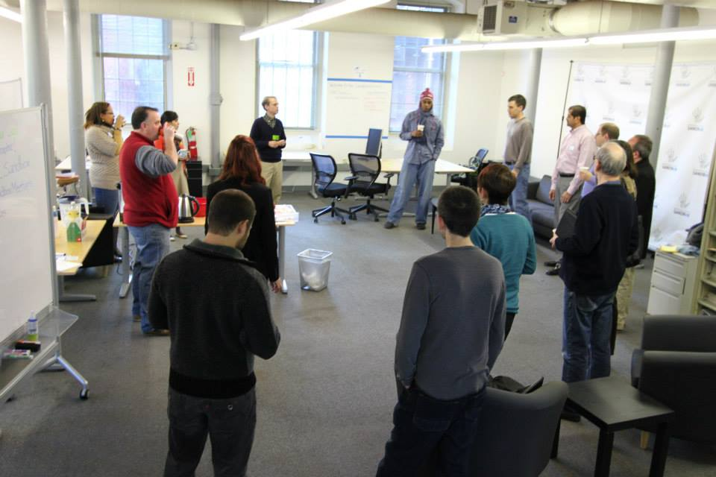
Sandbox Awareness Programs
Pitch Contests:
8 Presenters (from 40+ applicants)
English and Spanish
100+ attendees
Prize money/excitement!
Other Programs
Meetups every Tuesday
Workshops, panels, mixers

Slide 23
For the Most Promising: Accelerator
Twice/year (Dec-Feb, and June-Aug)
15-20 Accepted (30% chance of getting in)
12 week program, meet 2x/week
Lowell and Lawrence locations
2-3 mentors per team – mix of business/non profit executives
Started with basics, taught by experts:
Customer/market (Business Model Canvas)
Accounting, legal, marketing
Entrepreneurs to share wisdom/experience
3 Goals set for end of program
End of program: $30k contest

Slide 24
Ecosystem Impact
Sandbox “Entrepreneurship for All” promotes small business development in Gateway Cities.
Attracting statewide interest in model, luring Boston-Cambridge entrepreneurs & mentors to Lowell & Lawrence
Promoting sustainable non-profit business models
Broader University Commitment to Entrepreneurship & Economic Development

Slide 25
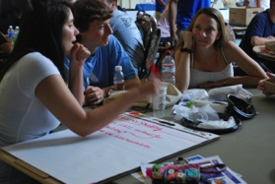
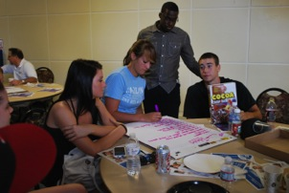
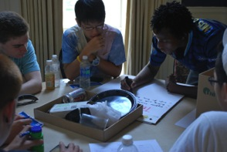
DifferenceMaker™ Impact
2014 Idea Challenge
70 applications, 160 Students DifferenceMaker Central, Faculty Fellows, 25 Alumni
2013 Idea Challenge
Non-Spec - raised $20K, won 3 national comp.
GrabABite – raised $11K, merged with ClickWaiter
Power Trike, Robot Arm joined Sandbox Accelerator

Slide 26
Economic Development Impact
M2D2
March 26 NVC Finals 15 national startups
$4M MLSC support 11K sq ft expansion
Innovation Hub
$1M EOHED support 11K sq ft tech incubator
Adv. Materials, IT, Biotech
Downtown location, Spin-outs,-ins, Corporate
2020 Strategic Planning Committee
Eco. Dev. Metrics for Report Card
APLU CICEP Innovation & Economic Prosperity Designation

Slide 27
Challenges & Rewards
Participation beyond Business & Engineering
Not all disciplines embrace Entrepreneurship
Must connect with the Social Mission
Top-level support important, but Bottom-up pressure is critical
Space – as effort grows, more space needed
Funding is available
Seed with grant or institutional funds
Effort attracts alumni support
Building the Team

Slide 28
Challenges & Rewards
Students & Faculty are engaged
Introduced 1600 Freshman in Orientation and Intro. sessions
Engaged 45 student teams, 125 students in IdeaChallenge
20 faculty from all 6 colleges
30 Intro to DifferenceMaker class sessions
Alumni are engaged
$35 K support in Year 1, growth anticipated
15 alumni volunteers for IdeaChallenge
Community is engaged
Non-profits soliciting student teams
Foundation interest growing

Slide 29
3rd Annual Deshpande Symposium on Innovation & Entrepreneurship in Higher Education
Panel Presentation Tracks
Entrepreneurship in the Curriculum
University Commercialization & Startups
Developing Entrepreneurial University Cultures
National Speakers & Colleagues
Optional Boston-Cambridge Innovation Tour
Visit http://continuinged.uml.edu/deshpande
See Steve Tello or Phil Weilerstein

Slide 30
For More Information
Joseph Hartman Joseph_Hartman@uml.edu
Tom O’Donnell Thomas_Odonnell@uml.edu
Steven Tello Steven_Tello@uml.edu
www.uml.edu/CIE

