Slide 1
Founding stories of engineering entrepreneurship programs: Research to inform practice
Helen L. Chen, Carolyn Estrada, Shannon Gilmartin, Angela Shartrand, Sheri Sheppard
epicenter.stanford.edu
Notes:
SHERI: You’ll be opening the show, so to speak. Some suggested points:
Welcome to Founding Stories of Engineering Entrepreneurship Programs! [Introduce everyone, Epicenter, Designing Education Lab] This afternoon, we’ll be diving into key findings from our research question- What are current models of educating engineers for entrepreneurship/entrepreneurial thinking? In the second half of today’s session, we’ll be talking to and taking questions for program directors and developers from three different universities about their engineering entrepreneurship program stories. [Introduce panelists? Or wait until later?]

Slide 2
You have two index cards in front of you…
What is your burning question about…
how to create an entrepreneurship program?
how to grow an entrepreneurship program?
Please put your name on the back of each card.

Slide 3
Organization of the session
Welcome and introduction to Epicenter research
A closer look at our study of entrepreneurship programs for undergraduate engineers
  Methods
  Findings related to program creation and growth
Q&A with the audience
Panel discussion with three engineers/leaders engaged in entrepreneurship program development
Q&A with the audience

Slide 4
Our approach to framing Epicenter Research:
Building knowledge, communities and connections
Those currently conducting
research in entrepreneurship education:
• Literature Review
• May 2012 Research Workshop
Entrepreneurship
education research
community
Workshops
Conferences
Collaborations
Materials
Faculty,
practitioners
and students
Epicenter
community
and
partners
Participants
and users,
collaborators
Co-framers,
collaborators
and users
Notes:
Epicenter Research is about understanding the larger entrepreneurial/engineering educational eco-systems in which Epicenter is working. Because Epicenter is not the "only game in town" we are focused on identifying how a variety of approaches (curricular, extra-curricular) work to help undergraduate engineering students learn entrepreneurial skills, abilities and attitudes, and develop entrepreneurial interests. Our research questions were informed by a “deep dive” into the existing literature in 2012 to what was known about these educational experiences, and to help us identify knowledge gaps.
Creating a larger research community--An equally strong Epicenter Research element goal is to support the engineering education research community by strengthening the network of researchers; this is a network that will outlast Epicenter.

Slide 5
Epicenter Research Questions
RQ1: What are current models of educating engineers for entrepreneurship/entrepreneurial thinking?
RQ2: What are undergraduate engineering students’ entrepreneurial interests, abilities, and achievements? How do these interests, abilities, and achievements change over time? Which educational and workplace environments/experiences influence the development of their entrepreneurial interests, abilities, and achievements?
RQ3: How can fundamental engineering curricula be reframed to stimulate integrative thinking, especially entrepreneurial thinking?

Slide 6
My Founding Story
Notes:
Presentation turns to Carolyn, beginning with her founding story…

Slide 7
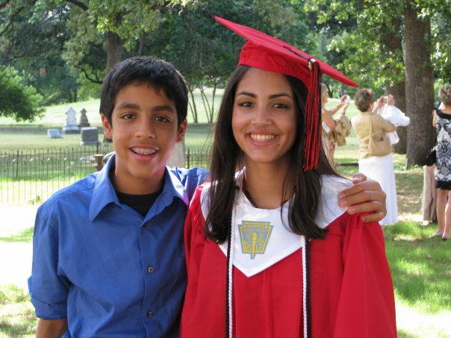

Slide 8

Mechanical engineering at Texas A&M
Notes:
From Dallas.. I decided to do engineering at Texas A&M because I loved my math classes in high school.

Slide 9
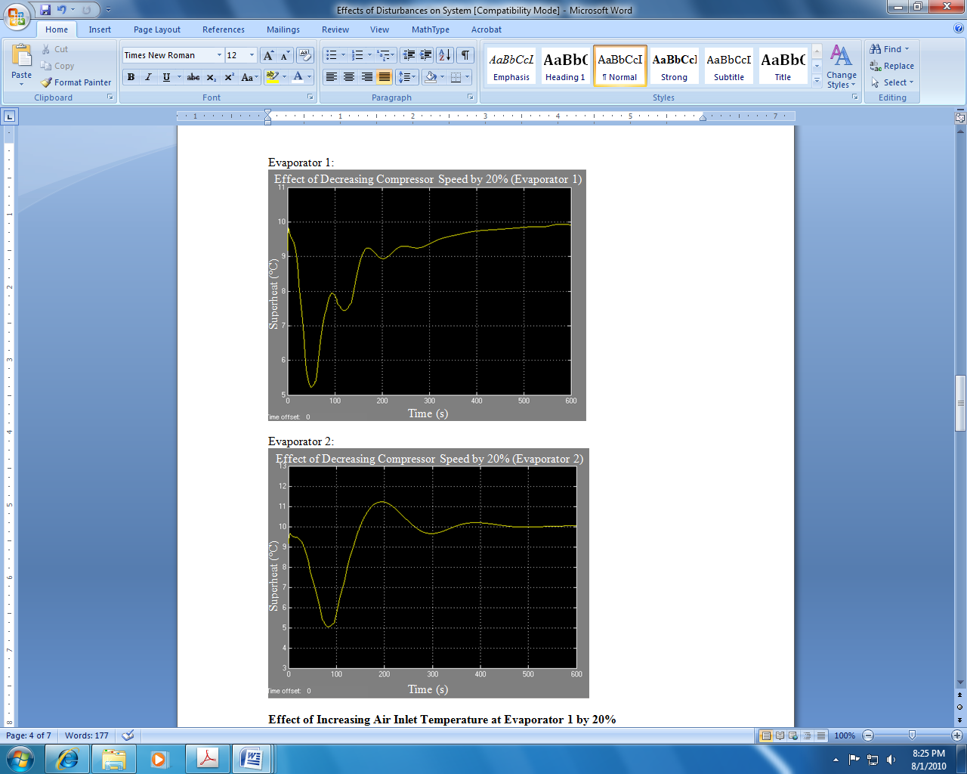
Mechanical engineering at Texas A&M
Controls research
Carolyn Estrada, USRG 2010 Poster
Notes:
While I was there, I grew as a researcher, focusing on controls- UAVs, electronic expansion valves in refrigeration systems.

Slide 10

Mechanical engineering at Texas A&M
Controls research
Graduate school at Stanford
Notes:
I came to Stanford thinking I was going to continue researching controls, but after my first couple of months out here, I realized that was not my calling. Like some of the programs you’ll hear about today, I ran into some growing pains of my own- trying to find what I was passionate about.

Slide 11
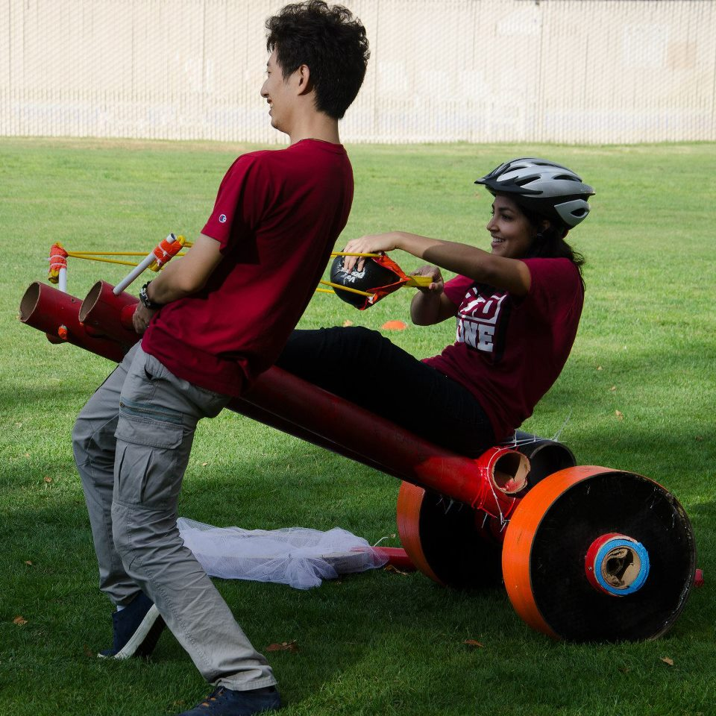
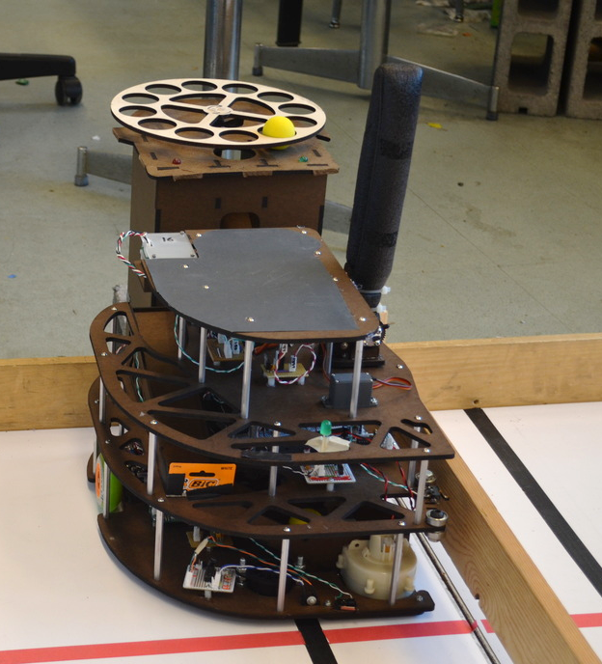
What do I want to do?

Slide 12

What do I want to do?
Engineering entrepreneurship education

Slide 13
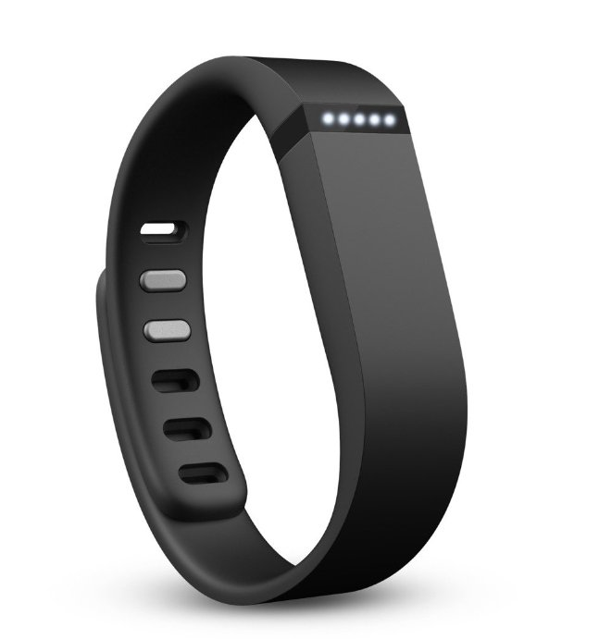

What do I want to do?
Engineering entrepreneurship education
What’s next?

Slide 14
RQ1 Research Methods

Slide 15
RQ1: What are current models of educating engineers for entrepreneurship/entrepreneurial thinking?
Quantitative program data were collected from 18 entrepreneurship programs at 17 U.S. colleges and universities
In-depth interviews were conducted with entrepreneurship program directors/coordinators at 12 of these 18 programs; these 12 programs compose the primary sample for analysis
Interviews averaged about 60 minutes in length
Notes:
* Focus is on interview data

Slide 16
RQ1: What are current models of educating engineers for entrepreneurship/entrepreneurial thinking?
The 12 we studied*…
Cross-disciplinary program
1
1
Program housed outside of engineering school
Programs housed within engineering schools
10
*Drawing from Duval-Couetil, Shartrand, and Reed (forthcoming)
Notes:
Reiterate that we’re looking at the interview sample. Programs are always changing, panel will talk about that, for this part of the data, we’re focusing
1. Programs housed outside of engineering schools/colleges (e.g., in schools of business) but are available to engineers (n=1)
2. Cross-disciplinary programs that include engineering as an administrative unit (n=1)
3. Programs housed within engineering schools/colleges (n=10)
on schools

Slide 17
RQ1 interview data analysis plan
Program histories
Reasons for starting, growth and change over time
Program frameworks
Program pedagogies
Program contexts
Notes:
Carolyn: per angela’s feedback, we can cut back on all of the grounded theory description below, and perhaps comment only on how we organized the data (into these 4 domains), each analyst coded one domain, and we conducted inter-rater agreement tests to make sure that there was consensus about the codes. For the purpose of the preso today, we are focused on the circle in red…. Or something like this
To analyze these data, we experimented with a highly collaborative and interactive coding process. Interview transcripts were first coded according to the major interview questions. Each of us then took on a set of these “block-coded” data and examined these “blocks” more deeply. These blocked sets roughly correspond to: (1) program histories, (2) program frameworks, (3) program pedagogies, and (4) program contexts. We looked for ideas and patterns within our blocked sets, and then across our blocked sets (a process that is still underway).
Given that each of us took on a particular “block” of data, rather than open-coding entire transcripts, this method does not follow a traditional grounded-theory approach. Grounded theory is the process of developing theory from deep, inductive, and very open-ended qualitative analysis; we are not necessarily aiming to generate theory, and we are not quite so open-ended, given that we have already blocked our data into content categories. However, our methods incorporate many of the same techniques: counting and clustering within and across our sets of data, comparing and contrasting examples to check our inferences, developing hypotheses and checking these hypotheses throughout. We also built in several checks against becoming too narrow and losing sight of the overall nature of the 12 programs: inter-rater agreement tests, examining other codes in the dataset that did not fall into our “block”, and reading full transcripts to make sure we did not miss data and to check our team members’ inferences.

Slide 18
Findings from our research

Slide 19
Findings from our research
Program Creation
Various conditions support program creation
  Impart business skills, perceived needs, leader with vision, critical do-ers, catalytic funding
Program Growth
Student interest can drive program growth
Ongoing and resolved “growing pains”

Slide 20
Program Creation

Slide 21
Various conditions support
program creation

Slide 22
3. Leader with vision
4. Critical
“do-ers”
Conditions behind program creation
2. Perceived needs related to entrepreneurship
5. Catalytic funding
PROCESS
INTENT
1. Imparting business skills

Slide 23
Condition 1:
Imparting Business Skills
[Students] need to have some idea of what business is about if they are going to successfully compete against their peers from other schools.

Slide 24
Conditions behind program creation
4. Critical
“do-ers”
3. Leader with vision
2. Perceived needs related to entrepreneurship
1. Imparting business skills
5. Catalytic funding

Slide 25
Condition 2: Perceived Needs
[Engineering students] just had very few ways to learn about [entrepreneurship] … That meant that they had to go try and fight their way into a business school class, which was pretty tough.
Notes:
Not all universities have business schools; not all business classes are available to engineering students.

Slide 26
Conditions behind program creation
4. Critical
“do-ers”
3. Leader with vision
2. Perceived needs related to entrepreneurship
1. Imparting business skills
5. Catalytic funding

Slide 27
Condition 3: Leader with Vision
That’s how we got started, because [the dean] helped to press the development officers to go get the endowment to fund the beginning of the program.

Slide 28
Conditions behind program creation
4. Critical
“do-ers”
3. Leader with vision
2. Perceived needs related to entrepreneurship
1. Imparting business skills
5. Catalytic funding

Slide 29
Condition 4:
Critical Do-ers from Industry
I came out of industry, having done some entrepreneurial things, and a lot of business and just commercial experience, and began to try to form an entrepreneurship certificate program in the College of Engineering.
Notes:
sometimes do-ers are brought in from industry

Slide 30
Condition 4:
Critical Do-ers from University
[The program director] got together with [business faculty] and … put together a proposal basically to introduce an … engineering entrepreneurship minor.

Slide 31
Conditions behind program creation
4. Critical
“do-ers”
3. Leader with vision
2. Perceived needs related to entrepreneurship
1. Imparting business skills
5. Catalytic funding

Slide 32
Condition 5: Catalytic Funding
We started raising significant money from foundations and individuals and [two years later] was more or less officially the kick off of [our program].

Slide 33
Program Growth

Slide 34
Student interest and demand often drive program growth
Notes:
Transition from starting the program to growing the program. Students’ interest manifested in several ways, including actively seeking out courses that sharpen non-engineering skills and actively spreading the word about the program to other students.

Slide 35
Student Demand
We have many students interested in entrepreneurship, but [also] a lot of students interested in “how as an engineering major can I learn about business?”

Slide 36
Student Demand
It was really eye-opening for our students to start talking about things like marketing strategies in the high tech space, to talk about venture capital, to talk about all these things they hear about.
Notes:
Another program

Slide 37
Programs reported both
resolved and ongoing “growing pains”
Notes:
Program growth can face challenges, such as the approval process for new curricula, limited availability of faculty, and how to teach classes?

Slide 38
Ongoing Growing Pains
We’ve never done [the course] since [the original professor left]. Part of it is we’ve never found somebody who could [teach] it.

Slide 39
Resolved Growing Pains
We’ve retained that pedagogical approach [for our course], even though it’s not quite as we originally formulated it.

Slide 40
Summary
Not all conditions presented are needed to start a program, but we found that all programs had at least one of these factors
Industry is a resource
The presence (or absence) of a business school plays a role in program development
Students play a big role in growing the program
Growing pains are present in multiple programs, but there are solutions for these challenges
  Leverage reality in your favor
Notes:
Big summary – business school + student demand, industry is important- people, projects, students are big part in growing program. There are solutions for ongoing growing pains. Leverage reality. Not all 5 conditions are needed to start a program.

Slide 41
Questions?
Not all conditions presented are needed to start a program, but we found that all programs had at least one of these factors
Industry is a resource
The presence (or absence) of a business school plays a role in program development
Students play a big role in growing the program
Growing pains are present in multiple programs, but there are solutions for these challenges
  Leverage reality in your favor
Notes:
Big summary – business school + student demand, industry is important- people, projects, students are big part in growing program. There are solutions for ongoing growing pains. Leverage reality. Not all 5 conditions are needed to start a program.

Slide 42
Q&A about RQ1 findings

Slide 43
Q&A about our research
Some questions to stimulate discussion:
For those of you who are working on program development, have you found other conditions that support program creation in addition to those we listed?
Is program creation possible without any of these conditions? What has been your experience?
What needs or opportunities are driving the agenda for program creation at your campus? For instance, is student demand driving program creation? How do external contexts play a role?

Slide 44
U.S.-Based Entrepreneurship Programs
for Undergraduate Engineers:
Scope, Development, Goals, and Pedagogies
S. Gilmartin, A. Shartrand, H. Chen, C. Estrada, & S. Sheppard
EPICENTER TECHNICAL BRIEF 1, February 2014

Slide 45
2014 Epicenter Research Summit
August 4-5, 2014
Stanford University

Slide 46
Panel Discussion

Slide 47
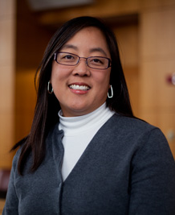
Our Panelists
Aileen Y. Huang-Saad
Associate Director for Academic Programs, Center for Entrepreneurship
Lecturer IV, Biomedical Engineering
University of Michigan

Slide 48
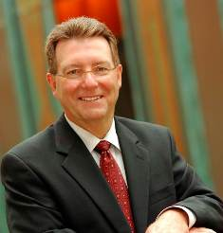
Our Panelists
Timothy L. Faley
Kiril Sokoloff Distinguished Professor of Entrepreneurship
Special Assistant to the President for Entrepreneurial Initiatives
University of the Virgin Islands

Slide 49
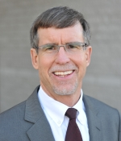
Our Panelists
E. Daniel Hirleman
Dean, School of Engineering
University of California, Merced

Slide 50
Guiding questions for our panelists
How would you describe your (planned or actual) entrepreneurship program for undergraduate engineers? What are the goals for the program you are developing or have already developed? What was the major impetus for getting things started at your campus?
What have you learned so far about the resources and roles needed for entrepreneurship program development? What have been the essential ingredients at your campus for getting things going?
What are you currently aiming to accomplish in the short term? What is your ultimate vision for entrepreneurship education for engineers at your campus?

Slide 51
Panel Discussion

Slide 52
UVI Entrepreneurship
Developing the next generation of Serial Entrepreneurs and Venture Investors
www.uvi.edu
March 2014

Slide 53
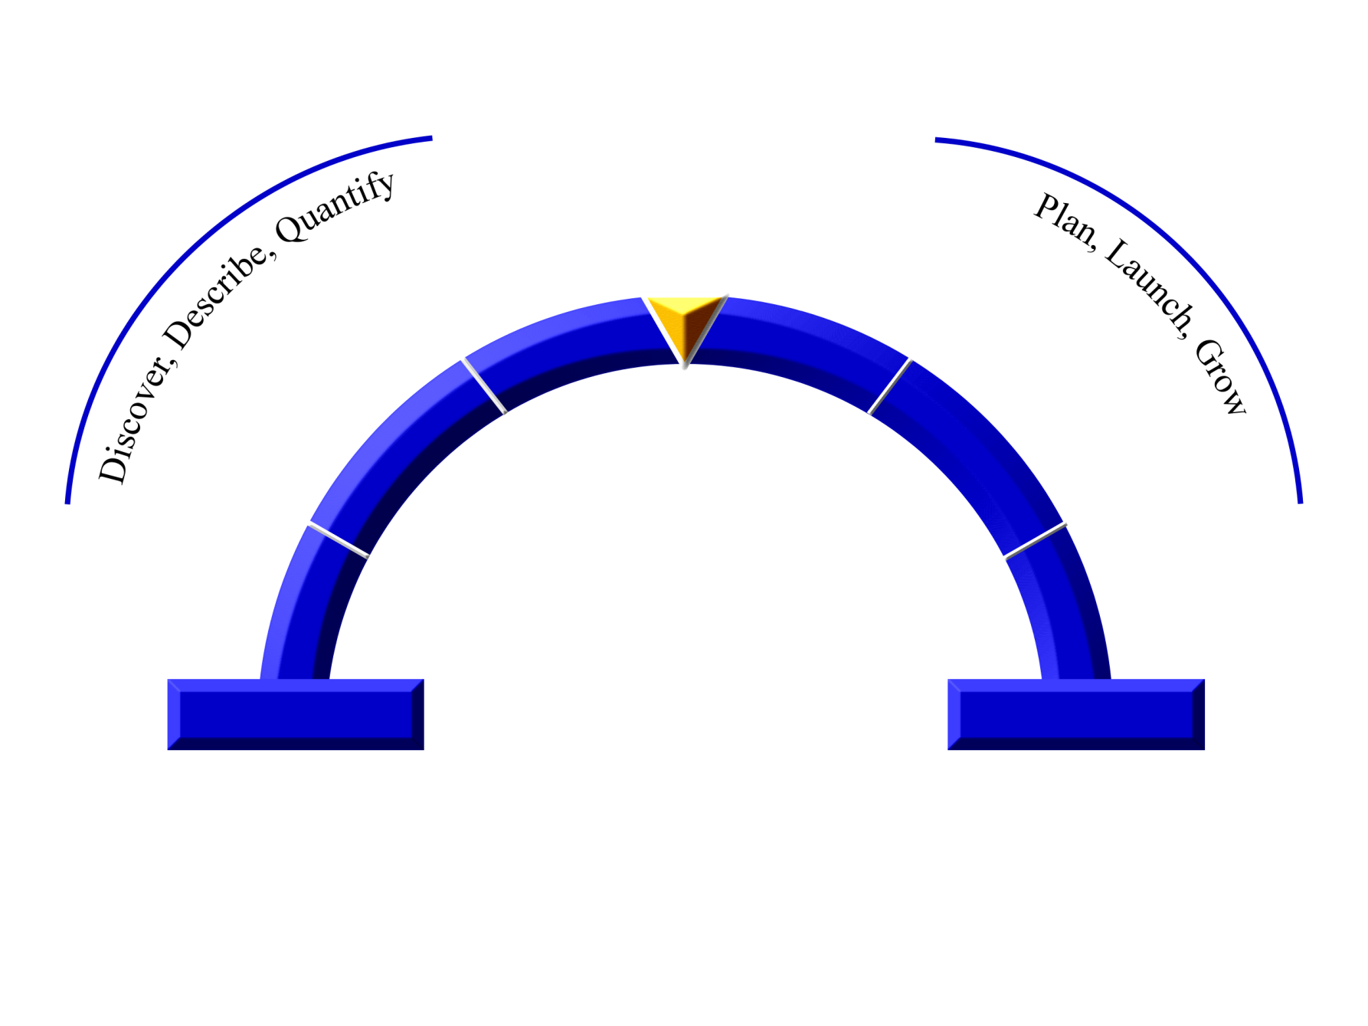
Innovative Business Formation has 2 Parts
The Entrepreneurial Arch
Discover
Business
Assessment
Operationalize Business
Execute
Business Design
Resource /
Due Diligence
Opportunity
Identification
Manage Growth
Capabilities
Business
Assets (physical/Intellectual)
Know-how, Skills, Expertise
Relationships, Networks
Aspirations, Passions, and Interests
Copyright © 2014 Timothy L. Faley
Book to be published by Cambridge Press
September 2014

Slide 54
Objective: Robust, complimentary programs; Investment per student matches outcome
Student Skill-building Impact Framework
Marquee Program
Quadrant
$$$
Scalable Skill-development Programs
$$
Highly visible, elite programs
Highly attractive to students
Least cost-effective
Must be able to move students that
do not get into these programs to
other skill-building programs
Ex: 13D B-Plan Competition
New: Business Investment Pitch (Involve Finance Students)
Highly effective, scalable programs
“Work-horse” programs
Most cost-effective to build skills
Goal is to drive students into programs
of this quadrant
NEW: Student Business Grant Programs
Low ------- Student Impact (Skill Development) --------- High
$
Developing Programs
Motivational
Program Quadrant
Developing student skill-building
programs
Assess programs of this quadrant to
move them to appropriate quadrants
or eliminate them so they do not become
resource distractions.
Awareness-raising and motivational
programs.
Low cost/student contact
Goal is to inspire students to move into
skill-development program quadrant
Ex: UVI Entrepreneurship Club
High School Entrepreneurship Programs
Low --------------------------- Number of Students --------------------------- High

Slide 55
Panel Discussion

Slide 56
Q&A with Panelists: Connecting Burning Questions to Panelists’ Stories

Slide 57
Q&A with our panelists and audience
What did you jot down at the beginning of the session?
Which “big questions” have been addressed for you?
Which remain? Which can be posed to our panelists?

Slide 58
Epicenter Research
Thank you for coming today!
For questions about Epicenter Research, please contact Professor Sheri Sheppard, Epicenter Co-PI, at sheppard@stanford.edu

Slide 59
Opportunities for Future Engagement
2014 Epicenter Research Summit
Please talk to any of today’s presenters: Sheri Sheppard, Carolyn Estrada, Helen Chen (Epicenter, Stanford) and Angela Shartrand (Epicenter, NCIIA)
Epicenter Pathways Initiatives
Please talk to Liz Nilsen (Epicenter, NCIIA) for more information

Slide 60
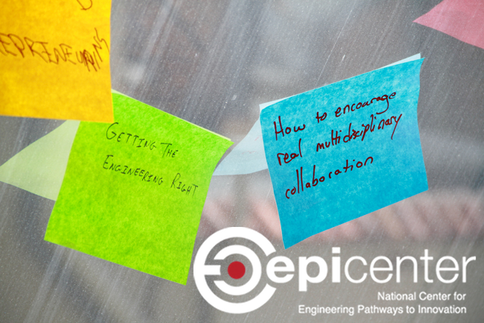


Thank you!
@EpicenterUSA
facebook.com/EpicenterUSA
bit.ly/epi-email

