Slide 1
Good vs Great Teams
Kimberly Benard,
Distinguished Fellowships
Alison Hynd,
Public Service Center
Libby Mahaffy,
Conflict Resolution

Slide 2
Principles
Team Dymanics
Have hard conversations early
Don’t avoid conflict, learn how to manage it
Emotions are important
Expect team to change
Resources
Connect with and contribute to the larger community
Cultivate mentors
Find connector people
Connect early and often
“Soft skills” are critical and can be learned
Structure
Discuss roles
Discuss decision making
Discuss when and how to meet
Discuss compensation
Discuss IP
Notes:
This is hard stuff! You don’t need to know how to do it. You just need to know the people who do know.

Slide 3
Ombuds Office
Dean for Students
Deans within the President’s or Chancellor’s Office
Mediation centers
Trusted faculty and staff
~
Helps people express concerns, resolve disputes, manage conflicts, and learn productive ways of communicating.
An independent, confidential, neutral, and informal resource.
Notes:
The MIT Ombuds Office helps people express concerns, resolve disputes, manage conflicts, and learn more productive ways of communicating. The Ombuds Office serves as an independent, confidential, neutral, and informal resource to the MIT Community. http://web.mit.edu/ombud/index.html
Part of the Office of the President

Slide 4
Conflict Resolution
Community mediation centers
Residence Life staff
Student Activities staff
Communications staff
~
Helps people to have better conflicts. Offers mediation, conflict coaching, facilitation and confidential consultations about difficult situations.
Notes:
At Conflict Resolution@MIT, we're here to help you have better conflicts (or prevent bad conflicts). Conflict Resolution@MIT offers confidential consultations about difficult conversations, difficult people, or ways to handle a dispute or conflict. We offer mediation, conflict coaching, facilitation, and more http://studentlife.mit.edu/mediation
Part of the Divison of Student Life

Slide 5
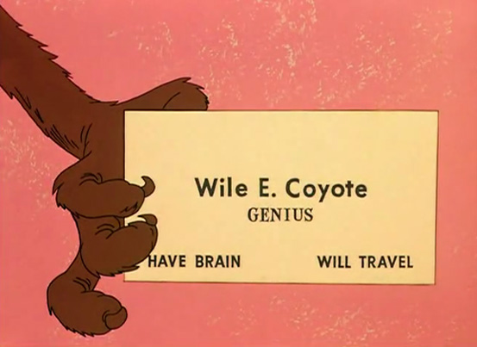
Venture Mentoring Service
Alumni clubs
Friends and family
Community mentoring programs
~
Matches prospective and experienced entrepreneurs with skilled mentors. Provides practical professional advice and coaching.
Notes:
VMS supports innovation and entrepreneurial activity throughout the MIT community by matching both prospective and experienced entrepreneurs with skilled volunteer mentors. We use a team mentoring approach with groups of 3 to 4 mentors sitting with the entrepreneur(s) in sessions that provide practical, day-to-day professional advice and coaching. VMS mentors are selected for their experience in areas relevant to the needs of new entrepreneurs and for their enthusiasm for the program.
http://vms.mit.edu/about
Part of the Office of the Provost

Slide 6
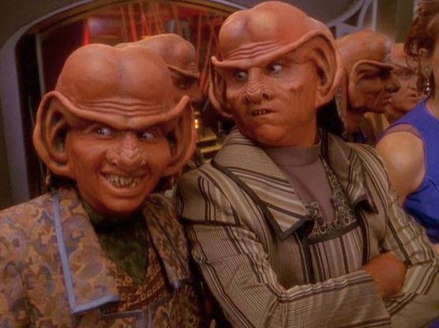
Trust Center for Entrepreneurship
Faculty who have done start-ups and know VCs
Local innovation centers
Competitive accelerators
Business plan competitions
~
Runs programs for student entrepreneurs e.g. networking events, entrepreneurs in residence, a summer enterprise accelerator.
Notes:
The Martin Trust Center for MIT Entrepreneurship provides the knowledge, support, and connections needed for MIT students to become entrepreneurs. Established in 1990, we serve all MIT students, across schools, across disciplines. We run numerous programs and events for MIT students interested in entrepreneurship such as: Peer Advisory Network and Entrepreneurs in Residence, speaker series, physical space, technology access, MIR Global Founders Skills Accelerator.
https://entrepreneurship.mit.edu
Run through the Sloan School of Management

Slide 7
Student Activities Office
Your campus has one of these!
~
Provides leadership training and community building resources.
Helps student groups deal with membership transition and STRESS.
Notes:
The Student Activities Office is committed to providing opportunities for students and student organizations to practice their leadership skills in a variety of ways and to gain the skills and feedback necessary to sharpen and define their abilities. The MIT Student Leadership Development Initiative intends to build the broad system and infrastructure necessary to support leadership opportunities across the entire Institute. They can assist with groups who undergo leadership transition as well as provide leadership trainings to students. They also help with event planning as well as sign off on events.
Part of the Division of Student Life

Slide 8
Parting Thoughts
“Have hard conversations early”
“Get food poisoning together”
“Contribute to a larger enterprise
community than just your own venture”
“The first idea is generally
not the useful one”
“If its difficult to figure out who’s the CEO, CTO, CMO, etc., then you have the wrong make-up for your team.”
“I love it when
a plan comes
together”
“I have found that making a sub-optimal decision quickly is better than making the optimal decision a month later”
“As roles became clear, everything started falling into place”
“It takes a few miracles to go from a student group to a successful enterprise”
“Managing conflict is very
important and can be taught”

