Slide 1
Spaces of Invention & Training
Jon Pearlman (jlp46@pitt.edu)
Mary Goldberg (mrh35@pitt.edu)

Slide 2
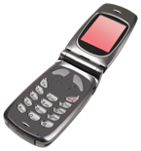
Process & Goals of Innovation
Ideate
Design
Prototype
Evaluate

Slide 3
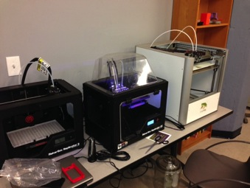
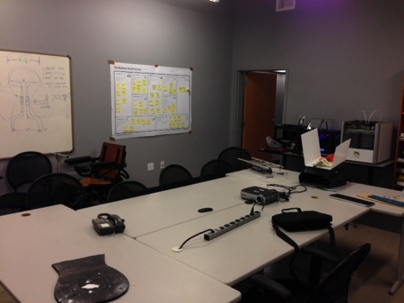
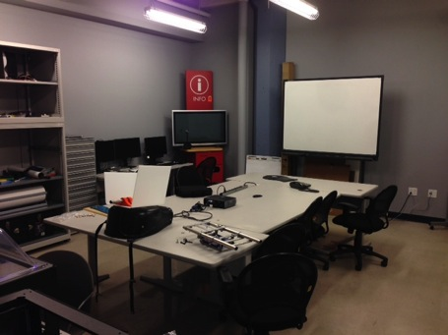
Ideate
Design
Prototype
Evaluate
Notes:
Ideate: RET-end users on the team; design class-students-adaptive sled hockey

Slide 4
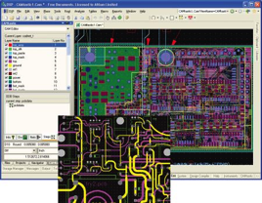
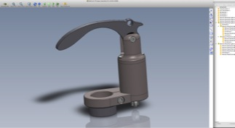
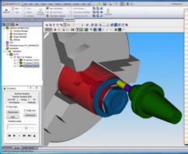
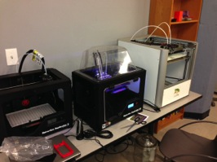
Ideate
Design
Prototype
Evaluate
Notes:
Design: Lynda.com; online design tools, free software from Autodesk
Flipped classroom
Olof-industrial design

Slide 5
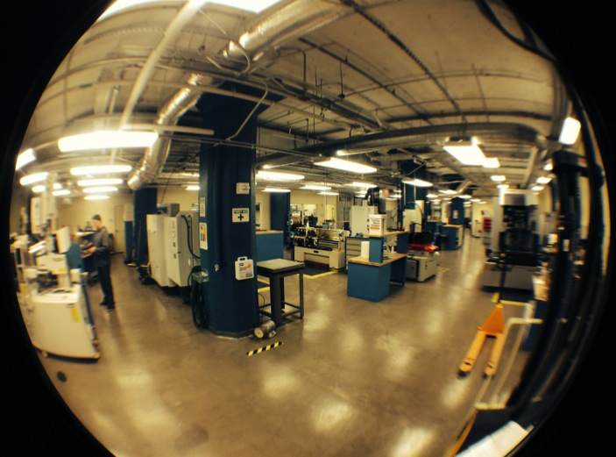
Ideate
Design
Prototype
Evaluate

Slide 6
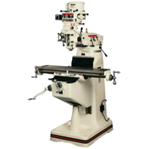
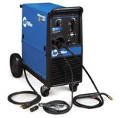
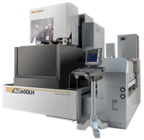
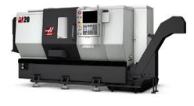
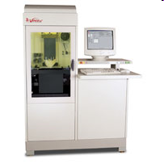
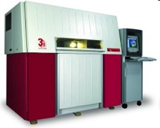
Ideate
Design
Prototype
Evaluate
Notes:
Each design goes through multiple prototype iterations Form & function prototype-bare minimum deliverable
Pediatric wheelchair-3D printed parts, mills, lathes, welding

Slide 7
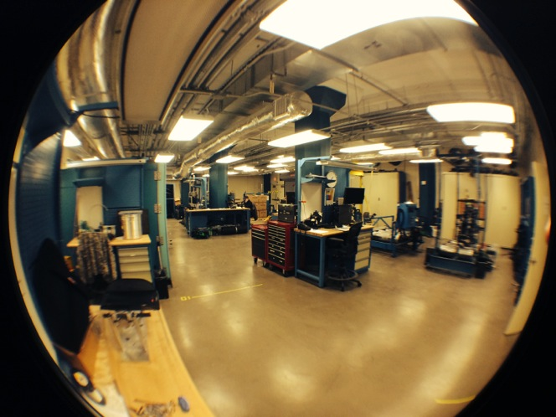
Ideate
Design
Prototype
Evaluate

Slide 8
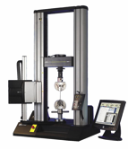
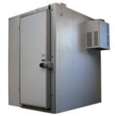
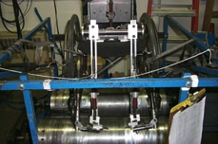
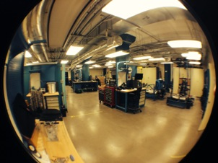
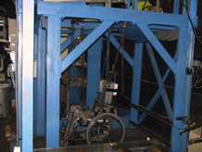
Ideate
Design
Prototype
Evaluate
Notes:
On that same project students used the wc testing equipment to evaluate their design

Slide 9
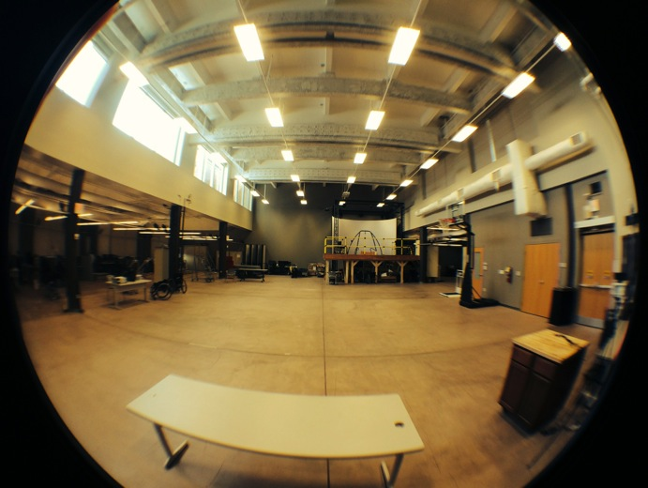
Ideate
Design
Prototype
Evaluate

Slide 10
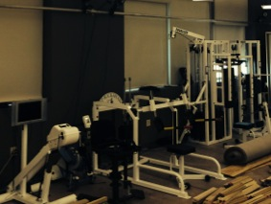
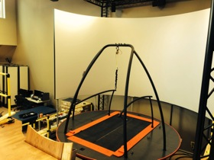
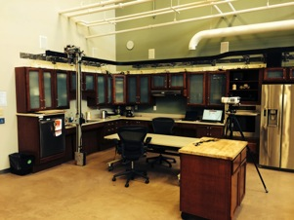
Ideate
Design
Prototype
Evaluate
Notes:
Antoher place we test is in clinics—including field trials in Mexico

Slide 11
Industry-Sponsors & Collaborations

Slide 12
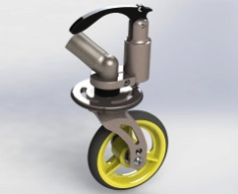
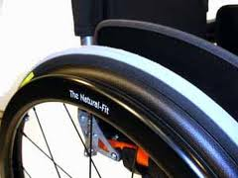
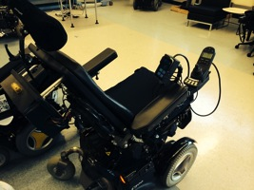
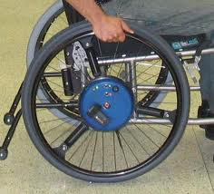
Outputs
Client-Centered Design Course Series
Research Experience for Undergraduates (REU)
Technology Innovations for People with Disabilities (TIPeD)
Experiential Learning for Veterans in Assistive Technology and Engineering (ELeVATE)
Advanced Inclusive Manufacturing (AIM)
Research Experience for Teachers (RET)

