Slide 1
Intercollegiate Student Projects as Tools for Developing the Entrepreneurial Mindset and Competencies in Engineering Students: Lessons learned
Kenneth Bloemer², Rebecca Blust², Edmond Dougherty⁴, Brian Garner¹, John Hageman², William Jordan¹, Darrell Kleinke³, Nassif Rayess^{3*}, and George Simmons⁴
¹Baylor University, ²University of Dayton, ³University of Detroit Mercy, ⁴Villanova University

Slide 2
Entrepreneurial Engineering Outcomes
Source: www.keenetwork.org

Slide 3
Entrepreneurial Engineering Outcomes
Source: www.keenetwork.org

Slide 4


Types of Intercollegiate Project:
Competitions
Collaborations

Slide 5




Benefits of Collaborative Projects

Slide 6
Meeting Structure
1st Semester
2nd Semester
Customer discovery
Concept design
Detail design
Prototyping
1
2
3,4
5
Faculty pre-course meeting
Student kickoff meeting (face to face)
Mid-project student meeting
Mid-project faculty meeting
Final Meeting (students and faculty)
Plus, weekly virtual meetings

Slide 7
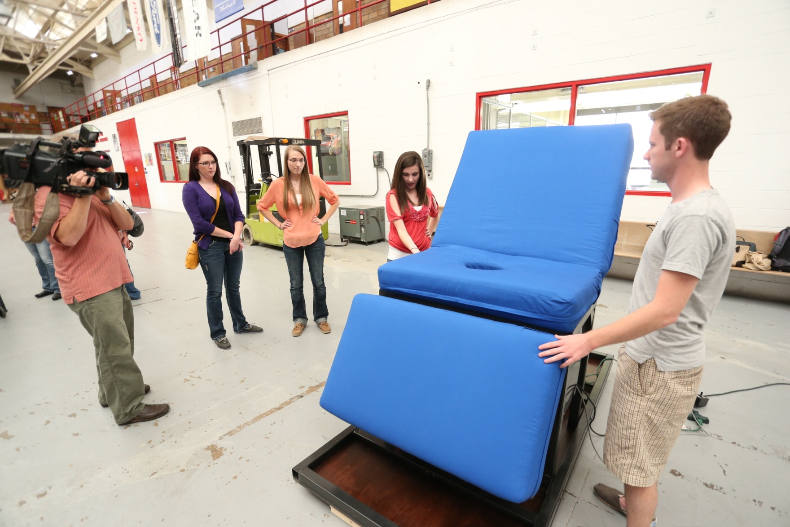
Medical Bed with Integrated Commode
Collaboration throughout entire process
Customer discovery
Concept design
Detail design
Prototyping
Collaboration

Slide 8
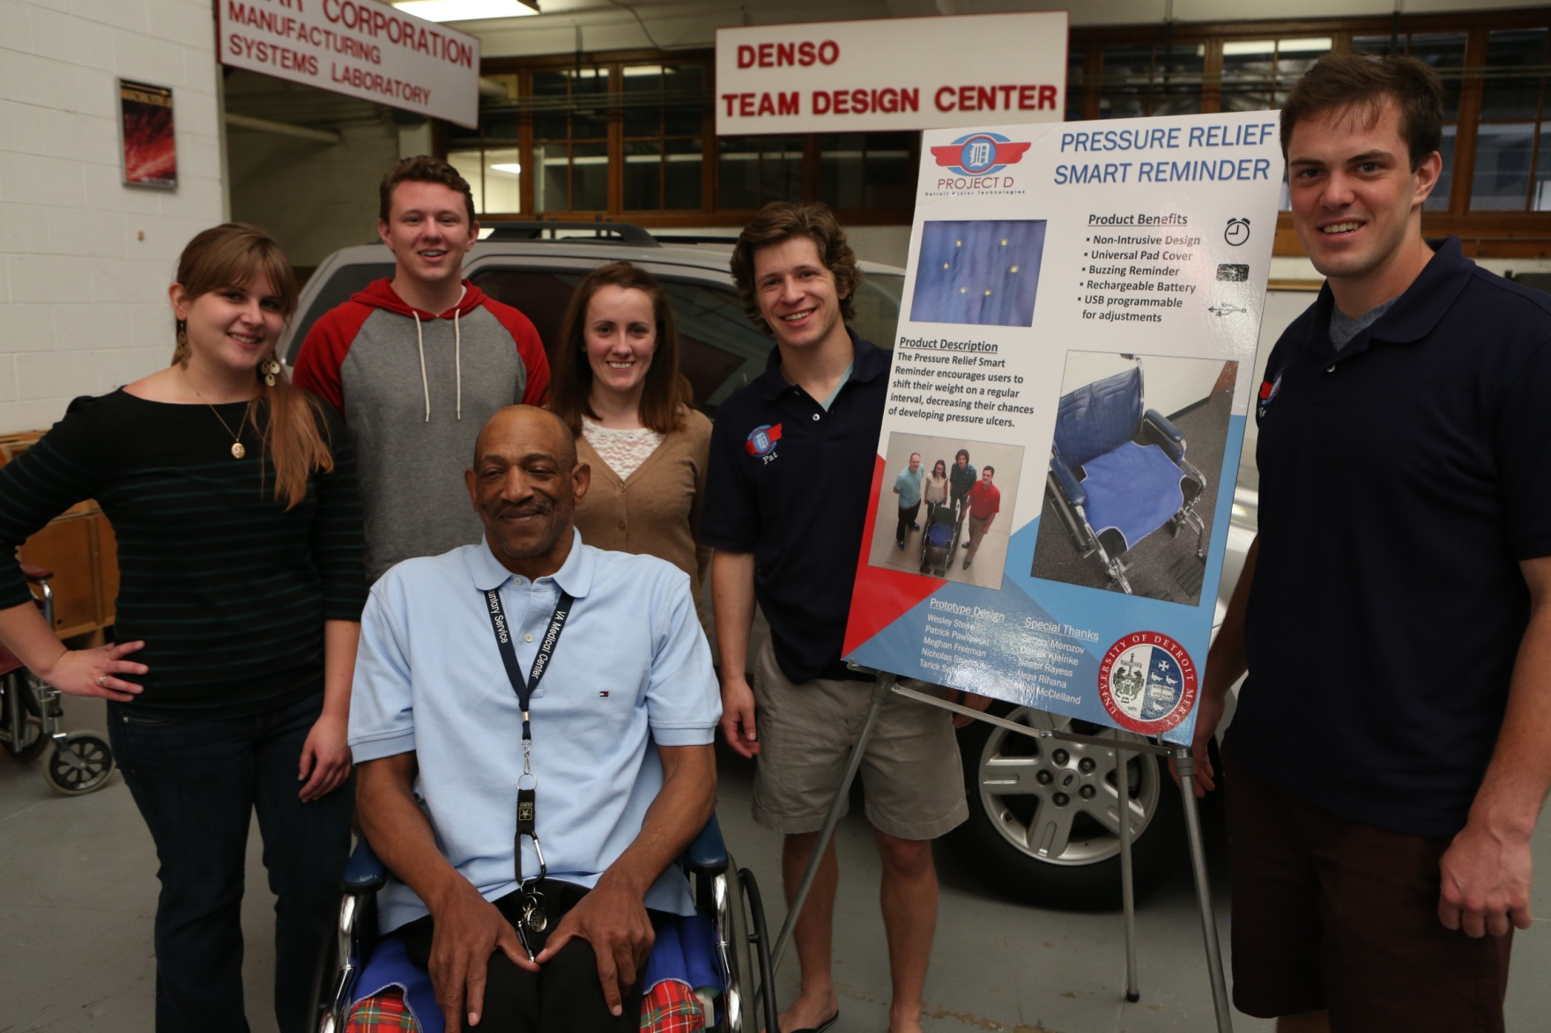
Pressure Sore Mitigation System
Collaboration effectively ended at prototyping
Groups created complimentary, but independent subsystems
Customer discovery
Concept design
Detail design
Prototyping
Collaboration

Slide 9
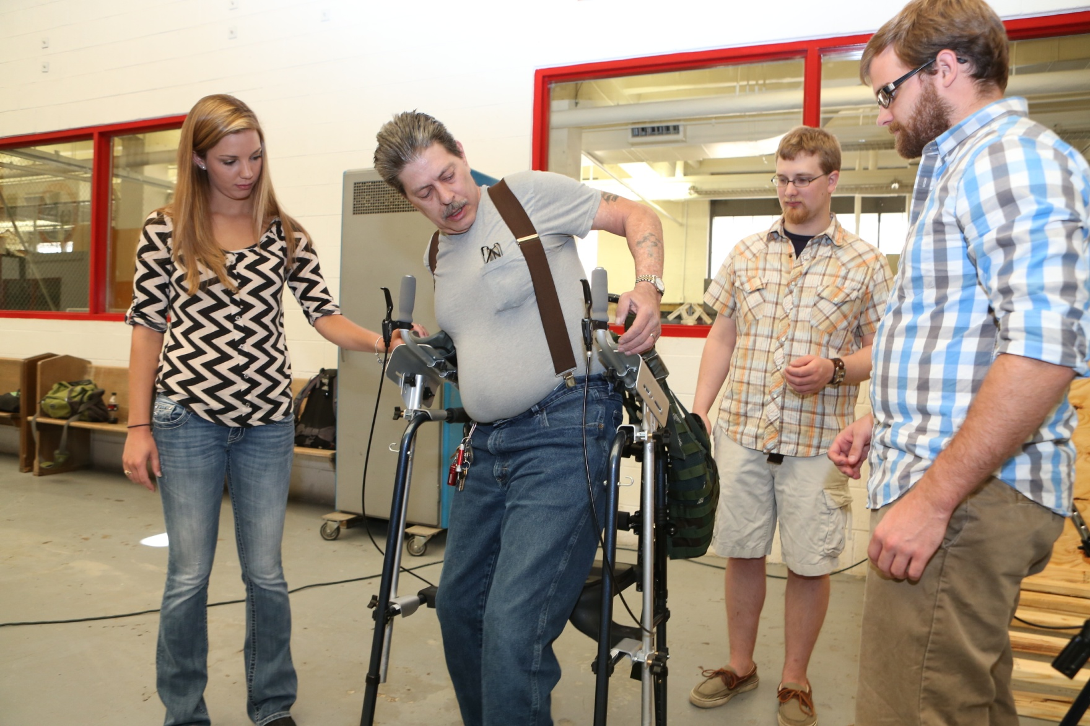
Customized Walker System
Collaboration ended at detail design
Groups created redundant and independent prototypes
Customer discovery
Concept design
Detail design
Prototyping
Collaboration

Slide 10
Lessons on Collaboration
Students will not collaborate on their own.
Faculty cannot force collaboration.
Project must motivate the collaboration.

Slide 11
Project must motivate the collaboration
Takeaway 1:
Limit the resources (time, money, skills…).
If they can deliver a prototype on their own, they will.

Slide 12
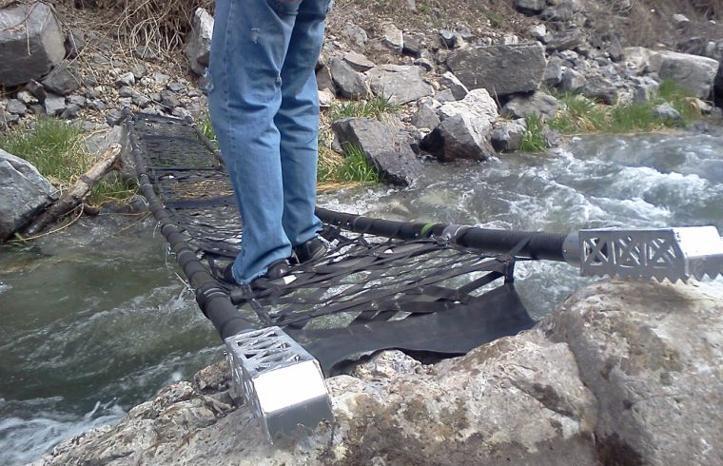
Project must motivate the collaboration
Takeaway 2:
Beware of competitions.
Use a project where the client is the winner.

Slide 13
Lessons on Communication
Virtual communication is not natural.
Students will communicate, but only as long as they have to.

Slide 14
Virtual communication is not natural
Takeaway 1:
It is a lot easier to communicate with one’s friends.
Bring students together in one location at the beginning for a multi-day team building exercise.
Geographical proximity is very useful

Slide 15
Virtual communication is not natural
Takeaway 2:
Conflict resolution cannot happen online.
Bring students together in one location midway through the process.

Slide 16
Students will communicate, but only as long as they have to.
Takeaway 1:
Communication drops off once information flow is no longer critical.
Prototyping sub-systems that must interface is best.

Slide 17
Lessons on Team Makeup
Intercollegiate collaborative projects involved a disproportionate number of female students.
Teams which included female students were more successful that all-male students.
These are observations only, need controlled experiments to draw proper conclusions.

Slide 18
Student Feedback
Students overwhelmingly indicated that the collaborative intercollegiate design experience is valuable for their job search. “That’s all they wanted to talk about” said one student who just went through a job interview, referring to the interviewers’ strong interest in the intercollegiate project.

Slide 19
Conclusions and Future work
Intercollegiate collaborative projects bring high perceived value to students and their careers.
Mindset and competencies surveys are not yet complete.
Can be done effectively and without excessive demands on resources.

Slide 20

Acknowledgement

