Slide 1
3/22/2014
Molly Wasko, UAB School of Business
mwasko@uab.edu

Slide 2
Agenda
About UAB
How did we get here
Overview of i2i program
Teams and Technologies
Team Experiences
Impacts at UAB

Slide 3
About UAB
Largest employer in the state of Alabama with 18,000 employees
Economic impact that exceeds $4.6 billion in B’ham area
Commercial center of the state
More than 17,500 students
31st nationally in federal research funding
20th in funding from the National Institutes of Health (10th among public universities)
External research funding exceeding $460 million
…….We don’t have the football team

Slide 4
Started with a Spark

Slide 5
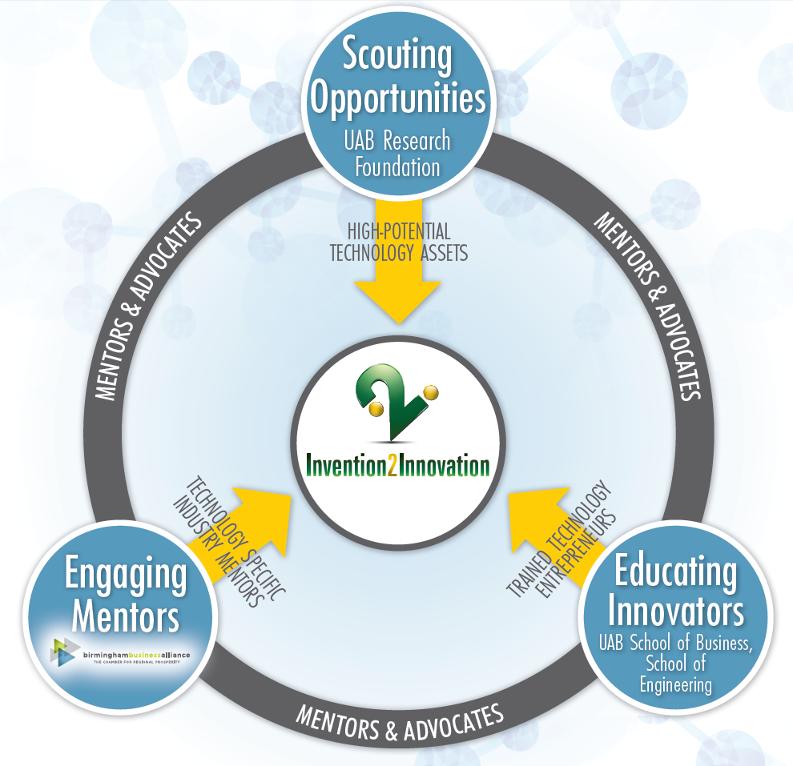
The i2i System

Slide 6
Scouting Opportunities

Slide 7
Educating Innovators

Slide 8
Engaging Mentors

Slide 9
The Implementation
Reviewed IP “shelf” in summer 2012 for HPTA
Competitive review of graduate students
Teamed MBA and Graduate Student from STEM
3 course sequence, with 1 credit hour DIS
Tuition covered + $5,000 project funds
Year long project: fall, spring, summer
Added mentors after fall class with a “pitch”

Slide 10
Totally X-ing Boundaries
Business
Biomedical Engineering
Dentistry
Optometry
Minority Health
Division of Preventive Medicine
Biophysical Sciences Center
Biochemistry and Molecular Genetics
Public Health
Research Foundation
Birmingham Business Alliance
Innovation Depot
Business Community

Slide 11
I Need Help
To Get My
Smile Back!
Notes:
People lose teeth everyday, - it’s currently a $3.5 billion market – and most of the time it’s the result of an accident but sometimes it’s caused by a medical necessity – gum disease or some other condition. When a person loses a tooth, he or she has several different options but they all have limitations. The most common limitation is time to repair – in many cases it can take six months from your first visit to the dentist until you’ve got your old smile back, that’s a long time to wait if you’ve got something to do – other than wait around with a hole in your mouth.

Slide 13
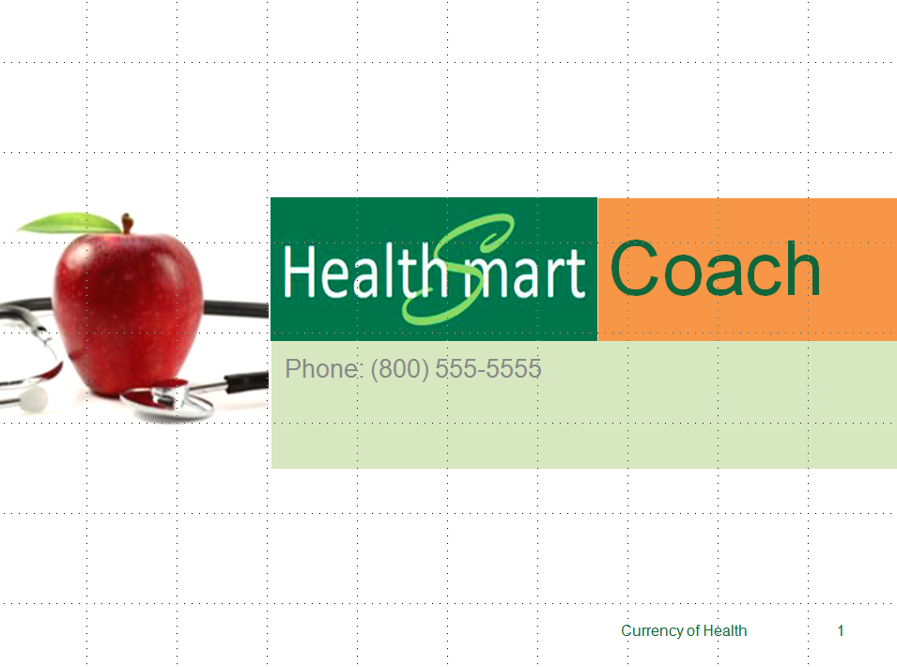

Slide 14
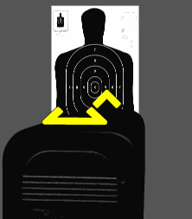
Opti-Sight
Easier, Faster more Accurate

Slide 16
Team Experiences
Team building and conflict management skills
Ownership of the idea; TechTransfer involved
Lead with project management skills
Active, available inventors and mentors
Dedicated faculty time
Finale’ event to celebrate
Schedule mentors time in advance

Slide 17
Realized Impacts
Institute for Innovation, Entrepreneurship and Commercialization launched 2013
Office of Innovation and Entrepreneurship in Collat School of Business 2014
Implementation academic programs
Minors, concentrations
Senior design capstone with BME
SciTech Honors College
MS in BME with concentration in Entrepreneurship

Slide 18
Innovation to Impact
Leveraged the NCIIA investment as the catalyst to build an entrepreneurial mindset across campus and the community

