Slide 1
Empowering the Tinkering Spirit
Don Lewis Millard, Ph.D.
National Science Foundation
dmillard@nsf.gov

Slide 2
Innovators...
Develop Solutions
Identify
Problems
Problems...
Thinkers
Those who think...
Those who tinker...
+

Slide 3
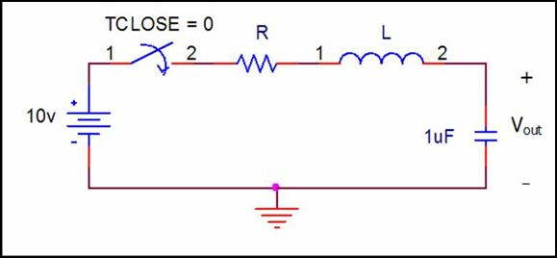
Training
2
2 + 3
5
3
10v
Given this input…
Analyze this system…
To get this output…

Slide 4
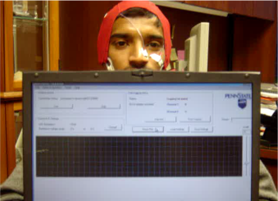
Career
10v
Given this input…
w/this desired output…
Design… this system

Slide 5
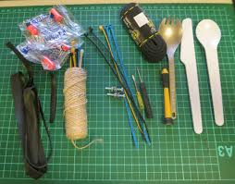
Integration + Synthesis

Slide 6
Childhood Toy

Slide 7
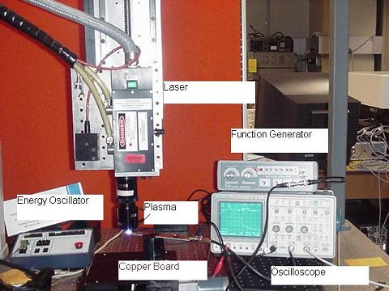
PhD Toy

Slide 8
Later in life...
Your leader
Your public
Your experience
Your heart

Slide 9
An Honor

Slide 10
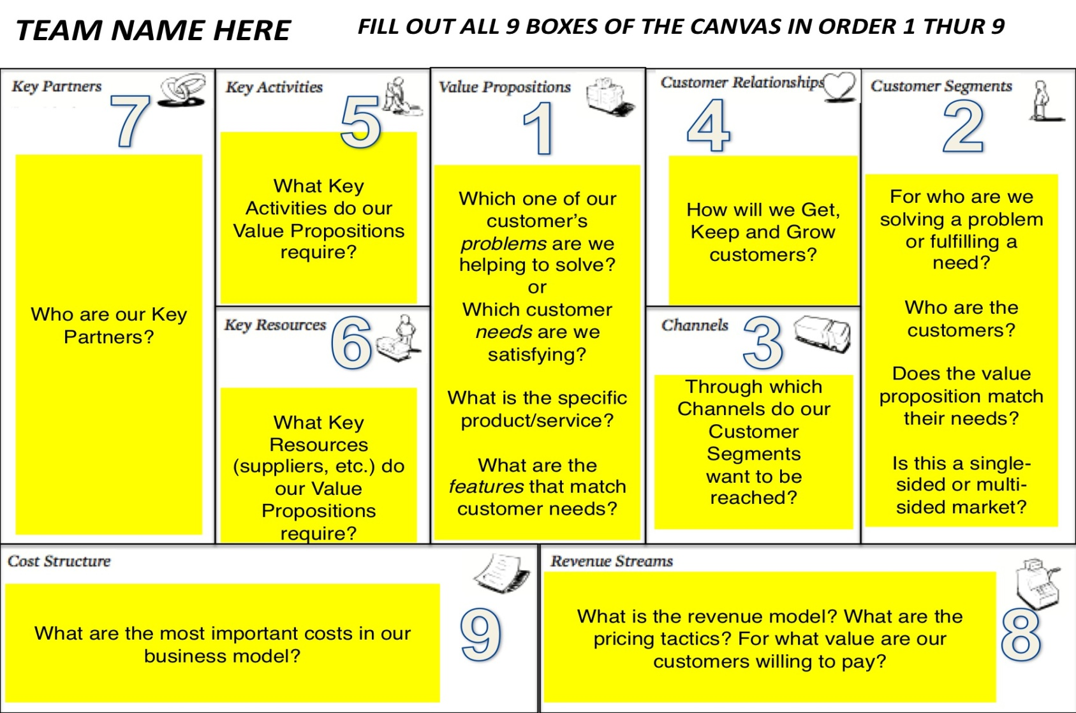
A Simple Strategy
Develop Hypothesis
Design Experiment
Test Hypothesis
Gather Insight

Slide 11
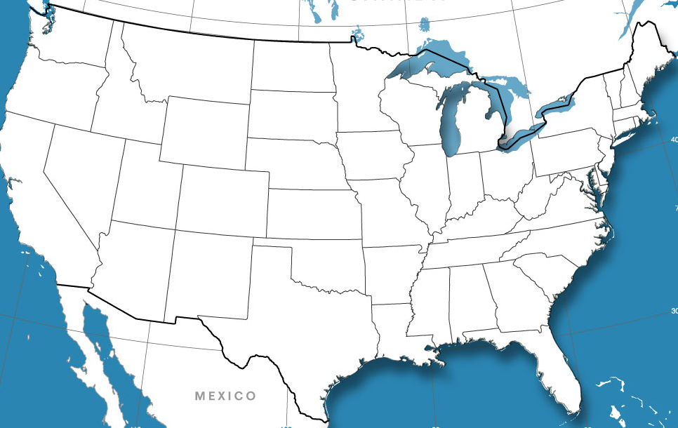
Building an I-CorpsTM “Fabric”
I-Corps™ Nodes (5)
I-Corps™ Sites (4)
I-Corps™ Mentors (>250)
I-Corps™ Teams (>300)

Slide 12
Two Years Later…
I-CorpsTM Teams
> 300
Curriculum Delivery
Start-Up creations
Mentor network
SBIR/STTR proposal submission to various agencies
One acquisition
Private investments
I-CorpsTM Nodes (5)
I-CorpsTM Sites (4+)
MOU with ARPA-E
More to come...

Slide 13
Epicenter - Goals
Propagating effective and accessible innovation and entrepreneurship offerings for engineering students
Faculty and student training, materials and resources to develop strong innovation and entrepreneurship offerings
Implementing innovation and entrepreneurship instruction – as a key priority for the future health of our nation

Slide 14
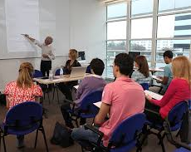
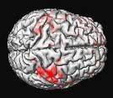
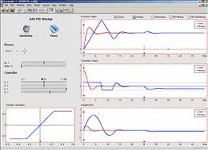
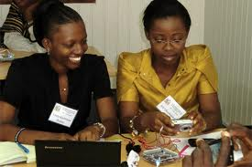
Opportunity Abounds
Identify Problems
Tinker
Innovate

Slide 15
Thanks.
dmillard@nsf.gov

