Slide 1
Social Entrepreneurship Fieldwork:
Student self-reported outcomes
Katelyn Holmes, Abdalla Nassar, Khanjan Mehta
Humanitarian Engineering and
Social Entrepreneurship (HESE) Program
The Pennsylvania State University

Slide 2
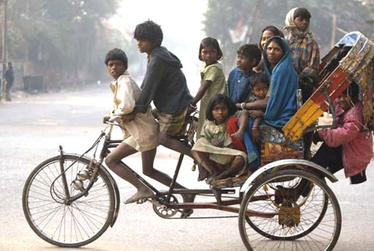
Global Developmental Challenges
Notes:
The Humanitarian Engineering and Social Entrepreneurship (HESE) Program engages students and
faculty across Penn State in the rigorous research, design, field-testing, and launch of technology-based social
enterprises.

Slide 3
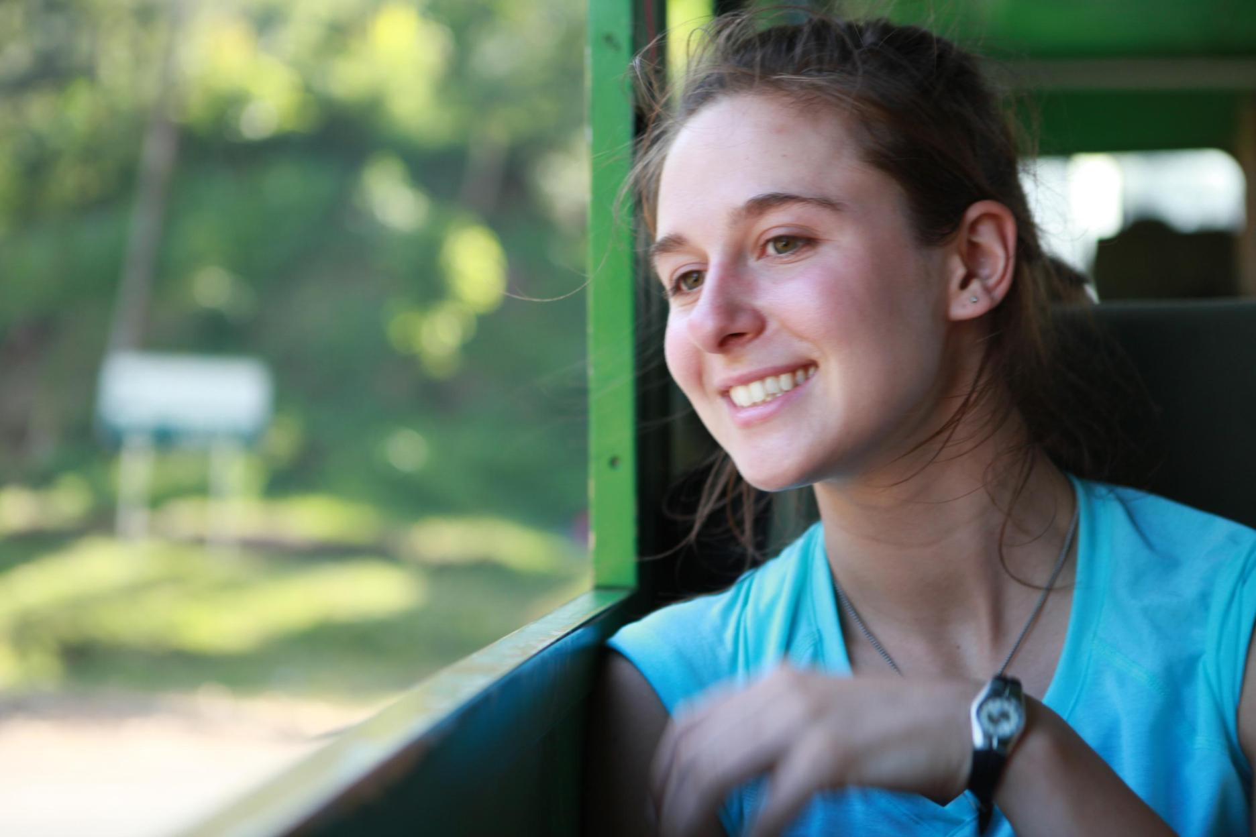
HESE Academic Program

Slide 4
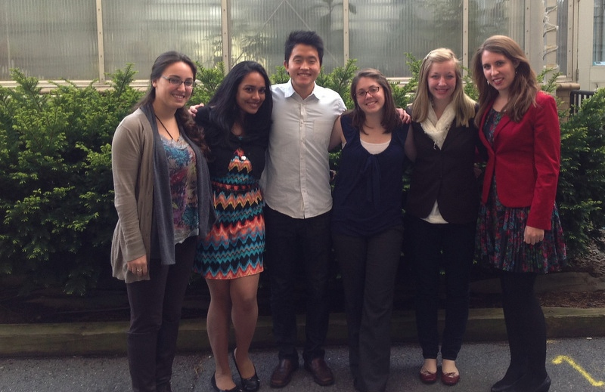
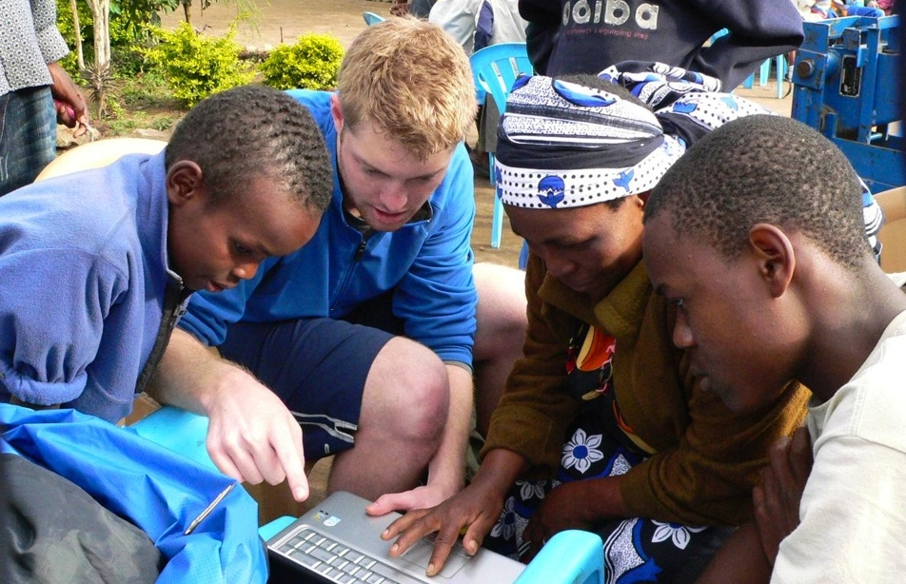
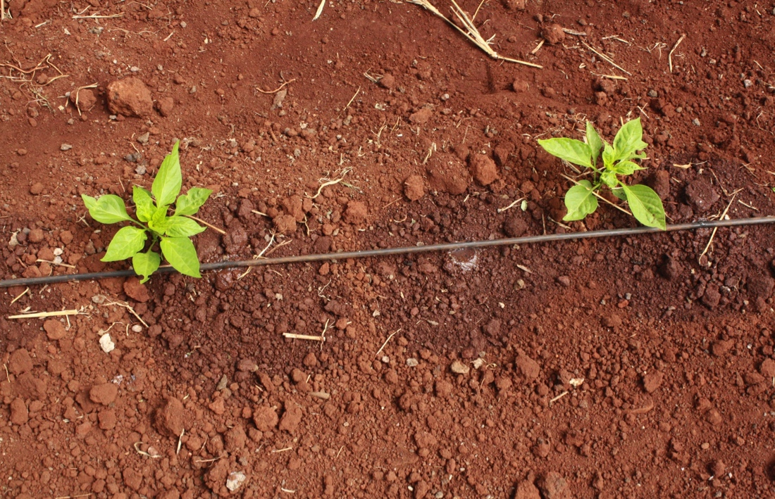
Convergence for Impact
Concepts, Disciplines and Epistemologies | Cultures and Countries
Learning, Research and Engagement | Academia, Industry, Govts & Nonprofits

Slide 5
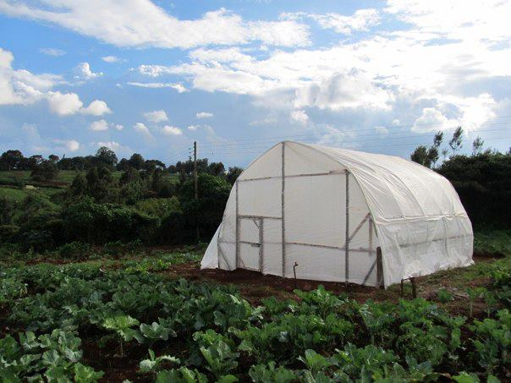
Affordable Greenhouses
Design
Notes:
Affordable…but it still needs to look sexy

Slide 6
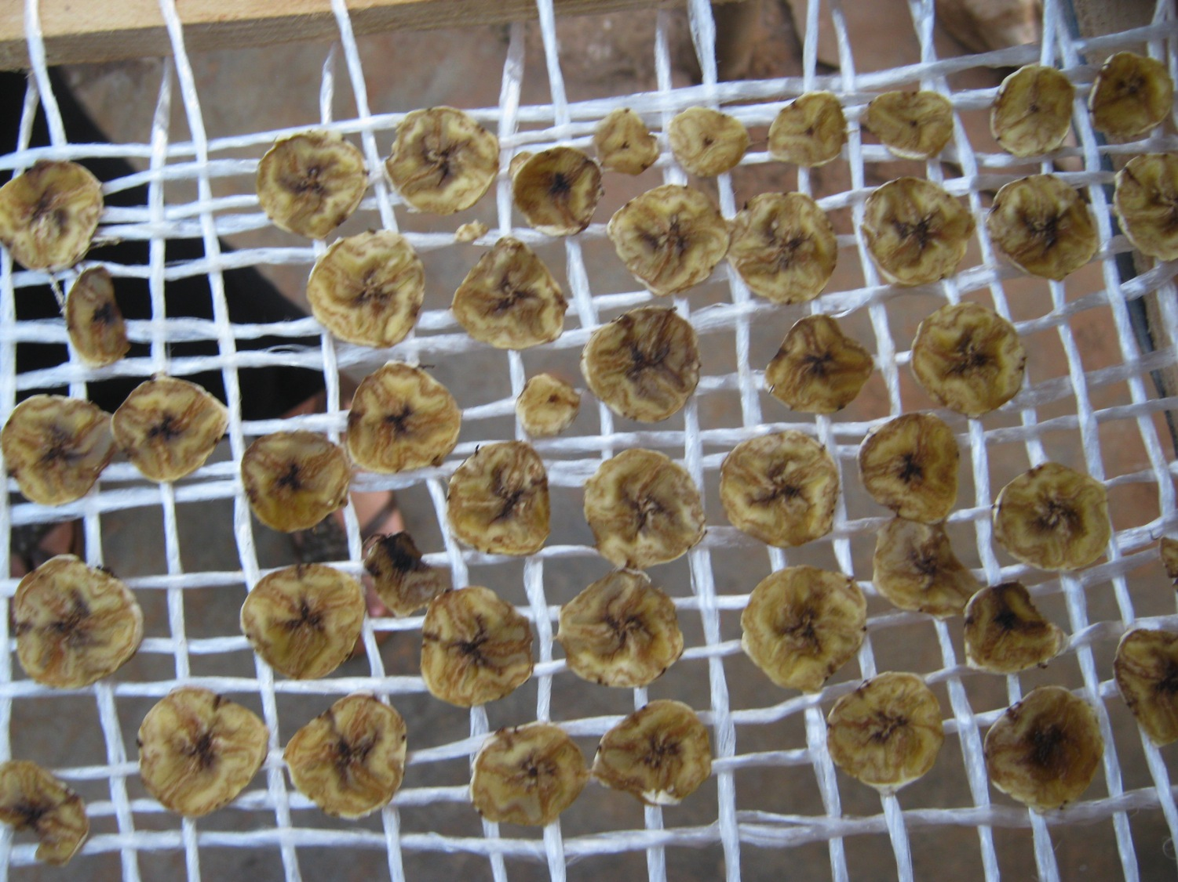
$250 Solar Food Dryers
$200 Solar Food Dryers

Slide 7
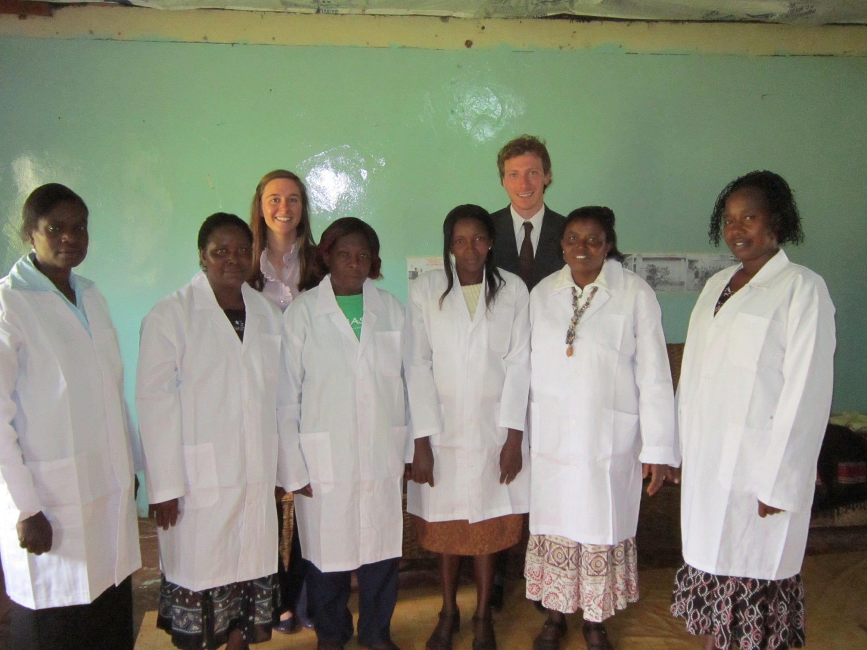
Current employees
Current Mashavu Social Franchisees
Eunice Ann Salome Margaret Lillian Ann
Notes:
They are…

Slide 8
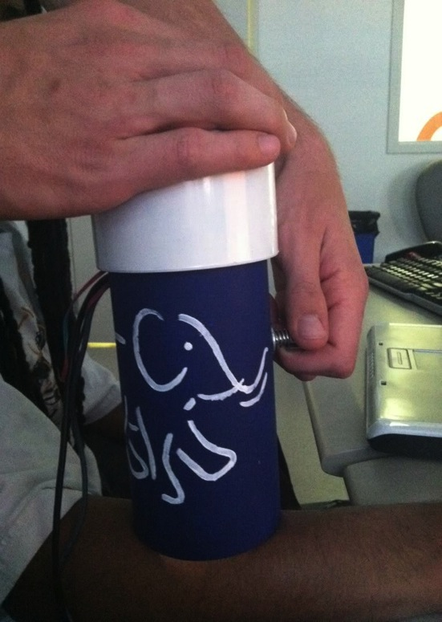
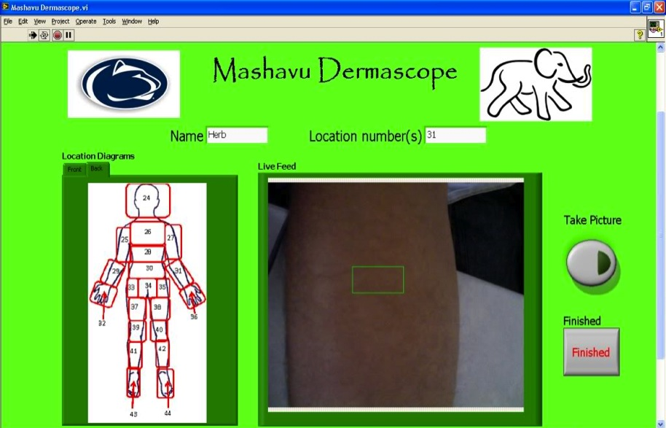
Mashavu $10 Dermascope

Slide 9
2 Cent Test Strip for UTI Detection

Slide 10
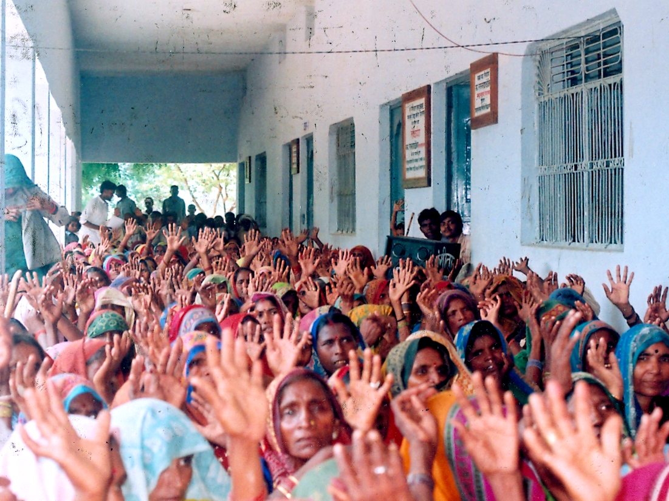
Design with Communities
Commercialize for Markets
Notes:
>> Problem of scale
>> 1, 2, 10 people…or we can focus on scale.
>>
>> TA: Design for scale…support co-creation so that ecosystems arise around your ventures

Slide 11
HESE Coursework
Cert. in HESE | Minor in ENTI: Social Eship

Slide 12
eplum Model of Engagement
80
Students
400
Students
HESE1
BIOE
401
ED
100
HESE
2
ME
440
Ind
496
Design for Developing Communities
HESE
3
ED
509
BA
301
HESE
4
ENGL 202C
EE
403

Slide 13
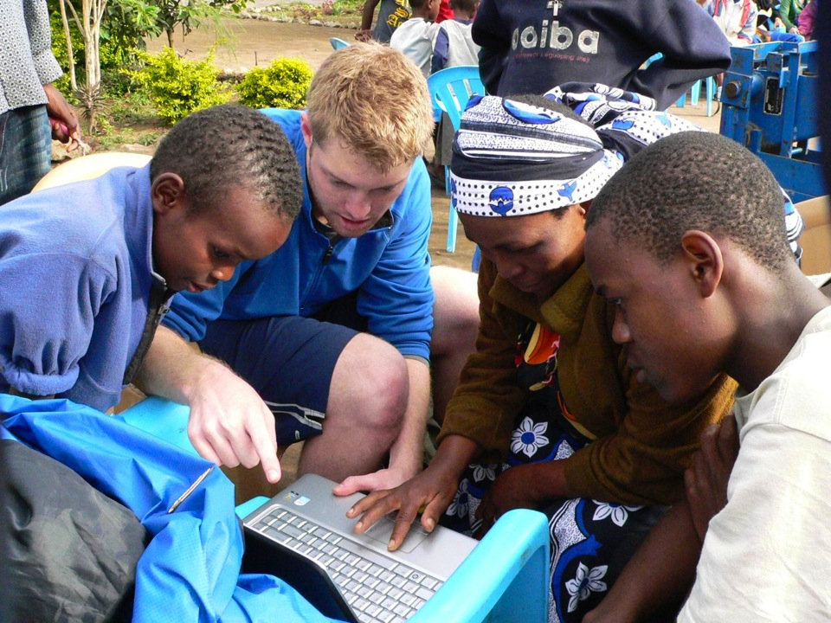
`
HESE: Student Experience
Notes:
Building ecosystems needs time, expertise
Universities are best-suited to develop and nurture these eco-systems
>> We need educational ecosystems to develop these entrepreneurial ecosystems
>> Convergence
>> Disciplines, Cultures, etc
>>TA: Diversity and Innovation are our primary competitive advantages

Slide 14
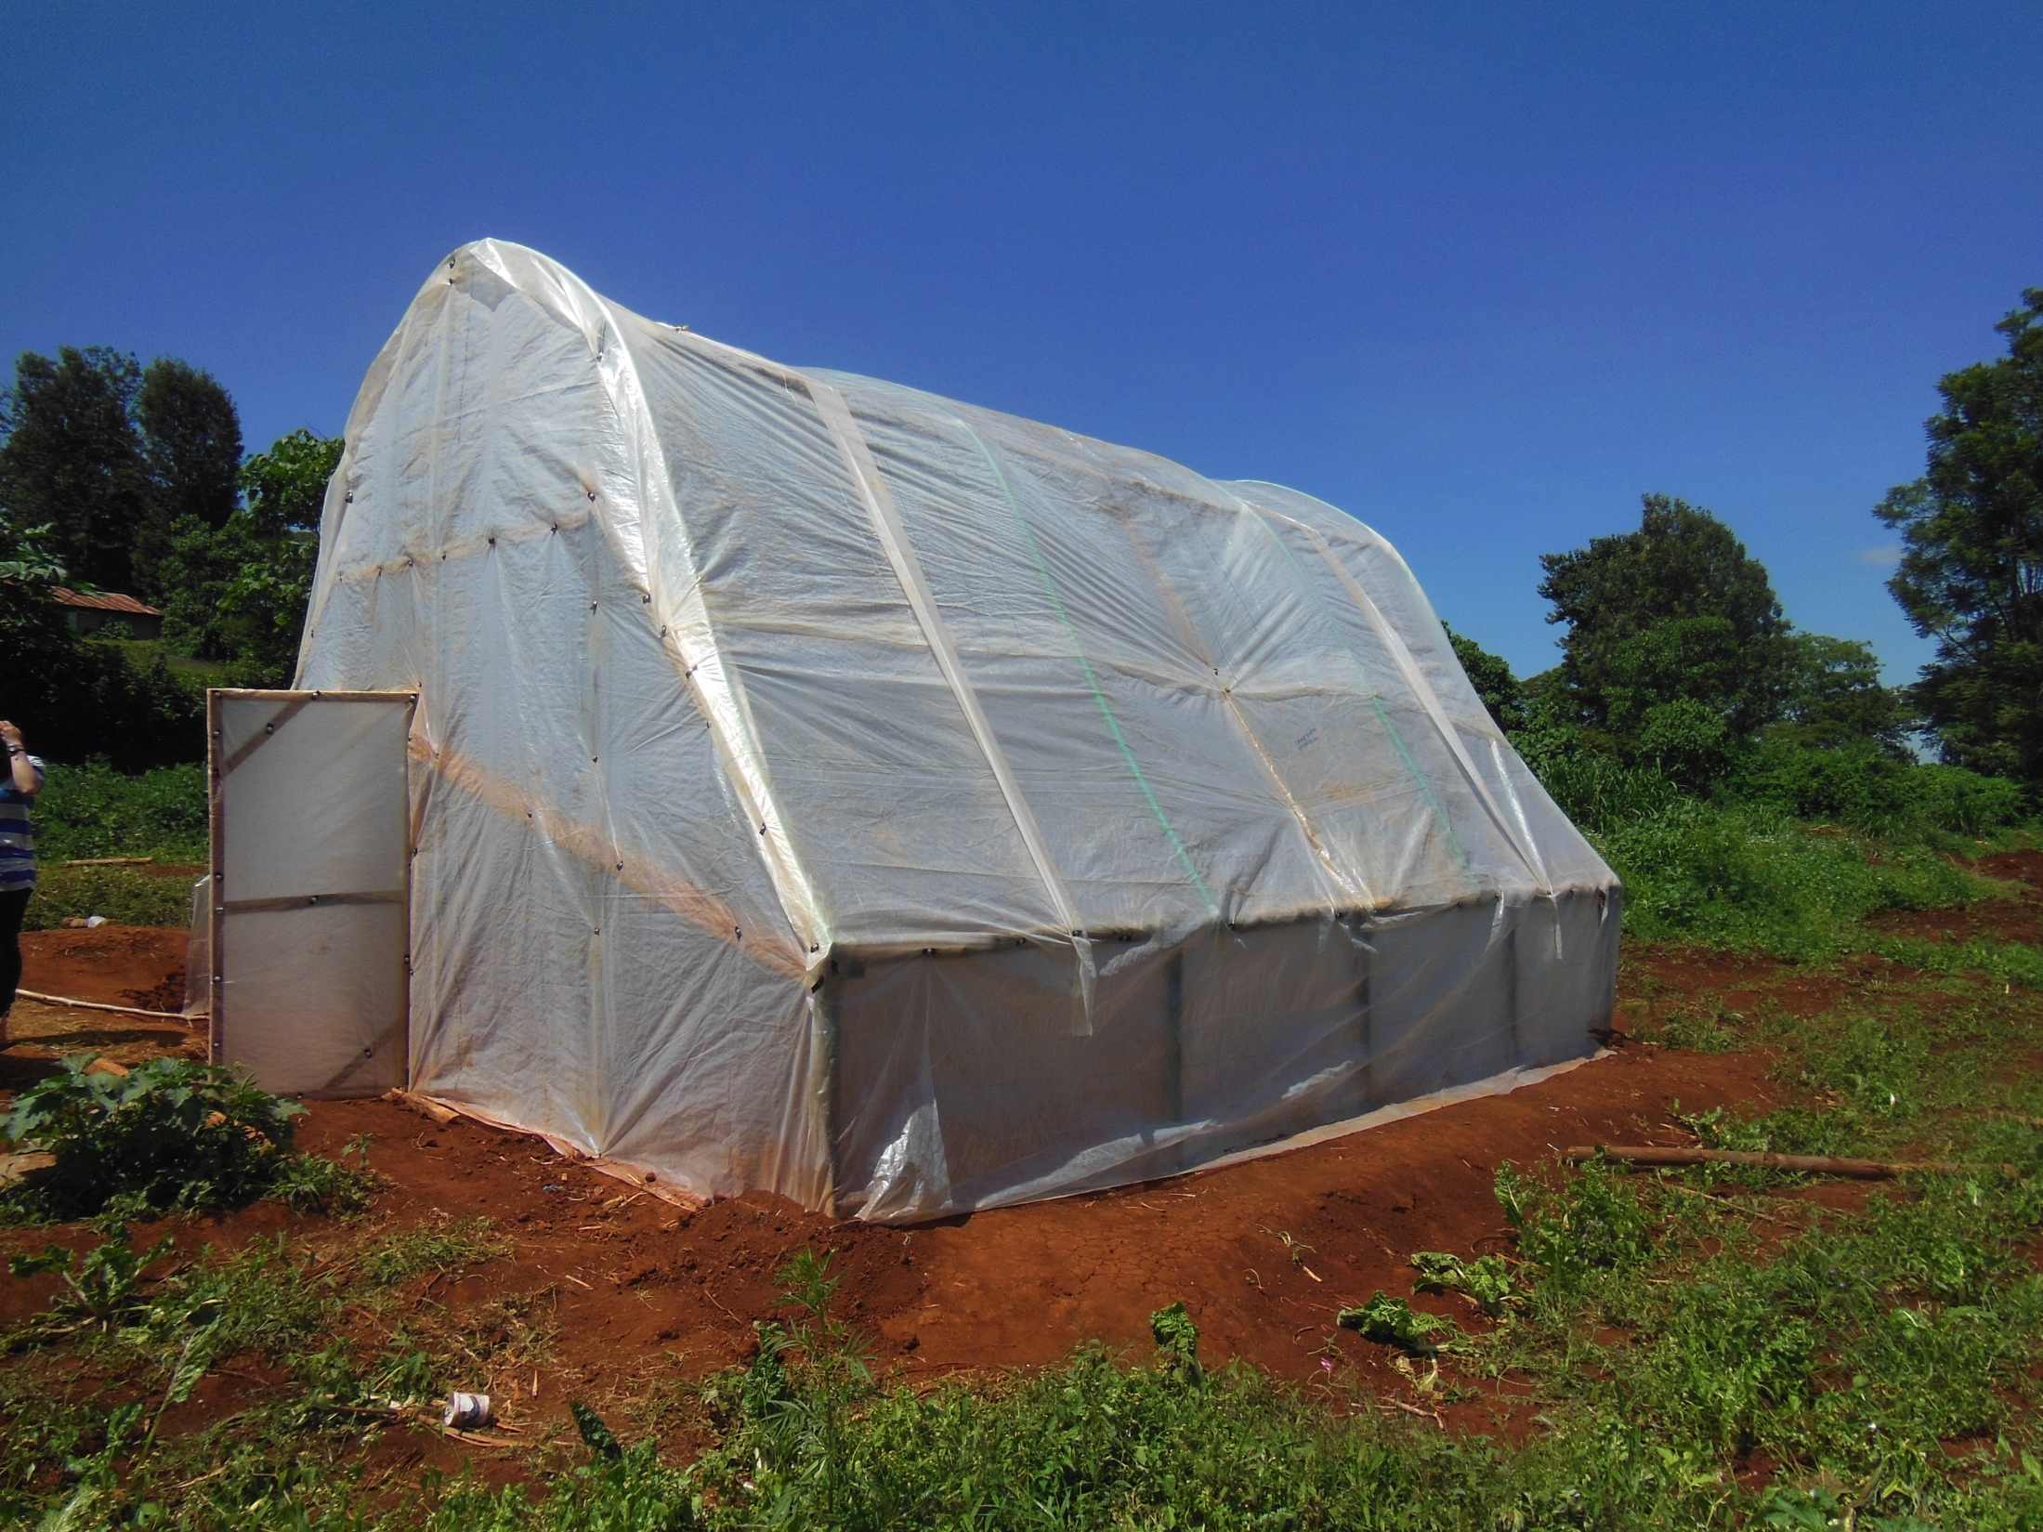
Research Glazing Substitutes
Researching Glazing Substitutes

Slide 15
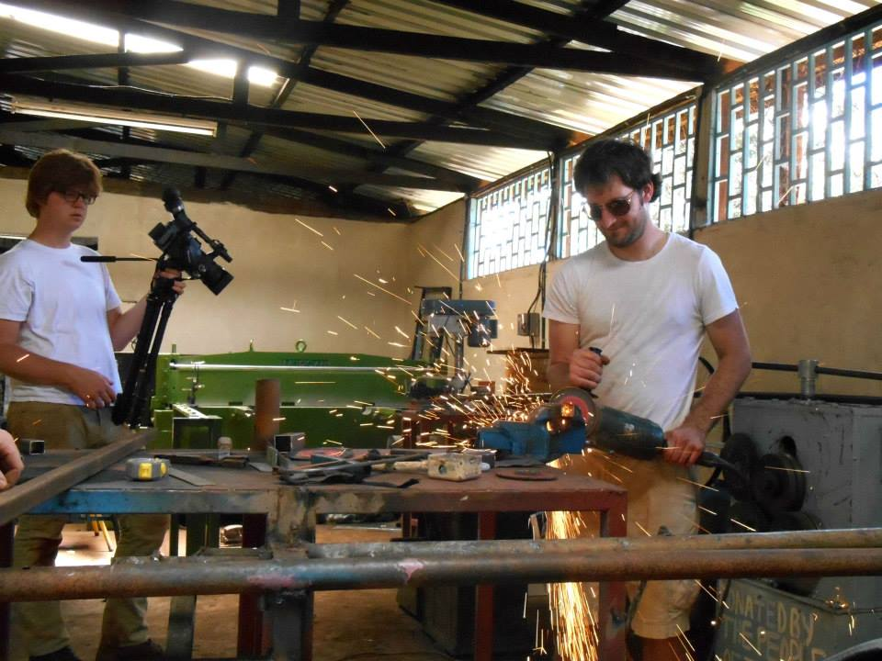
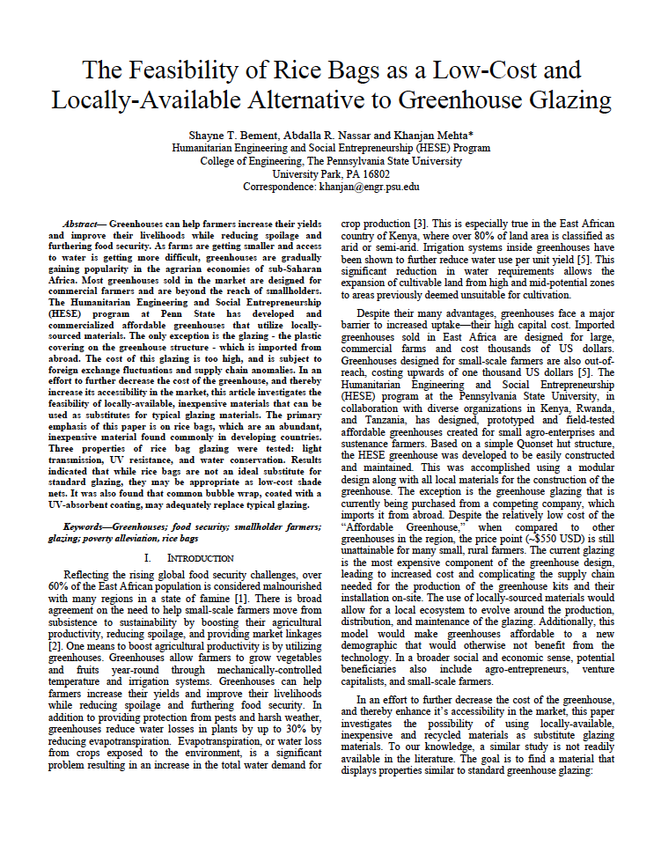
Classroom to Metal Shop
Classroom to Metal Shop

Slide 16
Radical Collaboration
Notes:
Radical Collaboration (better picture when I get home)

Slide 17
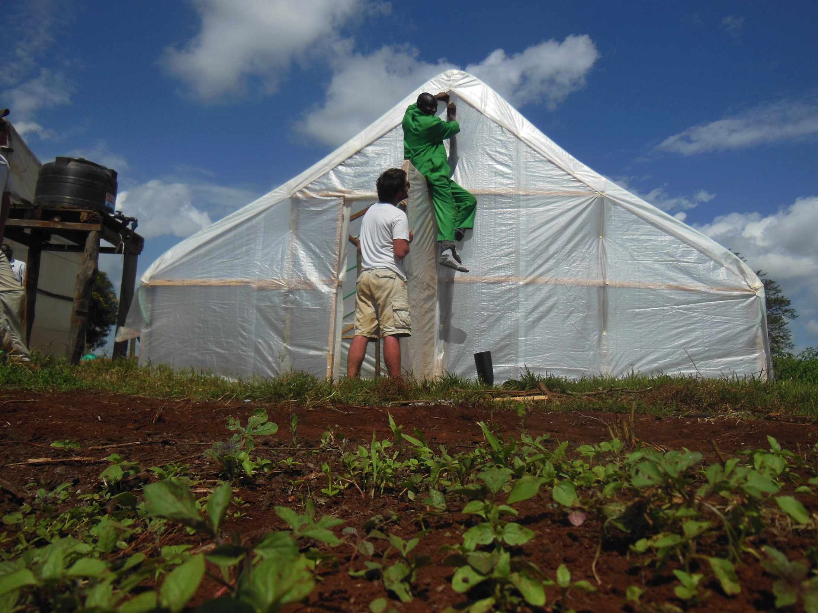
Radical Collaboration
Notes:
Radical Collaboration (better picture when I get home)

Slide 18
Programmatic Learning Outcomes
Human-Centered + Context-Driven Design
Social Entrepreneurship
Global Engagement
Systems Thinking
Ethical Reflection
Multidisciplinary Teamwork
Communication
Scholarly Research and Publication

Slide 19
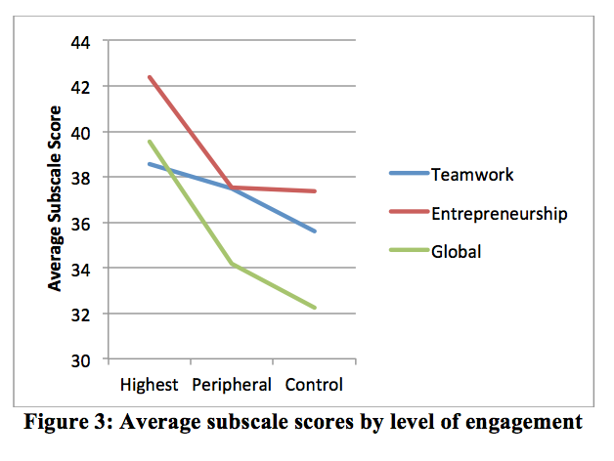
Pre-Post Surveys
Mehta, K., Zappe, S., Brannon, M., Zhao, Y., " An Educational and Entrepreneurial Ecosystem to Actualize Technology-Based Social Ventures”,
Special Issue of Advances in Engineering Education on Engineering Entrepreneurship Education (Under Review)

Slide 20
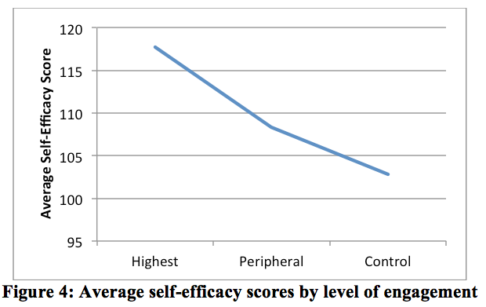
Pre-Post Surveys

Slide 21
Student Reflection
What are the top three things you learned during your HESE trip this Summer? Please elaborate.
How did the HESE trip facilitate your professional development? Please provide three examples.
How did the HESE trip help you grow personally? Please provide three examples.

Slide 22
Methodology
Content analysis
Coding schema developed from data
Compared responses between four researchers, adjusted the schema as necessary
Student responses and demographics imported into Nvivo
Themes compared within/across individuals

Slide 23
High-Level Coding Schema
Notes:
These are the “parents” of the code families. The size of the code in this slide is proportional to its frequency in the data.

Slide 24
Uniform Reporting Across Categories
Notes:
High reporting rates across all categories. The average student self reported learning outcomes in over 4 out of the six identified parent categories
Professionalism and personal development are the most highly reported.

Slide 25
Professional Growth
Notes:
Non-tech students appear to benefit more professionally. Learning or honing skillsets related to their skillset is the most self-reported code in both.

Slide 26
Personal Growth
Notes:
Sub categories of personal development.

Slide 27
Theory vs. Practice
Notes:
Non-tech students appear to benefit more professionally

Slide 28
Intercultural Competency
Notes:
Possible quotes:
“Although I was struggling to figure out the system that I thought seemed paternalistic and slightly ridiculous in that people needed “permission” from their superiors to simply talk to someone about their job, but what I realized is that at that moment, it didn’t matter what I did or did not think about the system. What did matter was at that moment, we had to work within it to get the information we needed [32].”
“ For instance, meetings with James Muiga of Wambugo Farms, a senior employee of a government ministry, were very informal and often involved a leisurely walk around the facilities. While meetings with executives of Taifa Sacco in their offices were more professional and structured with a clear agenda. Finally, when meeting the self-help groups in their environment the meetings had a clear agenda but unfolded in a very natural way. To sum this one up, I was already comfortable conducting business meetings, but this trip illustrated the need to adapt the meetings to the needs of the other party [056].”

Slide 29
Personal Development
Notes:
These are the individual codes within personal development
Common themes include gaining a better understanding of the commonalities of humanity or connecting with individuals. Here are some of the words students used to discuss their experiences…
“Humanity and humor transcend race and culture. My best memories of the trip are of when a Kenyan and I ended up laughing at the same situations, such as Ernie and I on the back of pike-piki [015]”
“Through building relationships with local people, I gained insight into how to view situations from a global perspective. After gaining an understanding of a different culture, I can now appreciate the complexity that goes into how a person can view a situation [65].”

Slide 30
Personal Development
“Humanity and humor transcend race and culture. My best memories of the trip are of when a Kenyan and I ended up laughing at the same situations, such as Ernie and I on the back of pike-piki [015]”
“Through building relationships with local people, I gained insight into how to view situations from a global perspective. After gaining an understanding of a different culture, I can now appreciate the complexity that goes into how a person can view a situation [65].”

Slide 31
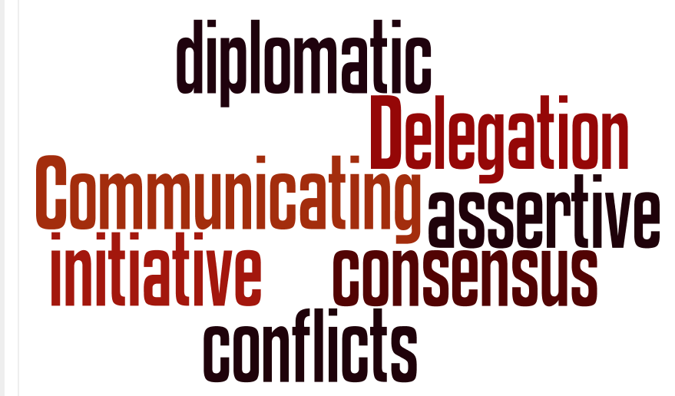
Teamwork
Notes:
Teamwork is essential to innovation. By engaging students in “living” projects, we force students to learn to work with others.
” Even when we disagreed about something, our team would eventually reach consensus that would reach a compromise much better than any individual thought. The sum of the parts as a whole is much greater than the sum of each separately [008].”
“As a generally passive person, I previously had problems in sticking with my decisions especially in the face of adversity. Often, I would drop my claims, just to stop the disagreement. However, the HESE trip showed me ways to keep to my resolve without letting the discussion elevate to an argument [065].”

Slide 32
Teamwork
” Even when we disagreed about something, our team would eventually reach consensus that would reach a compromise much better than any individual thought. The sum of the parts as a whole is much greater than the sum of each separately [008].”
“As a generally passive person, I previously had problems in sticking with my decisions especially in the face of adversity. Often, I would drop my claims, just to stop the disagreement. However, the HESE trip showed me ways to keep to my resolve without letting the discussion elevate to an argument [065].”

Slide 33
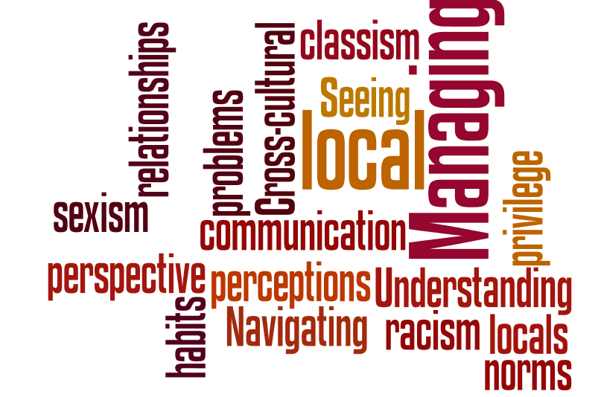
Intercultural Competency
Notes:
The world is composed of different people. Working in communities is complex and relationships are dynamic.
“ For instance, meetings with James Muiga of Wambugo Farms, a senior employee of a government ministry, were very informal and often involved a leisurely walk around the facilities. While meetings with executives of Taifa Sacco in their offices were more professional and structured with a clear agenda. Finally, when meeting the self-help groups in their environment the meetings had a clear agenda but unfolded in a very natural way. To sum this one up, I was already comfortable conducting business meetings, but this trip illustrated the need to adapt the meetings to the needs of the other party [056].”

Slide 34
Intercultural Competency
“ For instance, meetings with James Muiga of Wambugo Farms, a senior employee of a government ministry, were very informal and often involved a leisurely walk around the facilities. While meetings with executives of Taifa Sacco in their offices were more professional and structured with a clear agenda. Finally, when meeting the self-help groups in their environment the meetings had a clear agenda but unfolded in a very natural way. To sum this one up, I was already comfortable conducting business meetings, but this trip illustrated the need to adapt the meetings to the needs of the other party [056].”

Slide 35
Primacy of Capacity Building
We all are blind until we see
That in the human plan
Nothing is worth the making if
It does not make the man.
Why build these cities glorious
If man unbuilded goes?
In vain we build the world, unless
The builder also grows.
-Edwin Markham

