Slide 1
Student Leaders Shaping Campus Priorities
The Epicenter University Innovation Fellows Program

Slide 2
Epicenter
5-year NSF-funded initiative to transform undergraduate engineering education through three focused efforts:
research
faculty & institutional engagement
student movement

Slide 3
Activating Students for Rapid Impact
Focus students on the task of enhancing the Innovation Ecosystem with the goal of creating lasting institutional impact.
Pictured Above: UI Fellows at Stanford E-Week February 2013

Slide 4
Students’ Attitudes about Entrepreneurship Education
NO ENTREP COURSES
ENTREP COURSES
*
Aspirations and perceived impact
*
Offerings and opportunities
*
*
% agreement with statement
Notes:
sample of 501 engineering students in senior-level capstones, 3 large u’s with established entrepreneurial programs darker band is students who had not taken entre courses, lighter bar had.

Slide 5
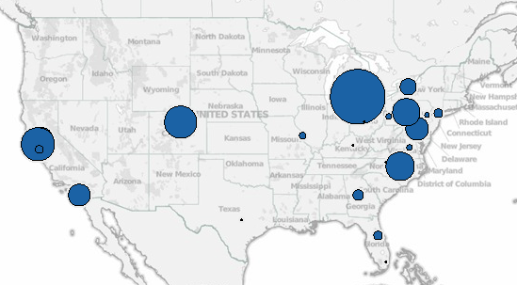
National Network, Breadth of Institutions
’12 - ’13
98 schools have now participated

Slide 6
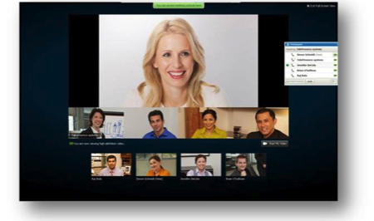
Training: 6 Weeks, Delivered via Facetime

Slide 7
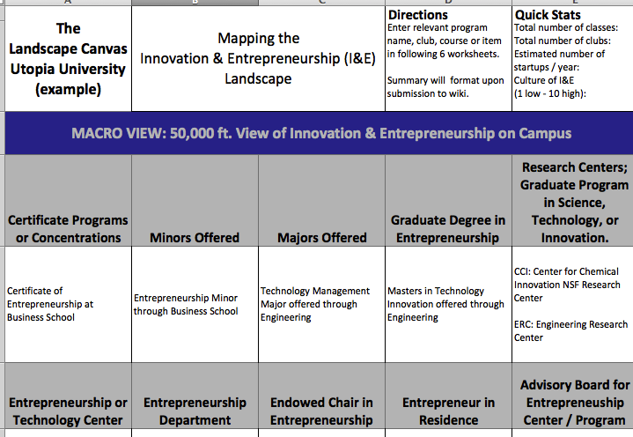
Highly-Experiential Learning

Slide 8
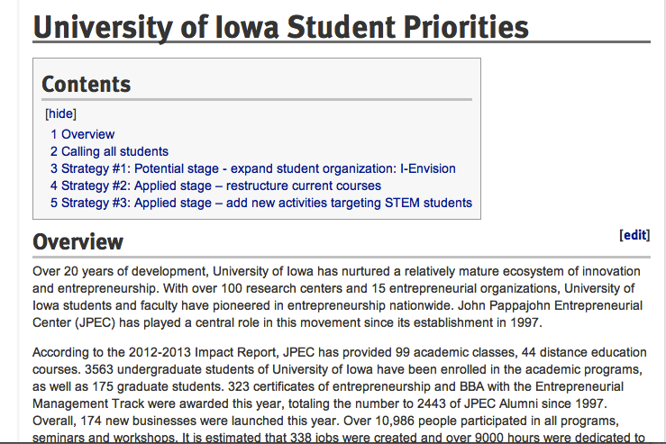
2-3 Year Action Plans

Slide 9
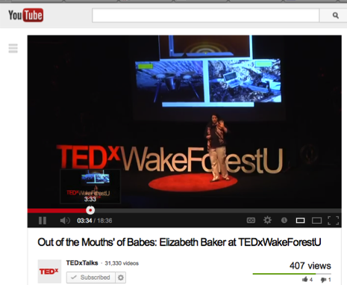
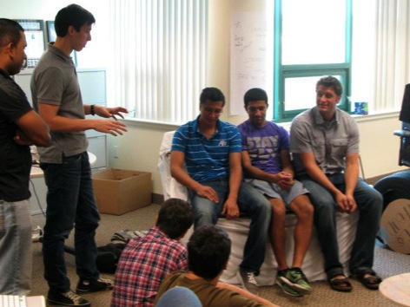
Students Deploy Diverse Strategies
Notes:
From the first 2 groups.

Slide 10
How to get involved
SUBMIT …
Student application
Faculty letter of support
Institutional sponsorship of $2,000
BY September 8th, 2014
TRAINING: Week of September 24 – November 4th
APPLY: http://www.dreamdesigndeliver.org

Slide 11
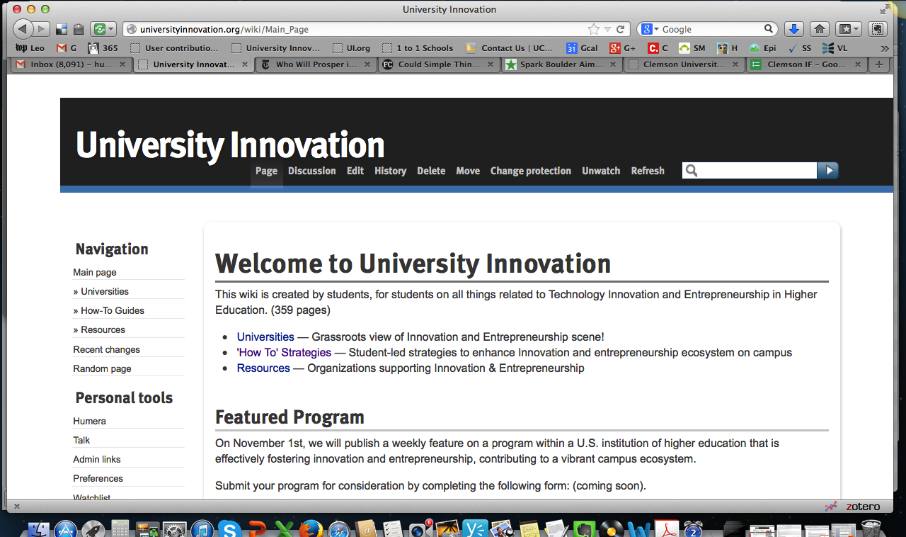
Learn More
universityinnovation.org
dreamdesigndeliver.org

