Slide 1
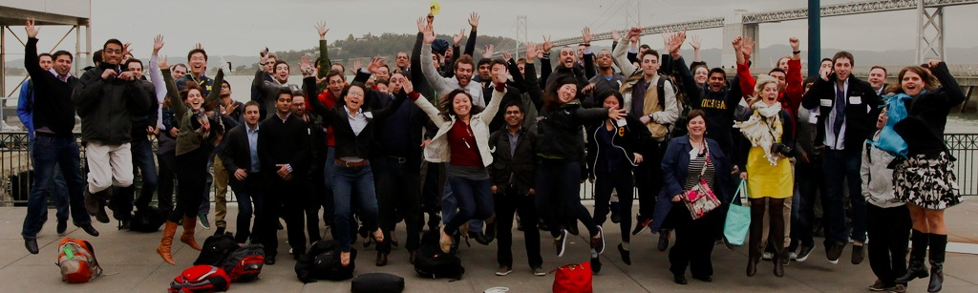

Student Leaders are Shaping Campus Priorities @ Michigan and Beyond
Aileen Huang-Saad, University of Michigan
Liz Nilsen, NCIIA
2014 NCIIA Open Conference

Slide 2
Agenda
The Premise of our Panel
Growth of Entrepreneurship @ UM
An Example of the Engine: 1000 pitches
Growing beyond UM: 1000 pitches Penn State
NCIIA University Fellows Program
Student Panel

Slide 3

Students are the Change Agent Engines on Campuses
Notes:
Students are the change agents on college campuses
Today – we wanted to demonstrate the effect of students movements through discussing what has been happening at University of Michigan over the last several years, giving an example of one of the major mechanisms students put in place to “spread the word” and then a description of how NCIIA is trying to seed these types of movements across other campuses

Slide 4
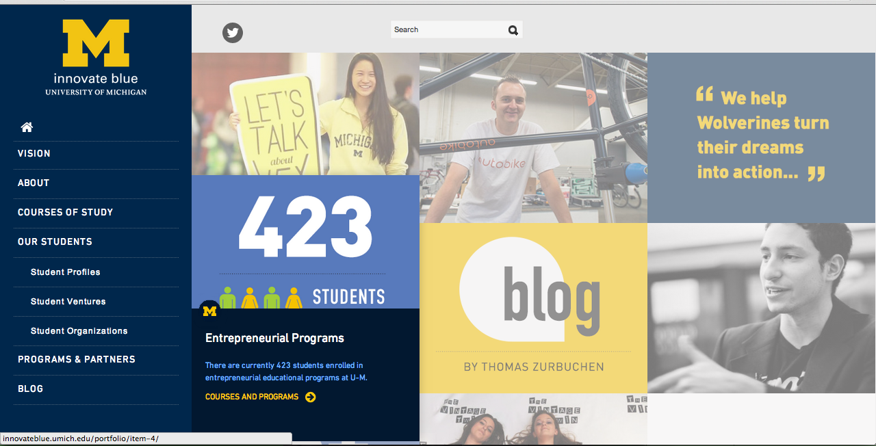
Entrepreneurship @ U of M
Notes:
Today at university of michigan – we have launched a campus wide initiative for undergraduate entrepreneurship that spreads across the 19 different schools and colleges that provides all students with entrepreneurial fundaments.
But how did we actually get here?

Slide 5
1999
Where we were
Notes:
In 1999 – we had just launched the first entrepreneurship institute on campus – the Zell Lurie Institute of Entrepreneurial Students
Outstanding program
Centered in the Ross School of Business
Launching innovative student run venture funds
But the reality – that was just a small subset of the University of Michigan Poputlation

Slide 6
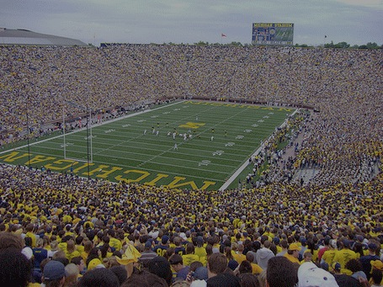
University of Michigan
19 Schools and Colleges
28,000 Undergraduates
44,000 Students
6,200 Faculty
Notes:
The reality is that access to entrepreneurship for students was limited and would only become widely available with growth

Slide 7





2008
Notes:
And so the College of Engineering created the Center for Entrepreneurship, The Dean was supportive and the growth was endorsed by the President, marysue coleman and students wanted it – from an organizational standpoint –we had the necessary managerial alignment to achieve some effective change – but as administrators, we know that in a large university, that isn’t enough to hit scale.
But how to do you hit scale? -- @ a University of Michigan – it is from students.
So when the Center for Entrepreneurship was created – so was a group call Mpowered. Totally student driven – lightly associated with the CFE – but passionate about inspiring and engaging all students with entrepreneurship

Slide 8


OUR MISSION
to expose students to entrepreneurship
So the goal of MPowered is two-fold: one, to bring out the few courageous self-starters among us to begin their entrepreneurial journey, and two, to spread their bold passion to the rest of the U-M community. In short, we’re starting the fire.

Slide 9

Notes:
They started with a simple objective – start with the front end of entrepreneurship – get people to share ideas -- get as many people as possible to realize that they can share ideas

Slide 10

“1000 Voices lobbies LSA for entrepreneurship classes”
Notes:
And as they saw the success of their awareness campaign – the lobbied the administration to expand their course offerings in entrepreneurship with the 1000 Voices campaign
Their aim was to get 1,000 signatures. And as of this morning, members of the 1000 Voices project surpassed their goal by five votes.
Launched by student group MPowered, the 1000 Voices project is a petition focusing on expanding student entrepreneurship beyond the walls of the Ross School of Business and College of Engineering. The campaign’s goal is to get LSA to offer entrepreneurial classes and other resources for students to implement their own innovative ideas.
Many LSA students have expressed a desire to have the option of taking such classes, said LSA junior Ankit Mehta, the president of MPowered, a group that focuses on entrepreneurship and student ventures. He added the purpose of 1000 Voices isn’t necessarily to incite students to start their own businesses, but to engender an entrepreneurial mindset into LSA classrooms.
“Entrepreneurship is not just a popular subject, it’s also a driving force of the world,” he said.
To spark this entrepreneurial energy in LSA, 1000 Voices is advocating for courses about entrepreneurship for students to gain credit toward their concentration through work outside class.
As of 1 a.m. this morning, the online petition, which was launched earlier this month, had recorded 1,005 “voices heard.” The organization will discuss the specifics of the integration of entrepreneurial-based classes into the college with the University administration after the petition gains 1,000 signatures.
“1000 Voices is more than just a petition, it’s a movement,” Mehta said. “This is a once in a lifetime opportunity. In the 194 years of our University’s history, no opportunity like this has ever come out.”
LSA junior Max Levenstein, who signed the petition, said having opportunities outside the classroom with hands-on entrepreneurial work would be beneficial to students.

Slide 11
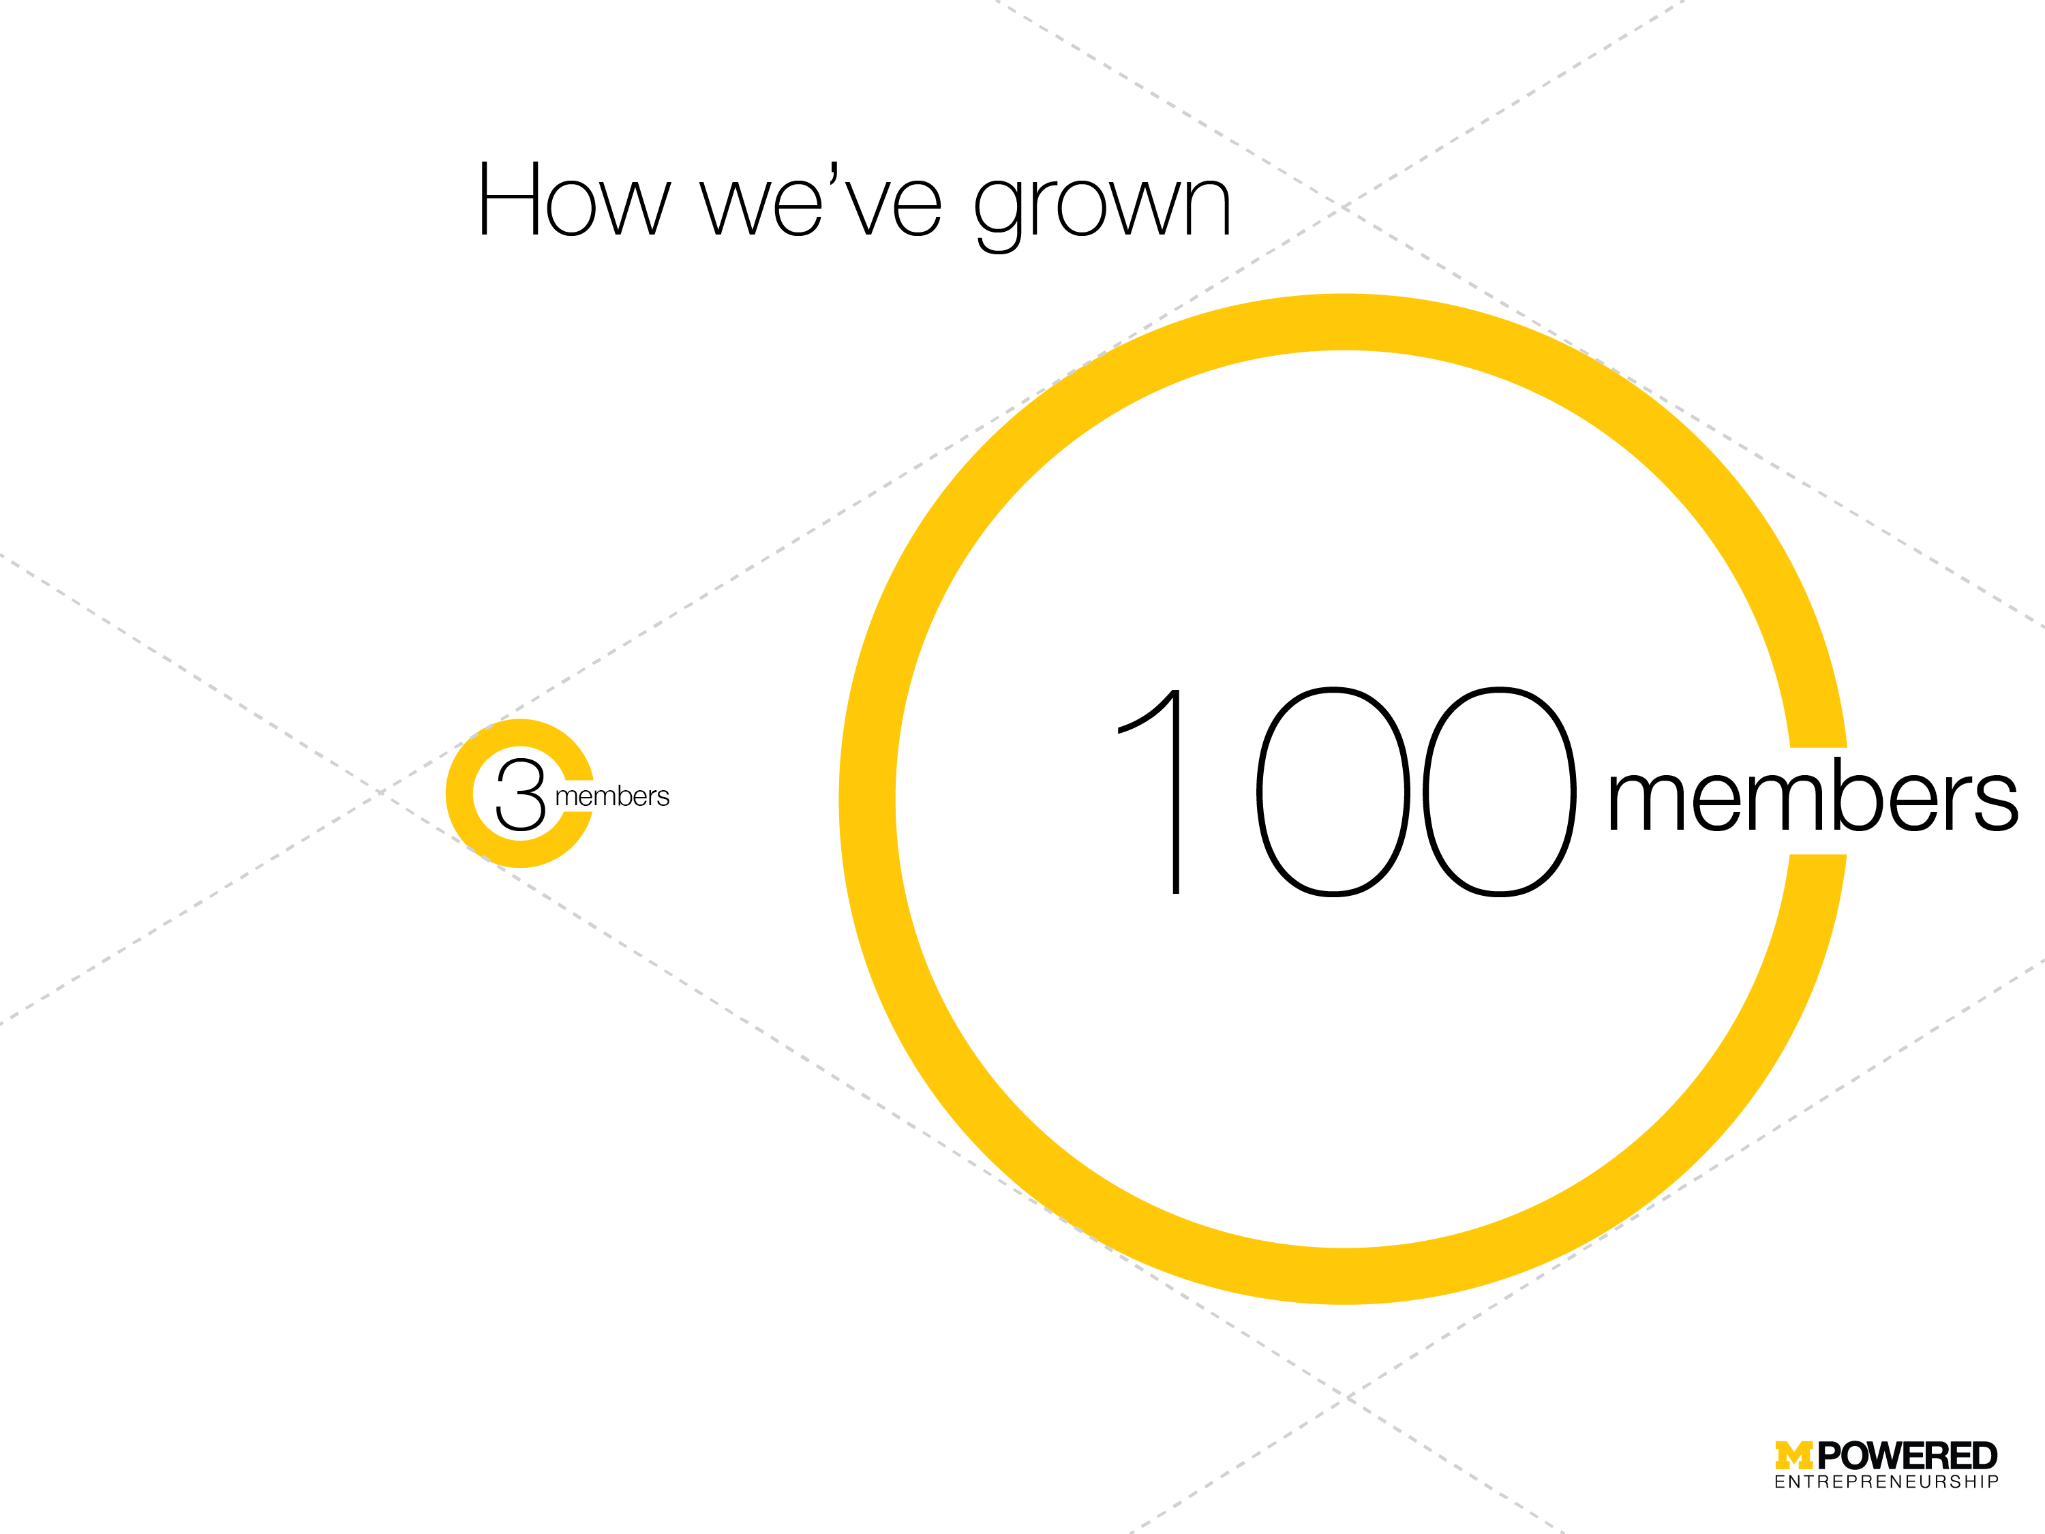

Slide 12




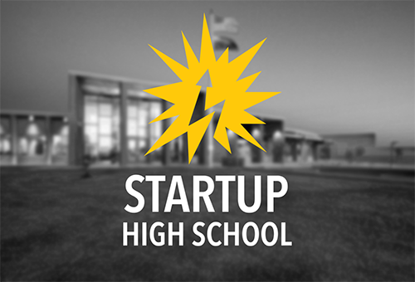

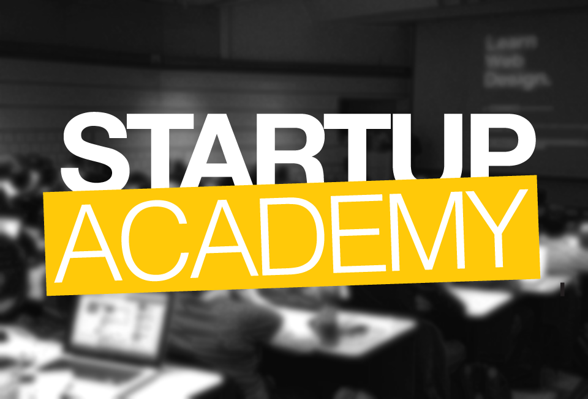

MPowered Today
Notes:
So how do we push them.
Our organization is split up into different projects, each one operating as a lean, autonomous group. Startup Career Fair brings over a hundred startups to Michigan each year, introducing them to a thousand students who most of which never considered working at a startup. MHacks is the largest student hackathon in the world, bringing in 1300 hackers from across the country to build in our turf. Makeathon was a hackathon for physical products, and we set them up with 3D printers, CAD mentors and all the power tools they could ask for. As of last year we’ve had over 6,000 students attend our events, and this year we hit 10,329.

Slide 13
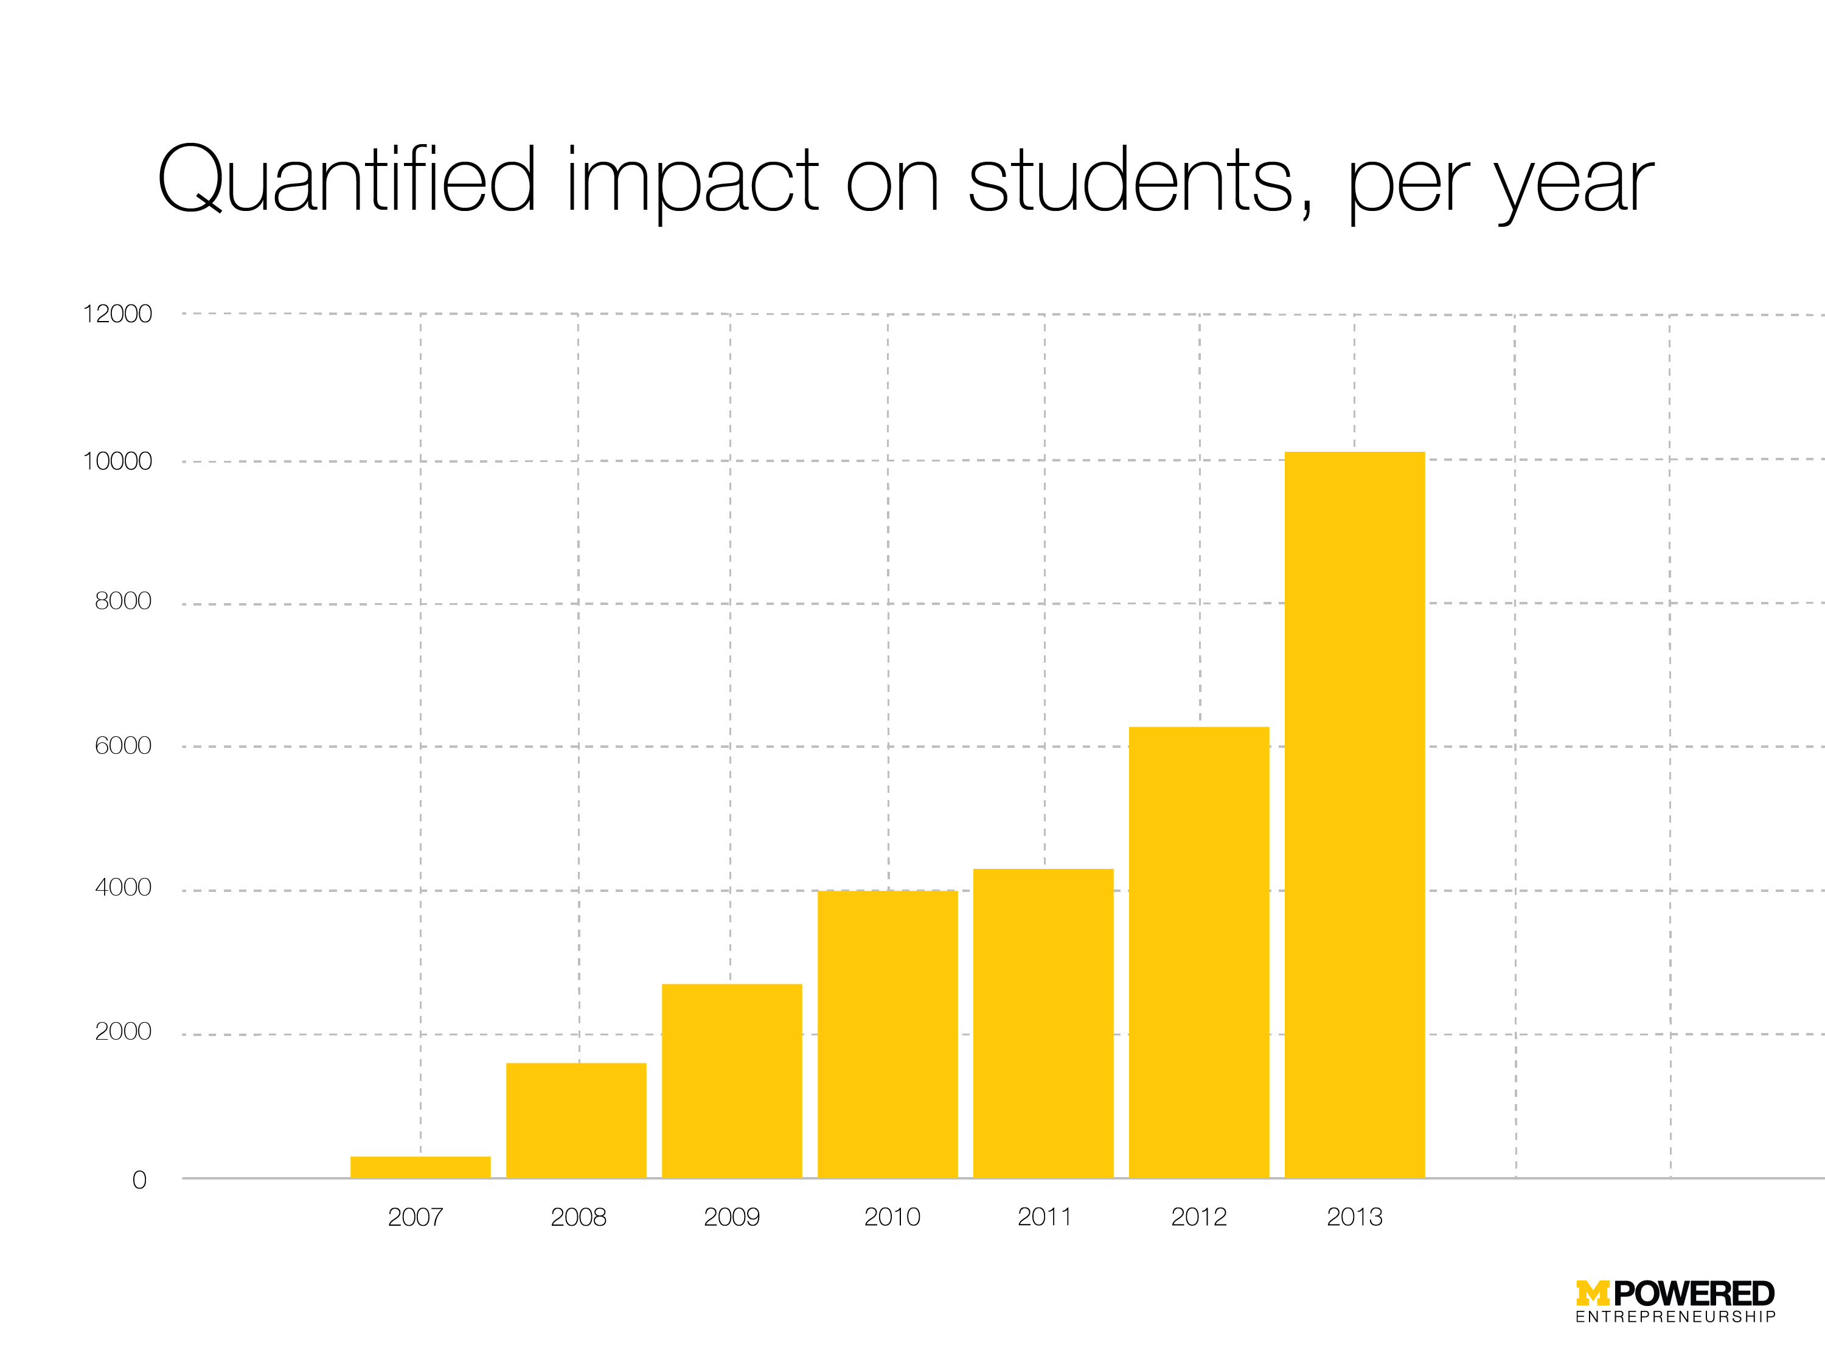
First 1000 Pitches
Notes:
What qualified as "impact" was that we got them to an MPowered event. The numbers that are in that bar graph DO contain overlaps (double-impacting people). the largest source of overlap between events was from MHacks II to MHacks III, but I was unable to filter down to unique impressions. 1000 Voices was not counted.
The first year of 1KP was 2008.

