Slide 2
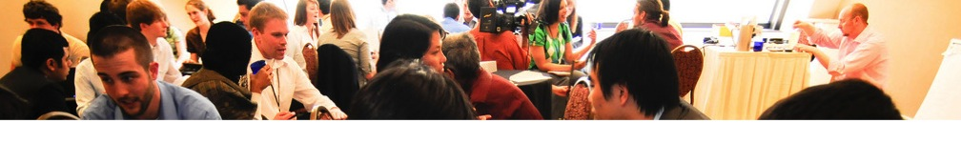
Global Connect 2015
Laura Sampath

Slide 3
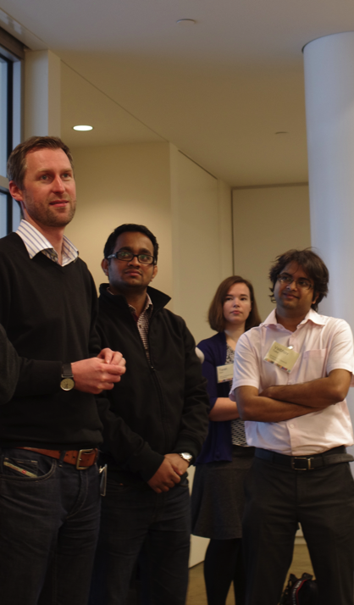
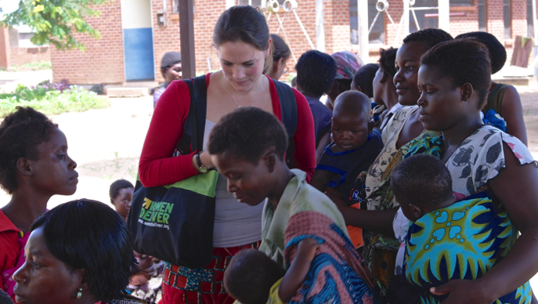
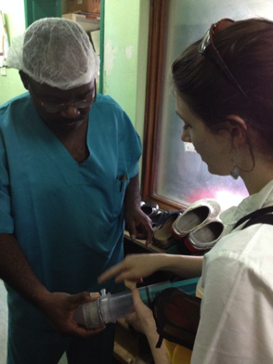
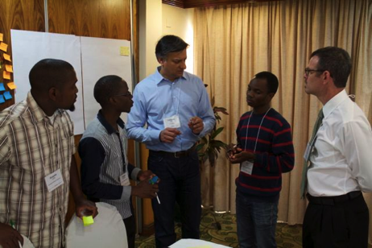
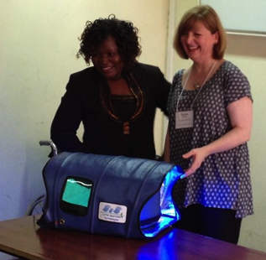
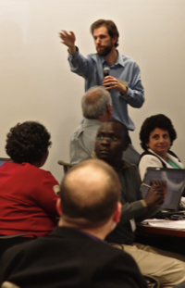
Community of Practice

Slide 4
About VentureWell
VentureWell is a higher education network that cultivates revolutionary ideas and promising inventions.
For nearly twenty years, we’ve been on a mission to launch new ventures from an emerging generation of young inventors driven to improve life for people and the planet.

Slide 5
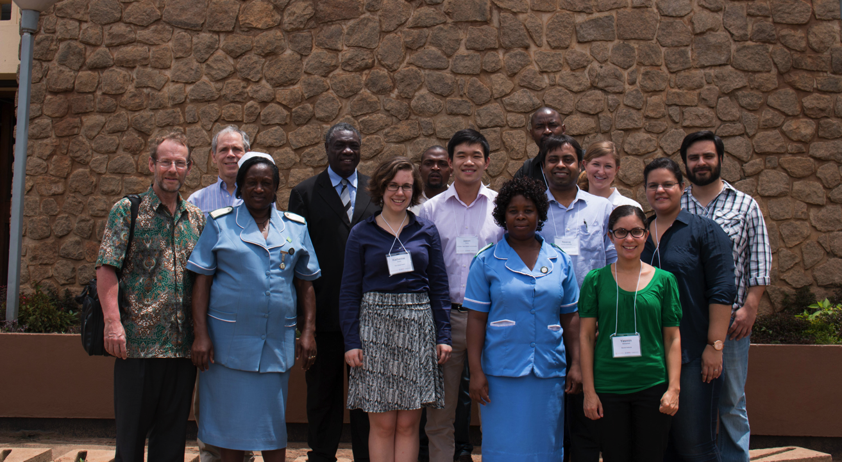
Xcelerator Training Program
Blantyre, Malawi
January 2015

Slide 6
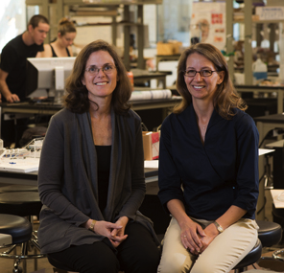
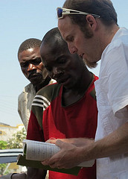
Global Presence

Slide 7
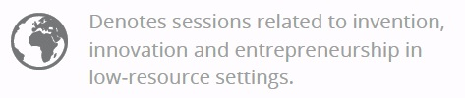
Global Sessions
FRIDAY
9 – 10.15: Papers
Pathways to Scale: The ten types of innovation
The East African Microcosm: How culture and context shape innovation in resource-constrained
environments
First-year Design Thinking for Extreme Affordability
11 – 12.15: Panel
Doing Something with Nothing and Nothing with Something
2.15 – 3.30: Workshop
Recognizing and Responding to Signs of Failure

Slide 8
Global Sessions
SATURDAY
11 – 12.15: Papers
From West Coast to Gold Coast: Teaching a capstone entrepreneurship course in Ghana based on Lean LaunchPad
Entrepreneurial Development Programs for Graduates: Case study of United States International University-Africa
Manufacturing Challenges and Strategies for Development Technologies
2.15 – 3.30: Panel
Global Innovation Hubs
3:45 pm - 5:00: Panel
Harder Than You Think: Surprises in starting a social venture abroad

Slide 9
Global Connect 2015
Ann Mei Chang
Director USAID Global Development Lab
Wendy Taylor,
Director, Center for Accelerating Innovation and Impact

Slide 10
Global Connect 2015

