Slide 1
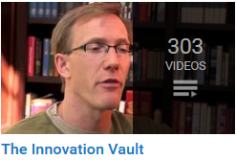
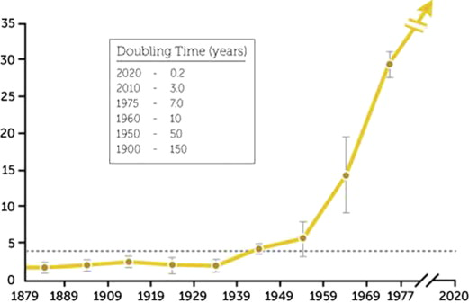
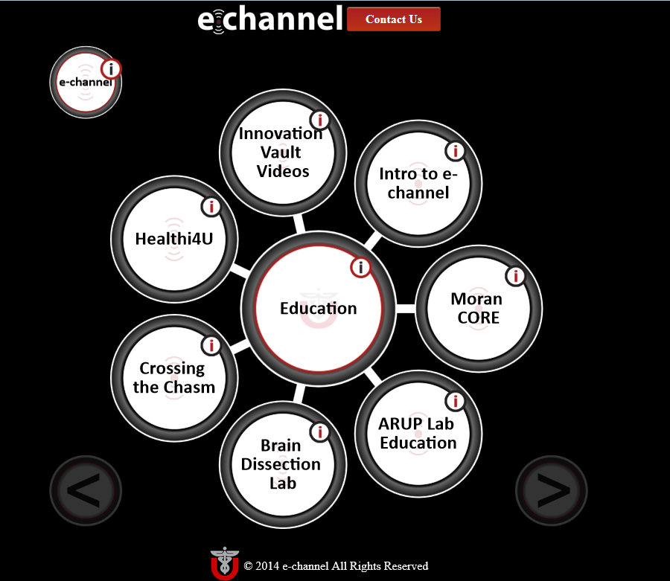
Innovation Vault: Advice at Your Fingertips
Barbara A. Ulmer¹, BA, Christy Jarvis¹, MLIS, Jean P. Shipman¹, MSLS, Andrew Maxwell^{2,} PhD; ¹University of Utah Spencer S. Eccles Health Sciences Library, Salt Lake City, Utah, U.S. and ²Canadian Innovation Centre (CIC), Waterloo, Ontario, Canada.
Conclusion
Objective
To meet the challenge of staying abreast of today’s swiftly evolving advancements in innovation and entrepreneurship and provide guidance for those seeking to grow an idea into a successfully marketed product or adopted process
Methods
CIC grant enabled production of recorded interviews/lectures by innovation and entrepreneurship luminaries & academics.
Canadian Innovation Centre (CIC) and Eccles Health Sciences Library (EHSL) partnered to create the Innovation Vault.
EHSL hired a content specialist to organize the videos into thematic collections, and describe their content to make them searchable and accessible to instructors, students, innovators and entrepreneurs.
Results
By Jan. 2016, collaboration resulted in creation of the Innovation Vault – a searchable video library.
The Innovation Vault contains hundreds of industry-based lessons and academic research that provide a comprehensive educational tool of prevalent knowledge in entrepreneurship and innovation.
The Innovation Vault is made available via e-channel: EHSL’s innovation-themed multimedia platform.
http://library.med.utah.edu/e-channel/
Conclusions
The Innovation Vault is a valuable education tool that provides expert insight and guidance at every stage of the innovation cycle.
Future efforts will focus on expanding the Innovation Vault to include additional content – contact us if interested in adding your content.
The Innovation Vault is one of many collections within e-channel of non-text based documents offering viable solutions for managing the nontraditional output accompanying the exponential growth of innovation knowledge.
The Innovation Vault Team:
Barb Ulmer
Chad Johnson
Bryan Hull
Christy Jarvis
Jean Shipman
Andrew Maxwell
See: http://library.med.utah.edu/echannel/

