Slide 1
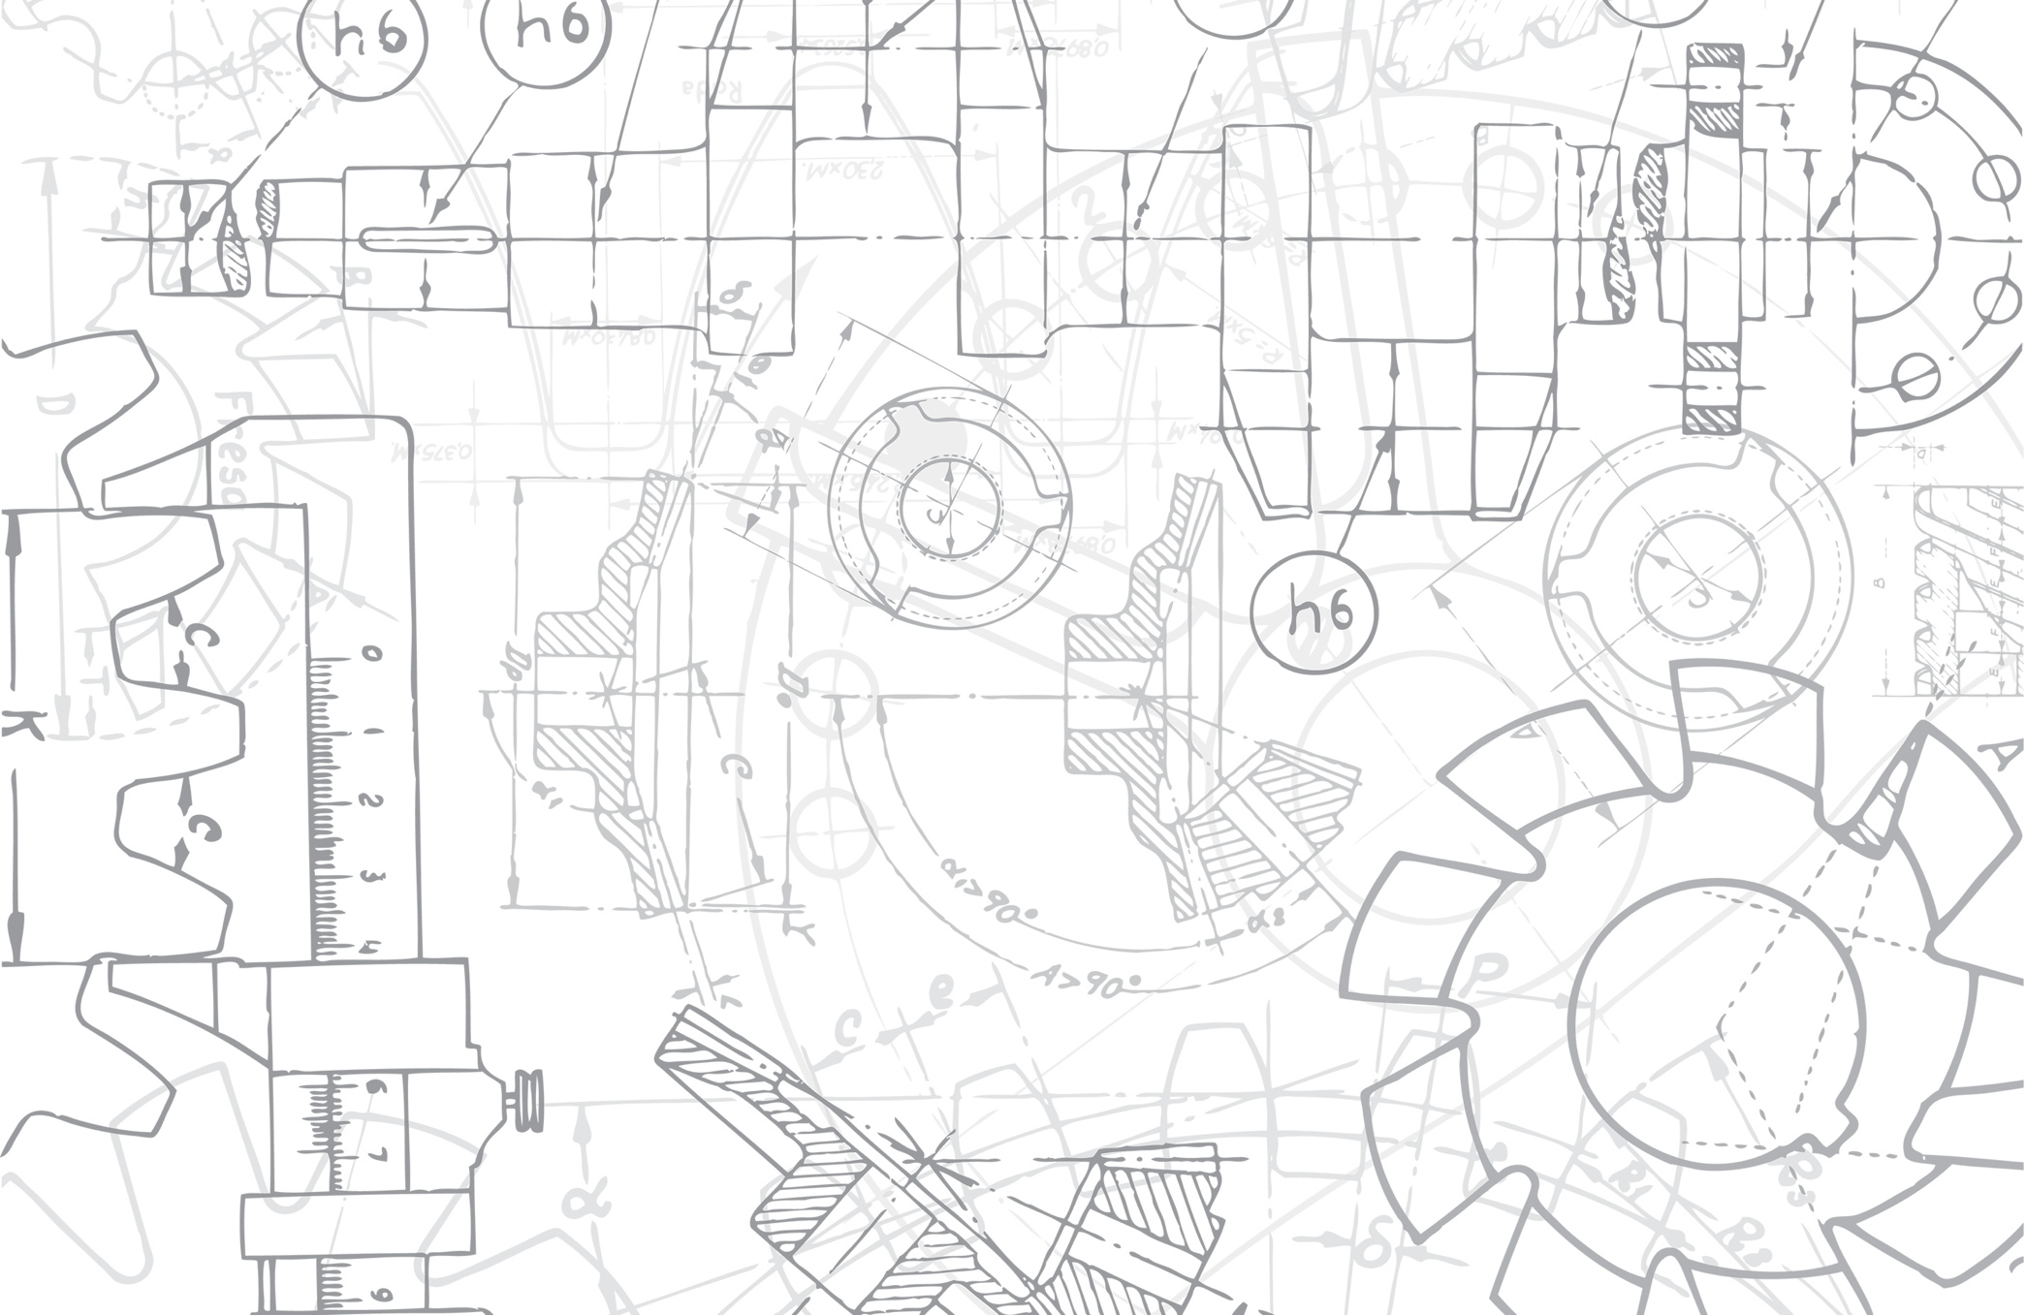

Emerging Insights from the Engineering Majors Survey
Helen L. Chen, Shannon Gilmartin, & Sheri Sheppard
Fostering Innovative Generations Studies
March 3, 2015
Creating Impact in Engineering Education Meetup

Slide 2
Fostering Innovative Generations Studies (FIGS) Research Questions
RESEARCH QUESTION 1 - PROGRAM MODELS
What are current models of educating engineers for entrepreneurship/entrepreneurial thinking?
RESEARCH QUESTION 2 - STUDENTS' INTERESTS AND GOALS
What are undergraduate engineering students’ innovation and entrepreneurial interests, abilities, and achievements? How do these interests, abilities, and achievements change over time? Which educational and workplace environments/experiences influence the development of their innovation and entrepreneurial interests, abilities, and achievements?
RESEARCH QUESTION 3 - CURRICULUM DEVELOPMENT
How can fundamental engineering curricula be reframed to stimulate integrative thinking, especially entrepreneurial thinking?
RESEARCH QUESTION 4 - RESEARCH COMMUNITY
What are the most effective strategies for fostering connections and community in the engineering entrepreneurship space?

Slide 3
What is the Engineering Majors Survey?
10 minute, online survey with 35 questions
Targeted at juniors and seniors across a nationally representative sample of 27 U.S. engineering schools in early 2015
~7,200 responses; ~6,200 were juniors and seniors; overall response rate: 20%
$25 Amazon gift card awarded to 154 students
In 2016, a follow-up survey will be administered providing longitudinal perspective
The EMS is among the largest and most extensive studies to date of engineering students' innovation pathways.

Slide 4
FIGS RQ2 Engineering Majors Survey: Participating Institutions
Arizona State University
Baylor University
Boise State University
Bucknell University
California State University-Fresno
Embry Riddle Aeronautical University-Daytona Beach
Franklin W. Olin College of Engineering
Indiana University-Purdue University-Indianapolis
Messiah College
Michigan Technological University
North Carolina State University at Raleigh
Rochester Institute of Technology
Seattle Pacific University
Smith College
Stanford University
Temple University
Tennessee Technological University
The University of Texas at San Antonio
Tufts University
University of Illinois at Urbana-Champaign
University of the District of Columbia
University of Utah
University of Wisconsin-Madison
University of Wisconsin-Platteville
Washington University in St Louis
Wayne State University
Western Michigan University

Slide 5
What is the Engineering Majors Survey?
Designed around Social Cognitive Career Theory (SCCT)
  This theoretical framework helps to explain the development of individuals’ academic and career choices and goals, and subsequent outcomes and achievements in their pathways
Key domains include
    Interests
    Self-efficacy
    Outcome expectations
    Learning experiences
    Background characteristics
    Contextual supports and barriers

Slide 6
Social Cognitive Career Theory (SCCT) and “The Engineering Majors Survey”: Predicting “Career goals: Innovative work” – Time-point 1
--Which survey sections/questions correspond with which SCCT domain(s) are in parentheses in each box
Background
characteristics/ influences (e.g., gender, race/ethnicity, family background) (select qs in Sections 1+5)
Current contextual influences (e.g., major, institutional/peer characteristics) (select qs in Sec. 1,2,5, + institutional dataset)
Engineering task self-efficacy (Sec.3, Q15)
Professional/interpersonal self-efficacy (Sec.3, Q15)
Learning experiences (e.g, involvement in HS and college eship and design activities, select peer and faculty interactions)
(Sec. 2, Qs 9-14)
Innovation self-efficacy (Sec.3, Q15)
Innovation interests (Sec. 3, Q17)
Career goals: Innovative work (Sec. 4, Q18)
Innovation outcome expectations (Sec.3, Q16)
Job targets (e.g., engineering vs non-engineering; start a company vs work within a start-up vs work within established company) (Sec. 4, Qs 19-22)
Solid black lines indicate hypothesized directional relationships based on SCCT; dashed blue lines indicate exploratory relationships
Adapted from Lent, Brown, & Hackett (1994) and Brunhaver (forthcoming)

Slide 7
Social Cognitive Career Theory (SCCT) and “The Engineering Majors Survey”: Predicting “Career goals: Innovative work” – Time-point 1
--Which survey sections/questions correspond with which SCCT domain(s) are in parentheses in each box
Background
characteristics/ influences (e.g., gender, race/ethnicity, family background) (select qs in Sections 1+5)
Current contextual influences (e.g., major, institutional/peer characteristics) (select qs in Sec. 1,2,5, + institutional dataset)
Engineering task self-efficacy (Sec.3, Q15)
Professional/interpersonal self-efficacy (Sec.3, Q15)
Learning experiences (e.g, involvement in HS and college eship and design activities, select peer and faculty interactions)
(Sec. 2, Qs 9-14)
Innovation self-efficacy (Sec.3, Q15)
Innovation interests (Sec. 3, Q17)
Career goals: Innovative work (Sec. 4, Q18)
Innovation outcome expectations (Sec.3, Q16)
Job targets (e.g., engineering vs non-engineering; start a company vs work within a start-up vs work within established company) (Sec. 4, Qs 19-22)
Solid black lines indicate hypothesized directional relationships based on SCCT; dashed blue lines indicate exploratory relationships
Adapted from Lent, Brown, & Hackett (1994) and Brunhaver (forthcoming)

Slide 8
Data Weighting
Women are over-represented in our sample
  ~30% women in sample
  ~20% women among engineering undergraduate students in the US
The purpose of weighting is to make our sample representative of the population by gender
Two-step weighting: first by school and then by strata for both genders

Slide 9
Selected EMS Respondent Characteristics
Majority are full-time students (94.9%)
One-third (30.6%) are transfer students
Primary major: Engineering (100%); 8.8% of respondents reported having a second major, half of which were in engineering fields
One quarter of the respondents are mechanical engineering majors
43% indicated they would likely enter graduate school in the first 5 years after graduation; over half (59%) of this group said they would likely pursue an MA/MS
Weighted data are used in summarizing the percentages

Slide 10
Selected Findings for Exploration
Undergraduate Experiences: What kinds of curricular and co-/extra-curricular learning experiences may be related to student innovation and entrepreneurship interests?
Postgraduate Plans: What do students’ anticipate doing in the first 5 years after graduation?
Career Motivations: What drives students to choose a particular career path?

Slide 11
A. Undergraduate Experiences - Overall
What kinds of curricular and co-/extra-curricular learning experiences may be related to students’ innovation and entrepreneurship interests?
EMS FINDING A
Have taken courses that included following topics: | % Yes
Designing and/or prototyping things or ideas | 72.6%
Theory of design | 56.5%
Leadership topics | 46.6%
Business or enterprise topics (including entrepreneurship or venture creation) | 35.4%
Weighted sample of all juniors & seniors
11

Slide 12
A. Undergraduate Experiences - Overall
EMS FINDING A
Have had the following experiences while an undergraduate: | % Yes
Worked in a professional engineering environment as an intern/co-op | 53.1%
Participated in other student clubs or groups in engineering | 43.6%
Participated in other student clubs or groups outside of engineering | 40.6%
Led a student organization | 25.6%
Participated in a community service-based club | 22.1%
Made use of a maker space/design or inventors studio/prototyping lab | 20.0%
Entered a business plan, business model, or elevator pitch competition | 5.2%
Weighted sample of all juniors & seniors
12

Slide 13
A. Undergraduate Experiences by Gender
EMS FINDING A
Chi-square tests, p <= 0.001; Effect sizes are small.
13

Slide 14
A. Undergraduate Experiences
Discussion Questions
EMS FINDING A
What kinds of learning experiences will students with an interest in entrepreneurship and innovation seek out?
Correspondingly, what kinds of experiences might encourage or foster students’ interests in I&E?
Women appear to be more engaged than men in several co-curricular experiences. What are the possible opportunities and implications for course, program, or activity design?
14

Slide 15
B. Postgraduate Plans - Overall
What do students anticipate doing in the first 5 years after graduation?
EMS FINDING A
EMS FINDING B
How likely is it that you will do each of the following in the first five years after graduation? | Probably/Definitely
Work as an employee for a medium- or large-size business | 66.6%
Work as an employee for a small business or start-up company | 26.3%
Work as an employee for the government, military, or public agency | 21.7%
Found or start your own for-profit organization | 14.0%
Work as an employee for a non-profit organization | 10.3%
Work as a faculty member or educational professional in a college or university | 6.6%
Found or start your own non-profit organization | 5.8%
Work as a teacher or educational professional in a K-12 school | 3.5%
Weighted sample of all juniors & seniors

Slide 16
B. Postgraduate Plans by URM Status
EMS FINDING A
EMS FINDING B
* Chi-square tests, p <= 0.001; Effect sizes are small. Found/start for- and non-profits approaching small effect sizes.

Slide 17
B. Postgraduate Plans
Discussion Questions
EMS FINDING A
EMS FINDING B
What programs, resources, courses, and experiences support and encourage multiple postgraduate pathways?
Where do these diverse pathways overlap with respect to preparation – are there fundamental skills and experiences that would benefit all students?
How can we acknowledge and support the growth and development of career pathways for URM and non-URM students?

Slide 18
C. Motivations
What motivations drive students to choose a particular career path?
(Grau et al., 2016)
EMS FINDING A
EMS FINDING B
EMS FINDING C
Career Motivations (N=256) | %
Giving back/helping people: I plan to use my engineering knowledge to better aid humanity. I would like to go into the field of international service work, providing infrastructure in developing nations | 34%
End goal for their life: My dream is to develop defense software. My plan is to work in some way that will have a positive impact on our environment | 25%
Secure future: This degree is a means to achieve financial stability. I am working on my degree to get the appropriate pay for the job I do. | 13%

Slide 19
C. Motivations
EMS FINDING A
EMS FINDING B
EMS FINDING C
Career Motivations (N=256) | %
Inherent love of engineering work: I feel that choosing my major was more about loving what I was going to be doing rather than making a bunch of money doing it. I plan on finding a job that is relevant to what I have learned in school that will allow for me to do what I love and keep me happy. | 10%
Desire to combine engineering with another field: I'm hoping to combine engineering and Chinese. I hope to be able to facilitate dialogue and innovation among the different countries in the Americas. | 7%
Men were more likely to write about having an inherent love of engineering work and about engineering as a means to a secure future
Men were more likely to write about having an inherent love of engineering work and about engineering as a means to a secure future.

Slide 20
C. Motivations
Discussion Questions
EMS FINDING A
EMS FINDING B
EMS FINDING C
What are the developmental considerations in how students’ career motivations evolve during their undergraduate careers?
What kinds of resources and advising services can be designed to address students’ career motivations?
What are the implications of gender differences in career motivations with respect to how engineering programs support and advise students?

Slide 21
EMS Next Steps
EMS 2.0 - Planned for Spring 2016 to all students who indicated they would be willing to receive an invitation (~60% of total respondents)
Master’s theses, abstracts, papers and presentations in progress in IJEE, JEE, and ASEE
Continuing to explore interest from the wider universe of schools in participating in future deployments of EMS1.0
What questions would you want to ask the EMS respondents after one year’s time? What changes might have occurred?

Slide 22
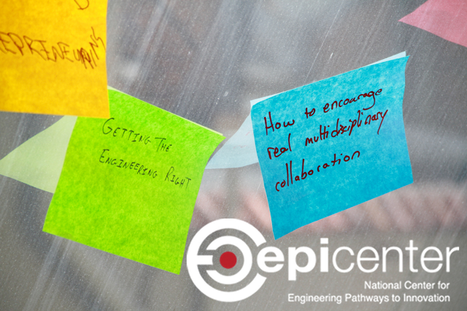


Thank you!
@EpicenterUSA
facebook.com/EpicenterUSA
bit.ly/epi-email

