Slide 1
East Coast vs. West Coast: Comparing Lean Launchpad and Disciplined Entrepreneurship
March 4, 2016
Mike Panesis Renee Rock

Slide 2
Agenda
Historical Perspective
Using DE in the Liberal Arts Classroom
Comparing DE and LLP
Reflections on teaching entrepreneurship– and what’s next
Discussion

Slide 3
Historical Perspective

Slide 4
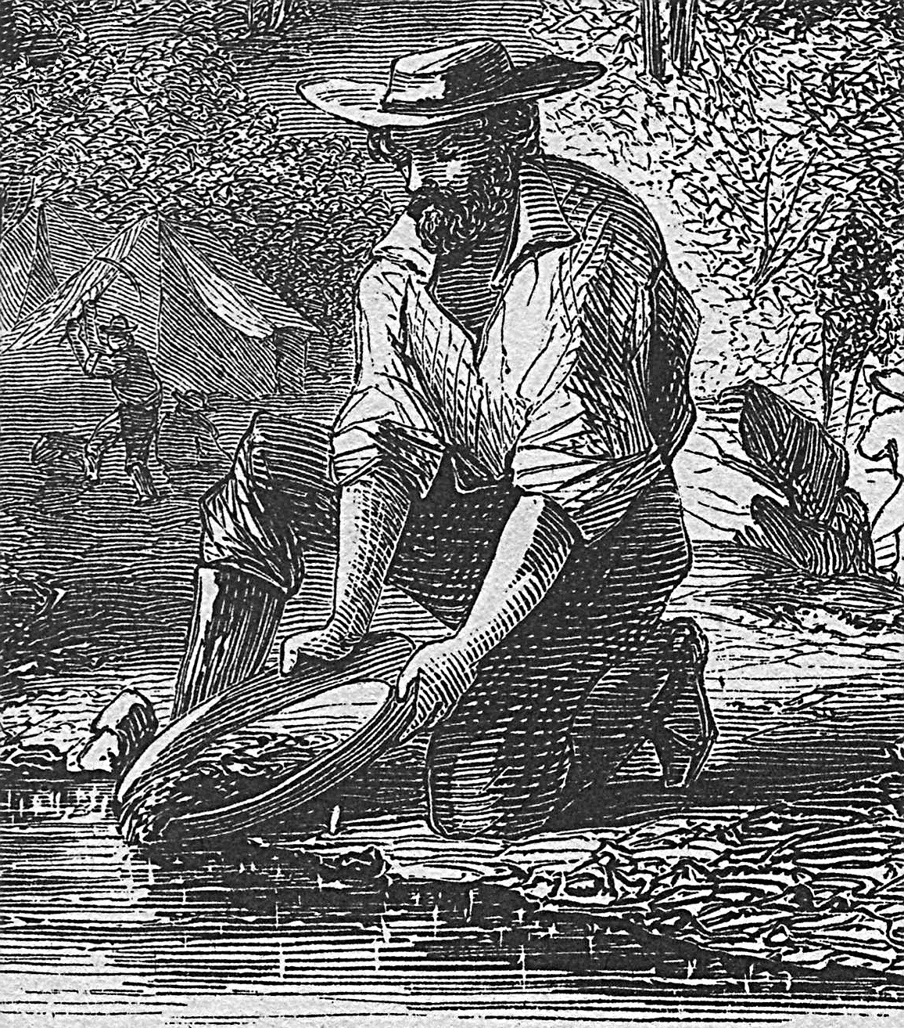
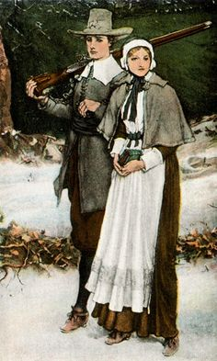
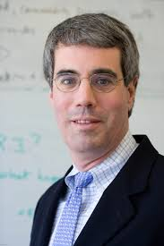
A long tradition…
West Coast
East Coast

Slide 5
This isn’t really new
Frank Robinson
Market Validation
1984

Slide 6
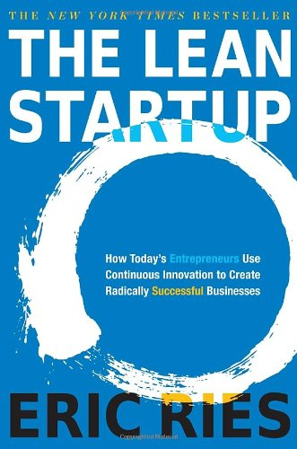
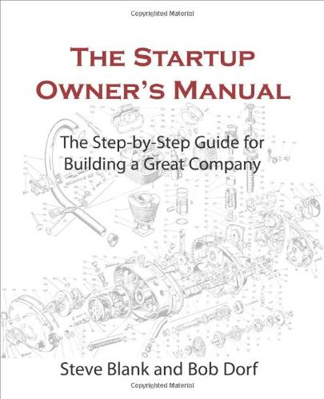
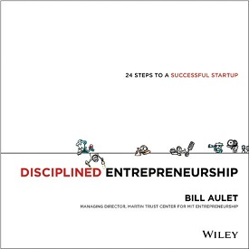
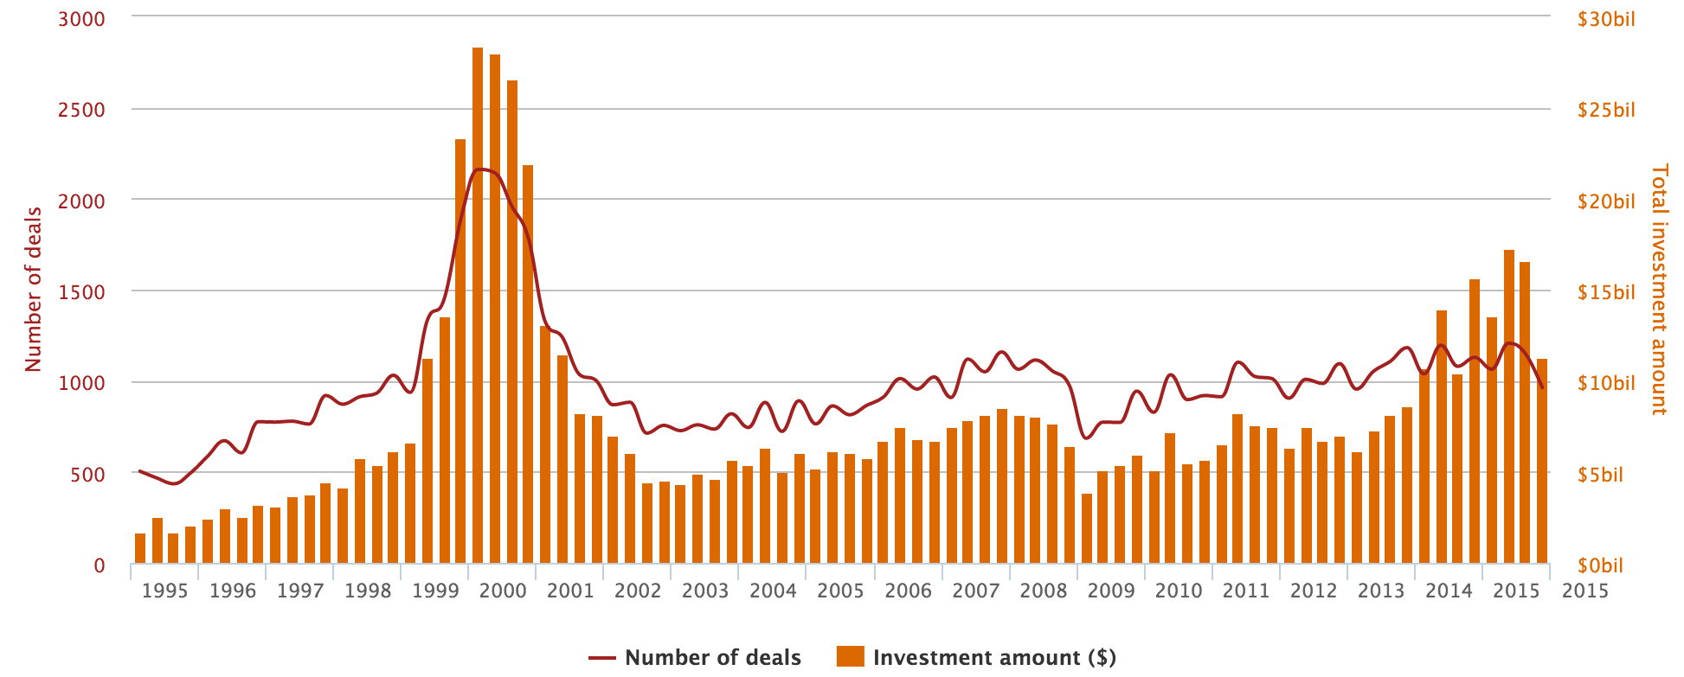
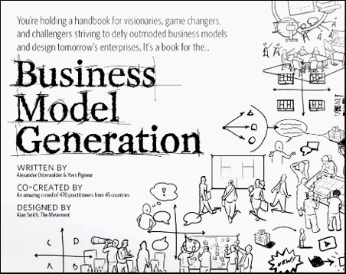
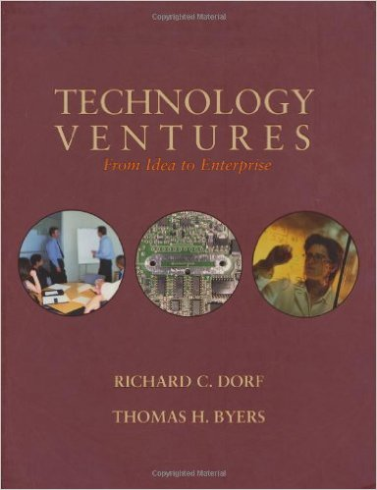
Evolution of Entrepreneurship Education
Total VC Investment
Source: PWC MoneyTree

Slide 7
Reality Check
Most student startup ideas– esp undergrad– have significant flaws
Most students won’t become entrepreneurs
How do we serve the entire student body, not just those who want to be the next Gates/Jobs/Thiel/Musk/Zuckerberg?
How keep the most enthusiastic entrepreneurs in school?
How big a difference is there between being and living like an entrepreneur?
Given the expansion of what we know about entrepreneurship, how do we expand the curriculum to fully prepare students for the real world?

Slide 8
Using DE in the Liberal Arts Classroom
Lessons Learned

Slide 9
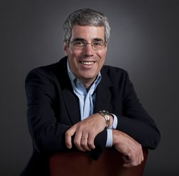
Teaching Entrepreneurship as a Process
(Bill Aulet, MIT)

Slide 10
Process
24 Step process
Come in with an idea
Identify sooner rather than later that your idea is not a good one.
Build a team
Execution considerations
Fund raising
Scaling

Slide 11
Logical Flow of Course
- Business Plan
Scaling
Presentation
Finance
Execution
Biz Model
Product
Market
Team
BP+
Idea
- Financial Statements
- Investor Strategy & Pitch
Go to Market
Sales
Marketing
Where to Extract Rent
Pricing
- Value Proposition
- Competitive Advantage
- Development Plans
- Segmentation
- Direct Validation
- Competition
Team Composition
Values
- Setting Expectations
Generation
Analysis
- Testing on Key Stakeholders

Slide 12
Assessing the Idea: Howard Anderson’s 27 Rules for Viability
Avoid dependence on OEM
Avoid dependence on Gov policy
Avoid simple extension of competitor
Avoid long lead time to succeed
Avoid soft dollar justification
Avoid complex DMP
Avoid markets where customer is not well funded
Avoid cross departmental sales
Select products with 4X+ benefit
Avoid Swiss Army Knives
Select doable sales metrics
Select where min process change
Select where can develop product family
Don’t worry; focus on process
Right can come from Wrong
Little Capital
Quick to generate Sales
Low break even
Does not require perfect execution
High Gross Margin products
Not require excellent management team
Identifiable customers
Reason marketing & sales costs
Avoid dominant buyer power
Intelligent customers
Avoid fads
Avoid requirement for global markets

Slide 13
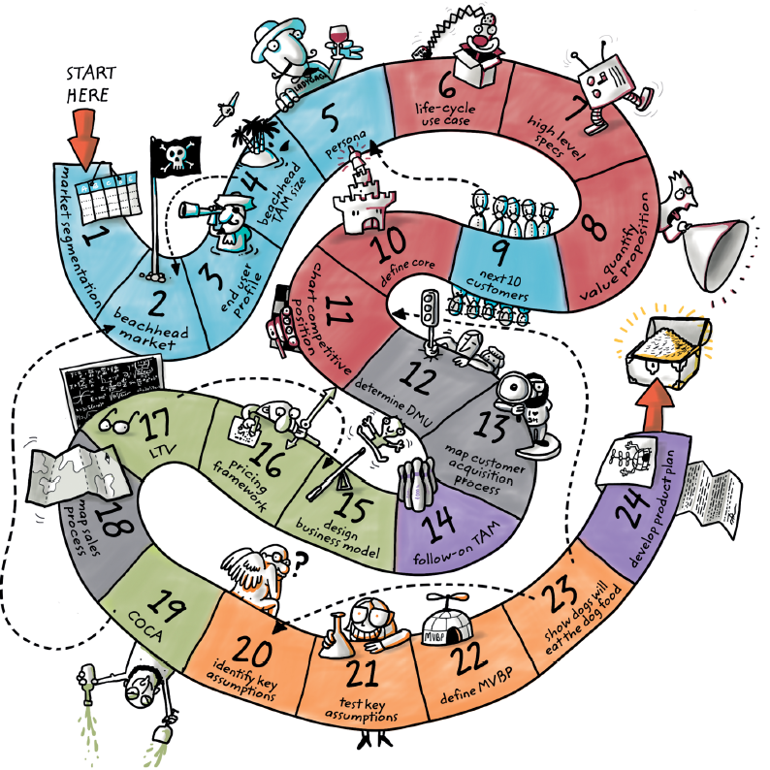
6 Themes of 24 Steps

Slide 19
Teaching the Teachers: The MIT Global Entrepreneurship Bootcamp Experience
“We don’t study entrepreneurs, we become entrepreneurs.”
Learn by doing: Identify, organize and build a new enterprise in 5 days
Demands hard work, long hours, little sleep, solid collaboration skills, discipline and creativity (rapid onboarding of entrepreneurial traits)
Focus on diversity (50 entrepreneurs from 27 different countries, but mostly men)
Lectures from MIT faculty, entrepreneurs, VCs from Martin Trust Center for Entrepreneurship
High tolerance for failure
High tolerance for alcohol consumption

Slide 20
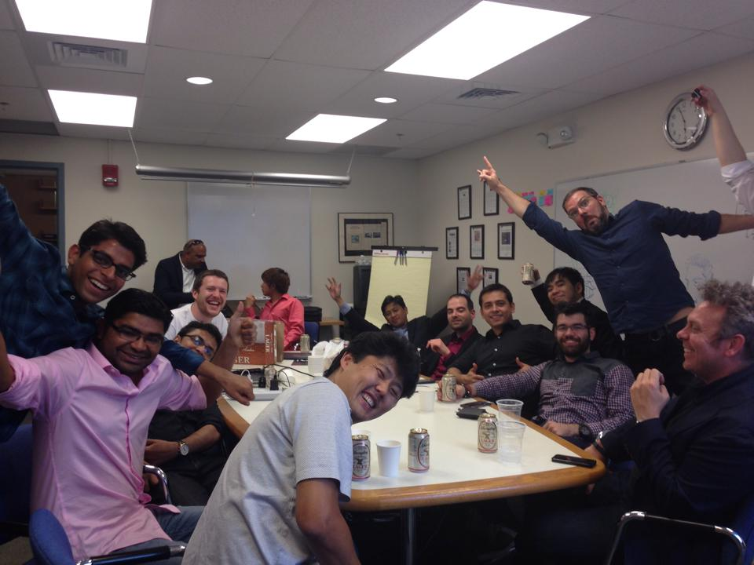

Slide 21
Comparing DE and LLP

Slide 22
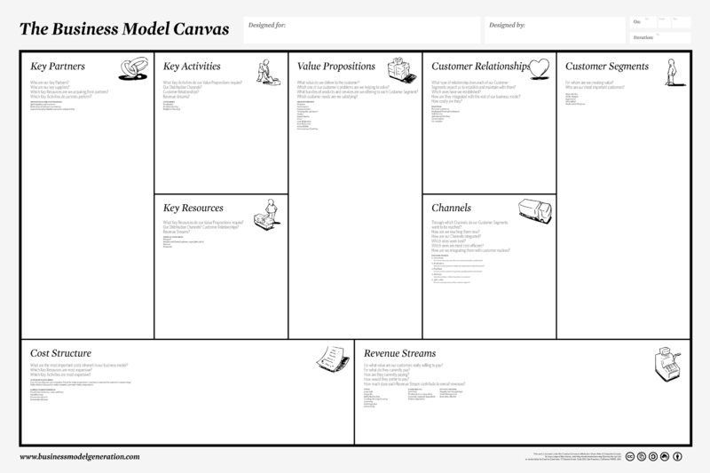
Map DE Steps to Business Model Canvas
Market Size
Competition
Metrics That Matter
Scientific Method

Slide 23
Comparing LLP and DE
Category | Lean Launchpad | Disciplined Entrepreneurship
Founder | Steve Blank | Bill Aulet
Founding Locations | Stanford & UC Berkeley | MIT
Textbooks/Papers | “The Startup Owner’s Manual”, Blank & Dorf “Business Model Generation”, Osterwalder & Pigneur “Four Steps to the Epiphany”, Blank “Why the Lean Startup Changes Everything”, Blank, HBR | “Disciplined Entrepreneurship”, Aulet
Affiliated Programs | Innovation Corps – NSF Startup Next (originally) | MITx Bootcamp
Educator Seminar | LLP Educators Seminar | Entrepreneurship Educators Forum MITx Entrepreneurship Educators Seminar w/ Certification
Web Sites | http://www.steveblank.com | http://disciplinedentrepreneurship.com
MOOC Affiliation | Udacity | EdX
Support Apps | Launchpad Central | Disciplined Entrepreneurship Toolbox

Slide 24
Comparing LLP and DE
Category | Lean Launchpad | Disciplined Entrepreneurship
Assertions | No business plan survived first contact with the customer A startup is not a smaller version of a large company. A startup is a search for a repeatable, sustainable business model | More founders = better odds of success Entrepreneurs need to be effective communicators, recruiters, and salespeople. Entrepreneurship can be taught

Slide 25
Comparing LLP and DE
Category | Lean Launchpad | Disciplined Entrepreneurship
Innovation Catalyst | Market Pull | Technology Push
Engine | Scientific Method | 24 Steps
Approach to Iteration | Fixed | Variable – repeat steps as needed
Central Framework | Business Model Canvas | 6 Themes
Approach to Customer Engagement | Get out of the classroom/lab/office | Get out of the classroom/lab/office
First Step | Value proposition hypothesis | Market segmentation
Role of mentors | Critical, co-teach in classroom | Critical, co-teach in classroom MIT Mentor Network
Formation of student teams | Mixers & info sessions six weeks prior | Entrepreneur type categorization

Slide 26
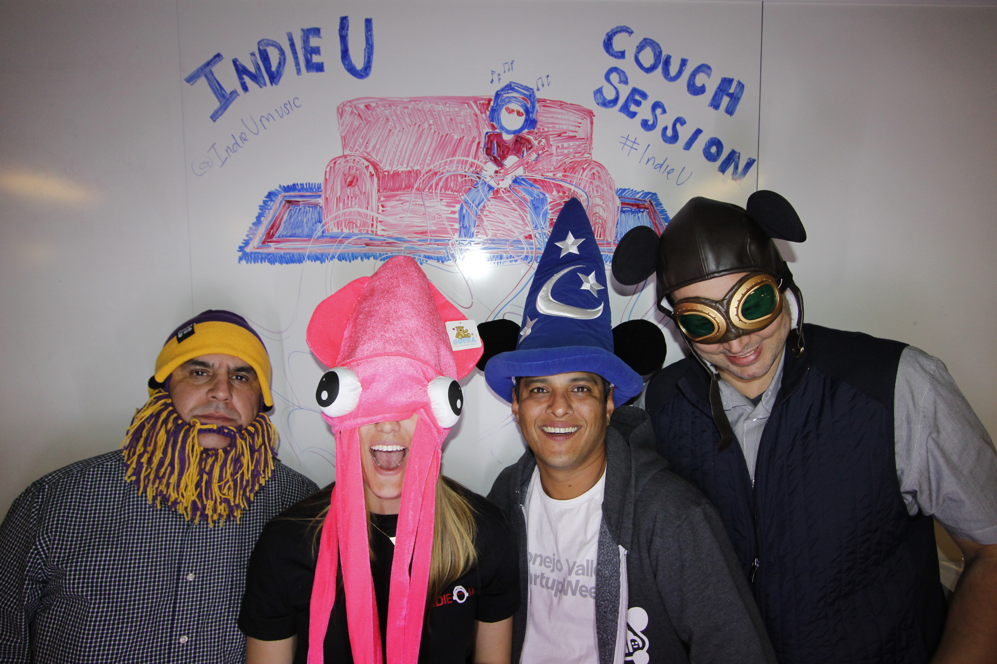
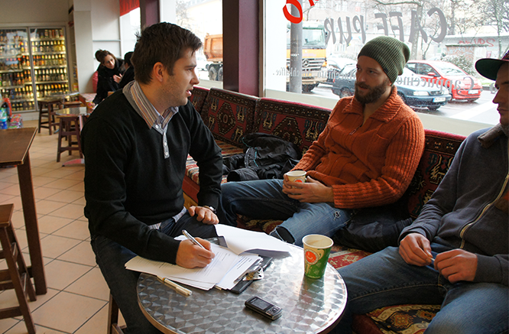
Conclusion: Both Work, because…
Early Customer Interaction
Mentor Engagement

Slide 27
Room for both in Entrepreneurship Minor
1. Discovery
4. Realization
3. Feasibility
Entrepreneurship Core
2. Modeling
3 courses in sequence
Each covers similar subjects
Entrepreneurial thinking
Customer discovery
Business model generation
Hypothesis testing
Emphasis shifts
Discovery
Modeling
Feasibility
Realization
Specialization (Electives)
Agile Product Development
Entrepreneurial Marketing & Selling
Entrepreneurial Finance
Legal Aspects of Entrepreneurship
Growth-Stage Venture Management
Order of Use
Aulet
Blank
Others

Slide 28
Reflections on teaching entrepreneurship – and what’s next

Slide 29
Going Forward: Finding the Right Fit
Segmentation
Research all types of students enrolling entrepreneurship classes today
Personas
Describe real representative samples from similar institutions (e.g. liberal arts colleges)
Needs
Identify needs by persona
Design
Delivery
Action
Flexibility, customization, rigor and quality
Multiple mechanisms for delivery (traditional, blended, online, consortium, partner institutions, competitions, co-curricular activities, advisory network/mentors)
Identify gaps (technical, engineering, business, arts etc.) collaboration, experimentation, open source teaching leading to best practices

Slide 30
Mapping to Needs

Slide 31
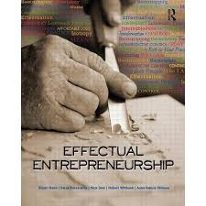
Teaching Entrepreneurship as a Mindset
Effectual Entrepreneurship
Principles of Effectual Entrepreneurship
How do entrepreneurs think?
What makes entrepreneurs entrepreneurial?
Causal (managerial) vs. effectual (entrepreneurial) thinking
Optimizing available resources: and committing the fewest resources to a new idea
Who I am
What I know
Who I know
Saras Sarasvathy, University of Virginia

Slide 32
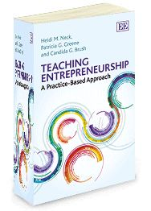
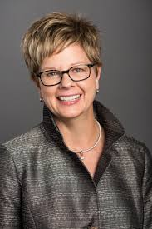
Teaching Entrepreneurship as a Method that Requires Practice (Heidi Neck, Babson)
Teaching entrepreneurship as a method
A set of practices (play, empathy, creation, experimentation, and reflection
Phases of learning
Iterative
Creative
Action focus
Investment for learning
Collaborative

Slide 33
Discussion

